Slide 1
Update on STAR Status
AGS/RHIC Time Mtg
March 5, 2013
Bill Christie
Outline/Summary:
Work on STAR Trigger and Sub system timing has been extensive
At this point we believe we’re set for Run 13.
Extensive effort to get local ZDC based Polarimetry “vetted” into two scalar systems (24 and 48 bit) and through raw data analysis.
Some minor tweaking will continue, but we’re ready to switch to longitudinal polarization, and provide Real-time feedback for rotator current tuning.
Still working on tuning/commissioning of FGT and FMS
Full Shift crews starting today. We’re working to get entire STAR system up and running physics triggers configuration. Few days of tuning to go.

Slide 2
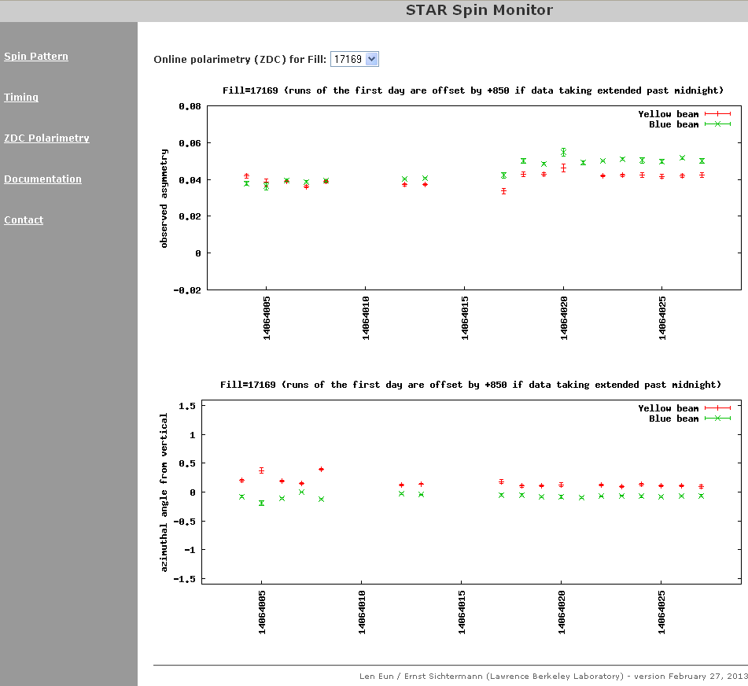
Preliminary STAR Scalar based ZDC Polarimetry data from this morning’s Store
Work on timing in bits
Message is that we’re ready to switch to Longitudinal, not that we have absolute Polarization values.

Slide 3
“Raw” data
Y εphys = 3.87 ± 0.25%
B εphys = 4.69 ± 0.24%
Fill 17169. Today ~ 9 am.
Scalar data
Y εphys = 4.20 ± 0.07%
B εphys = 5.16 ± 0.07%

