Slide 1
PHENIX Run-13 status
Hubert van Hecke
for the PHENIX collaboration

Slide 2
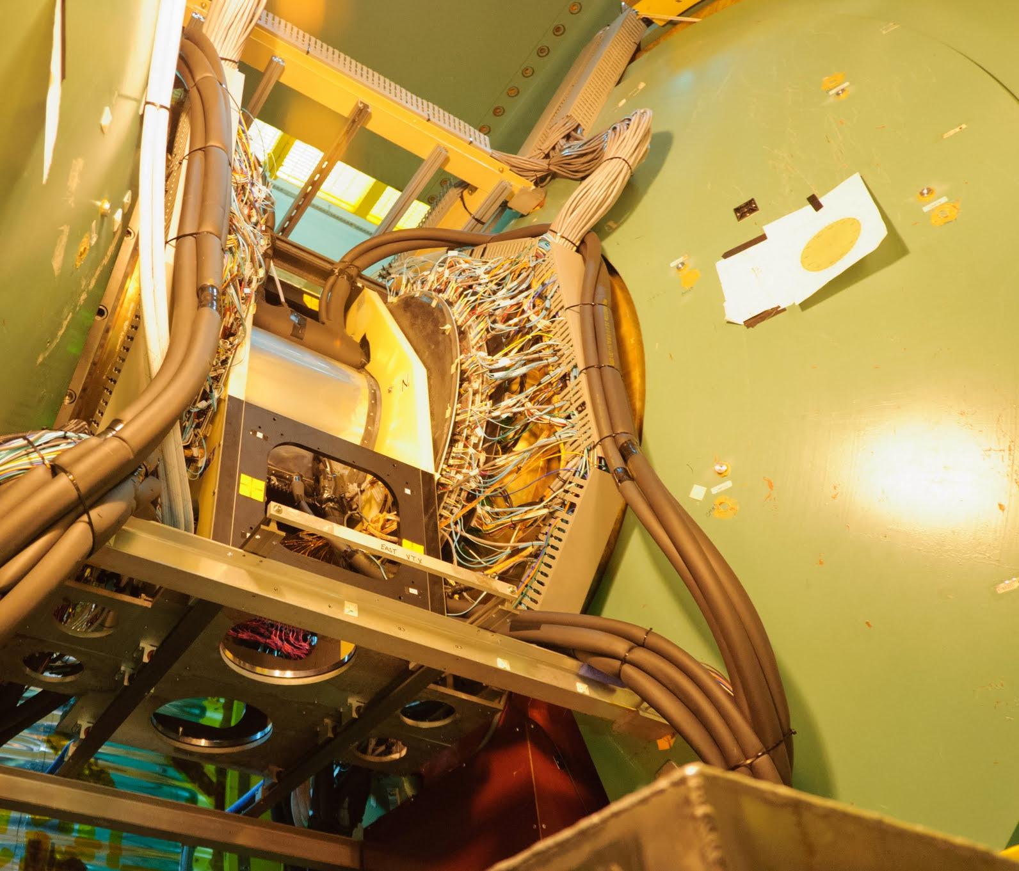
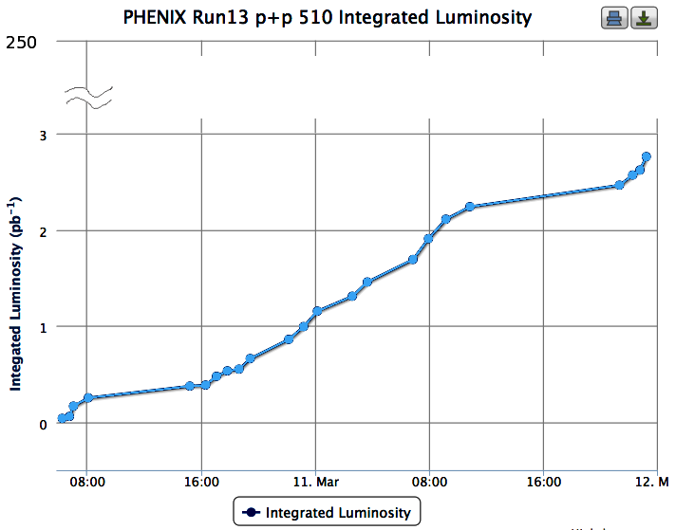
Regular runs have started
Last Friday, moved the Silicon detectors into place
Started regular data taking on Sunday with the first store
Data taking continues with all systems

