Slide 1
Time Meeting
March 19, 2013
Agenda
Safety
Schedule
Machine and system reports

Slide 2

Safety and training
Ed Lessard

Slide 3
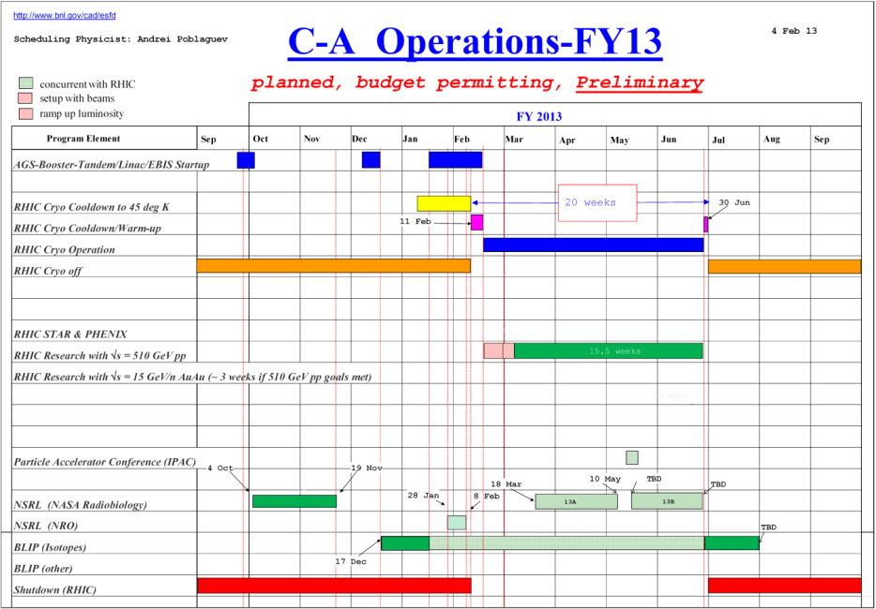
Schedule
Continue to follow the preliminary schedule
BLIP Run continues
NSRL Run13A
RHIC run Physics
(ramp/store development continues)
March 18: NSRL run 13A started
March 20: Scheduled Maintenance (LIPA outage 6:00-18:00)
March 27: APEX

Slide 4
Schedule
Monday | March 18 | 00:00 - 24:00 | Run Physics*
Tuesday | March 19 | 00:00 - 24:00 | Run Physics*
Wednesday | March 20 | 00:00 - 06:00 00:06 - 20:00 20:00 - 24:00 | Run Physics* Maintenance Run Physics* | LIPA outage Store dump at 8am New targets in the CNI polarimeter (~10 hours)
Thursday | March 21 | 00:00 - 24:00 | Run Physics*
Friday | March 22 | 00:00 - 24:00 | Run Physics*
Saturday | March 23 | 00:00 - 24:00 | Run physics*
Sunday | March 24 | 00:00 - 24:00 | Run Physics*
Monday | March 25 | 00:00 - 24:00 | Run Physics*
Tuesday | March 26 | 00:00 - 24:00 | Run Physics*
Wednesday | March 27 | 00:00 - 08:00 08:00 - 24:00 | Run Physics* APEX
* Ramp/store development concurrently with physics runs.

Slide 5
Machine and system reports
RHIC pp Run13 Vahid Ranjbar
STAR Len Eun
PHENIX Hubert van Hecke
AGS Haixin Huang
OPPIS Anatoli Zelenski
Maintenance Paul Sampson
Operations Peter Ingrassia
RCF Michaels Ernst

Slide 6
Next Time Meeting
Next Time Meeting: Tuesday, March 26
1:30PM, Snyder

