Slide 1
PHENIX Run-13 status
Hubert van Hecke
for the PHENIX collaboration

Slide 2
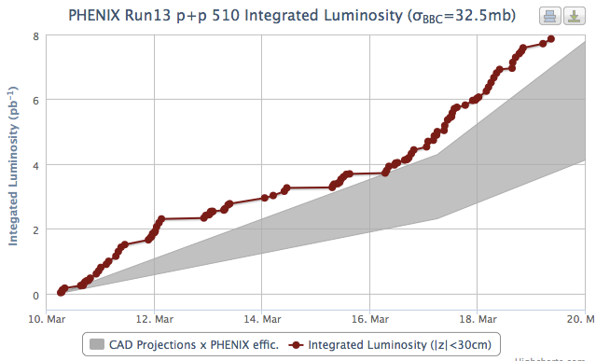
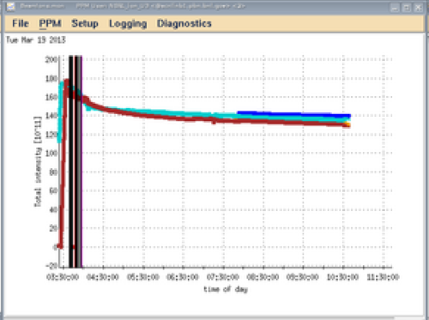
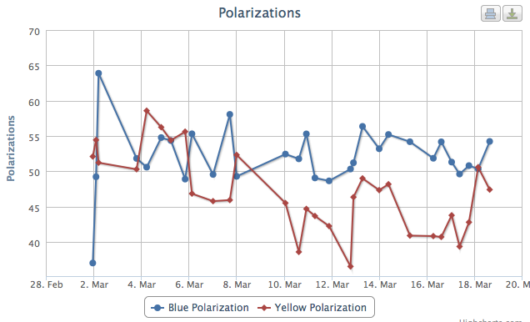
Regular runs continuing
Data taking continues with all systems
Pol, pol lifetime, yellow lifetime are concerns, but improvements are still being made…

