Slide 1
Take 5 for Safety
Picture of the Week
Electrical Safety
Collider-Accelerator Department
3-19-2013

Slide 2
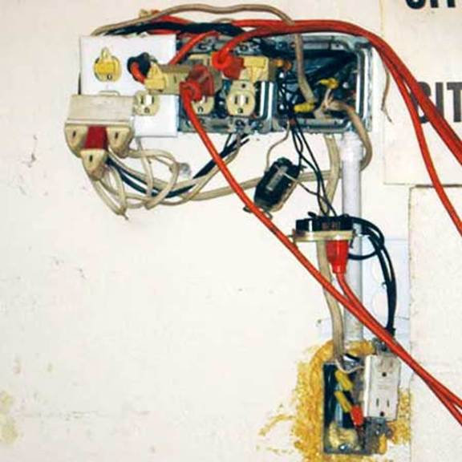
Picture of the Week

Slide 3
Which is correct, A or B?
Assume qualified people have brought magnets in an accelerator into an electrically safe condition and are working on them. Assume they have removed a magnet cover and a piece of de-energized LOTO’d bus is exposed. Assume they leave the area for some reason.
Do these workers have to establish a physical barrier around their work area to protect people from an electrical hazard? Or is there no electrical hazard because the equipment has been put into an electrically safe condition?
Nothing has to be done because no one is supposed to be working on the bus other than those who made it electrically safe
A boundary must be set up assuming the bus is energized to the system voltage

Slide 4
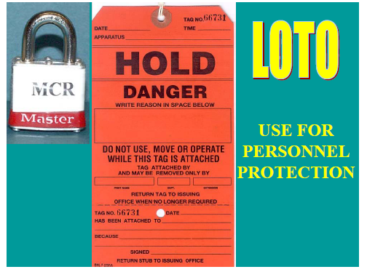
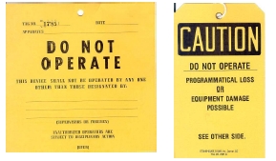
Which tag can be used for personnel protection?

Slide 5
C-AD OPM and training program to the rescue
Comprehensive, up-to-date OPM LOTO procedures written in our own words and crafted with broad participation of C-AD workers
On the job training in C-AD LOTO procedures; ‘learning by doing’ as opposed to classroom training or web training in SBMS Subject Area

