Slide 1
Time Meeting March 26, 2013
Agenda
Safety
Schedule
Machine and system reports

Slide 2
Safety and training
Ed Lessard

Slide 3
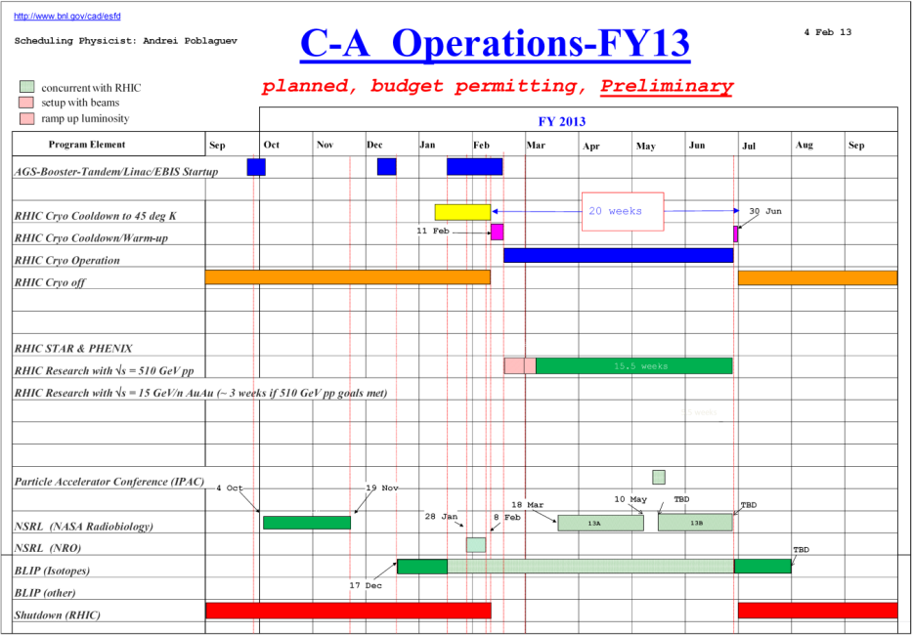
Schedule
Continue to follow the preliminary schedule
BLIP Run continues
NSRL Run13A continues
RHIC run Physics
(beam development between
8-hours stores)
March 27: APEX (8:00 – 24:00)
April 3 : Scheduled Maintenance (8:00-16:00)

Slide 4
Schedule
Monday | March 25 | 00:00 - 24:00 | Run Physics* | Switch to 8-hour physics store
Tuesday | March 26 | 00:00 - 24:00 | Run Physics* | Switch to the AGS harmonic 12 operation
Wednesday | March 27 | 00:00 - 08:00 08:00 - 24:00 | Run Physics* APEX
Thursday | March 28 | 00:00 - 24:00 | Run Physics* | Injection lifetime study (4 hours)
Friday | March 29 | 00:00 - 24:00 | Run Physics*
Saturday | March 30 | 00:00 - 24:00 | Run physics*
Sunday | March 31 | 00:00 - 24:00 | Run Physics*
Monday | April 1 | 00:00 - 24:00 | Run Physics*
Tuesday | April 2 | 00:00 - 24:00 | Run Physics*
Wednesday | April 3 | 00:00 - 08:00 08:00 - 16:00 | Run Physics* Maintenance
* 8-hour stores, Beam development between stores

Slide 5
Machine and system reports
RHIC pp Run13 Vahid Ranjbar
STAR Pibero Djawotho
PHENIX Hubert van Hecke
BLIP Leonard Mausner
AGS Haixin Huang
APEX Mei Bai
Operations Peter Ingrassia
RCF Michaels Ernst

Slide 6
Next Time Meeting
Next Time Meeting: Tuesday, April 2
1:30PM, Snyder

