Slide 1
PHENIX Run-13 status
Hubert van Hecke
for the PHENIX collaboration

Slide 2
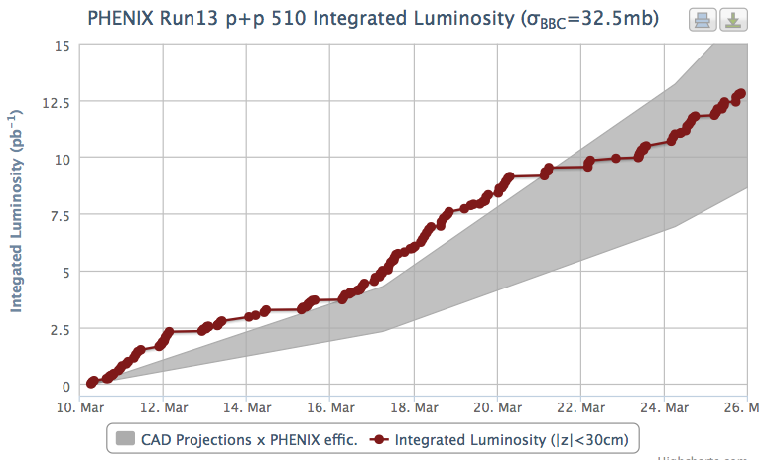
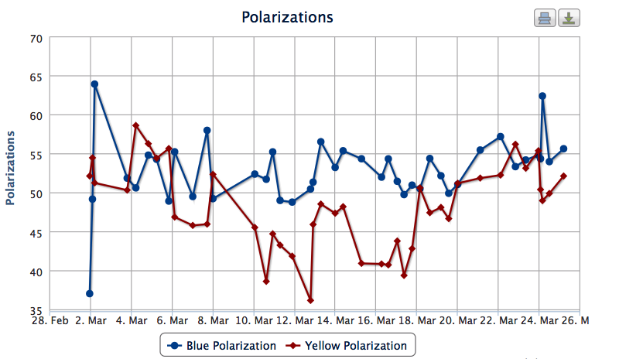
Regular runs continuing
Data taking continues with all systems
Accumulated luminosity is suffering from long down beam times.
Polarization is improving

Slide 3
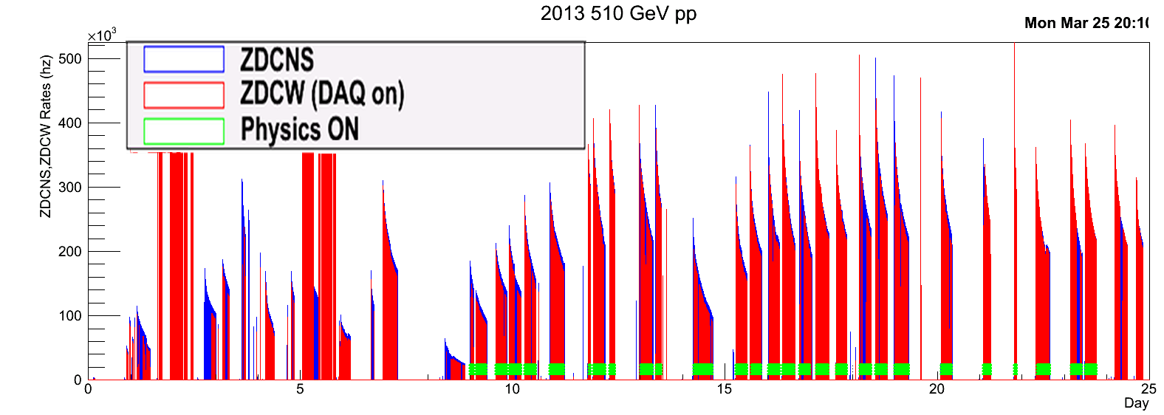
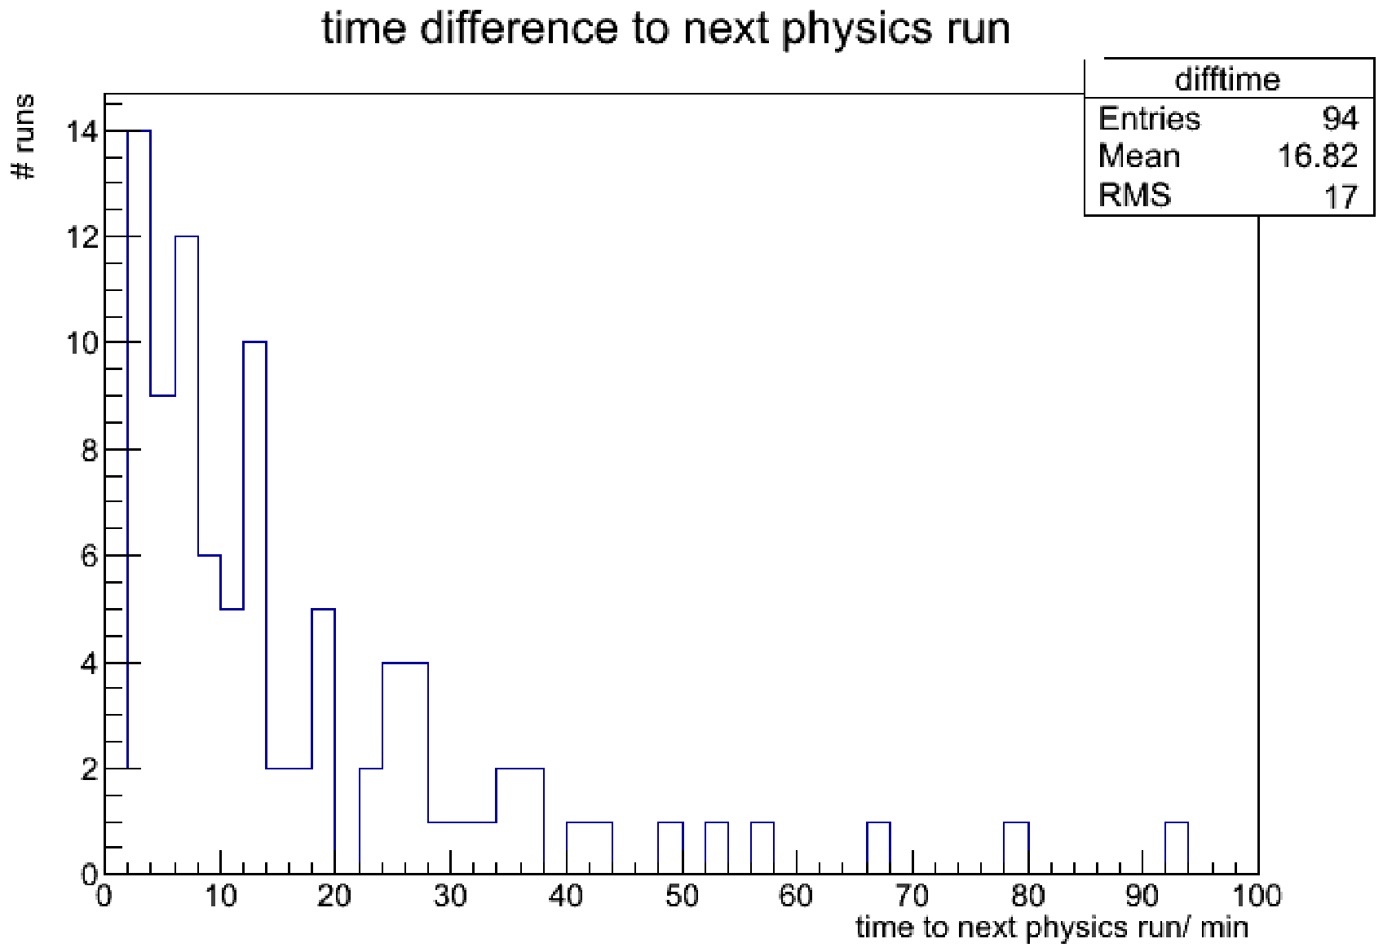
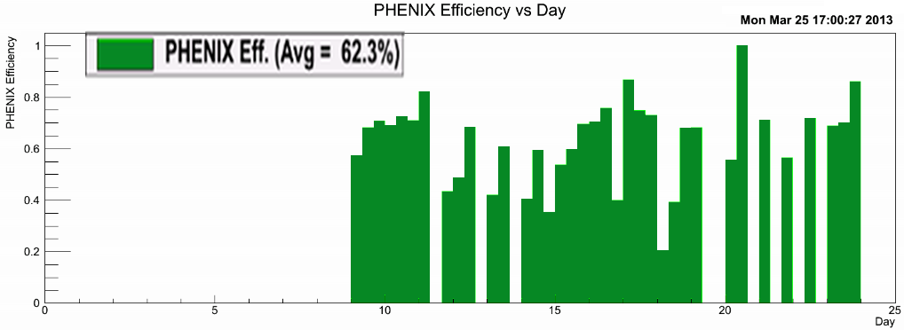
Data taking efficiency
Studying our data taking efficiencies
Time between physics runs

Slide 4
Data

