Slide 1
Time Meeting April 2, 2013
Agenda
Safety
Schedule
Machine and system reports

Slide 2
Safety and training
Ed Lessard

Slide 3
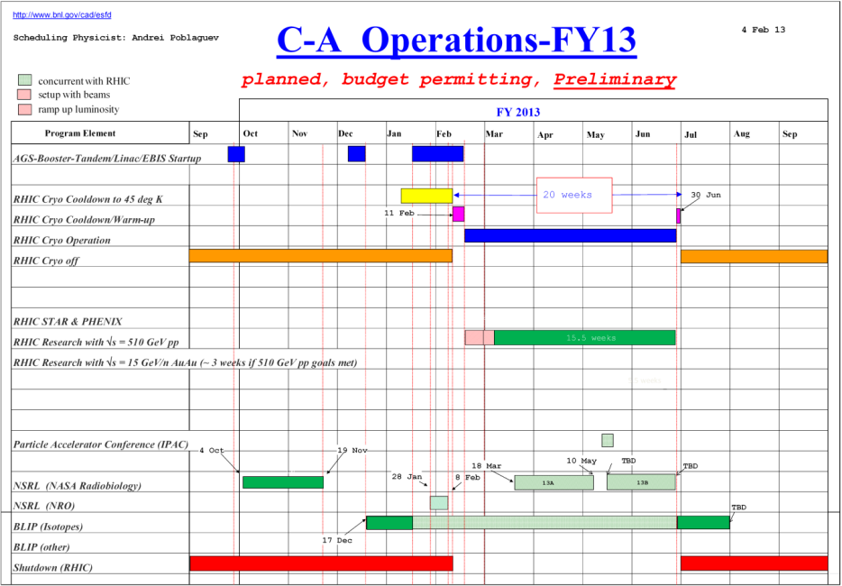
Schedule
Continue to follow the preliminary schedule
BLIP Run continues
NSRL Run13A continues
RHIC run Physics
(beam development continues)
April 2: AGS will be stopped at 18:00 for 24 hours
to repair Simens MG. Long store at RHIC.
April 3: Scheduled Maintenance (8:00-16:00)
April 10: APEX (8:00 – 24:00)

Slide 4
Schedule
Monday | April 1 | 00:00 - 24:00 | Run Physics*
Tuesday | April 2 | 00:00 - 24:00 | Run Physics* | 18:00 Start to repair Siemens MG (24 hours)
Wednesday | April 3 | 00:00 - 06:00 06:00 - 18:00 18:00 - 24:00 | Run Physics* Maintenance Run Physics* | Long store (18:00 – 06:00) Maintenance behind Siemens repair
Thursday | April 4 | 00:00 - 24:00 | Run Physics* | A possible revert to the FY12 lattice (still under discussion)
Friday | April 5 | 00:00 - 24:00 | Run Physics*
Saturday | April 6 | 00:00 - 24:00 | Run physics*
Sunday | April 7 | 00:00 - 24:00 | Run Physics*
Monday | April 8 | 00:00 - 24:00 | Run Physics*
Tuesday | April 9 | 00:00 - 24:00 | Run Physics*
Wednesday | April 10 | 00:00 - 08:00 08:00 - 24:00 | Run Physics* APEX
* 8-hour stores, Beam development between stores

Slide 5
Machine and system reports
RHIC pp Run13 Vahid Ranjbar
STAR Pibero Djawotho
PHENIX Hubert van Hecke
AGS Haixin Huang
APEX Mei Bai
Maintenance Paul Sampson
Operations Peter Ingrassia
RCF Michaels Ernst

Slide 6
Michael Ernst:
RCF status with respect to
PHENIX and STAR data taking:
all storage and network-related services have been running stably and at the expected level of performance
there were no service outages and/or performance degradations
overall the level of data transfer activity is slightly higher compared to 1-2 weeks ago, but overall it’s ~50% below expectation

Slide 7
Next Time Meeting
Next Time Meeting: Tuesday, April 9
1:30PM, Snyder

