Slide 1
PHENIX Run-13 status
Hubert van Hecke
for the PHENIX collaboration

Slide 2
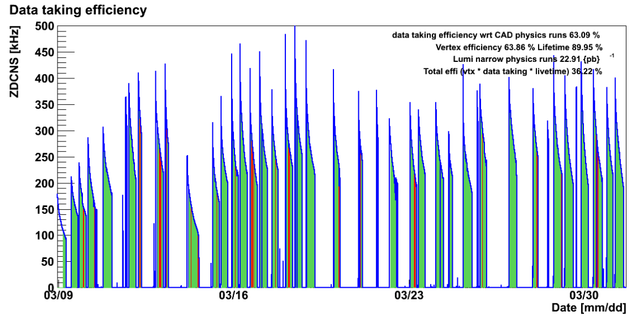
Phenix efficiencies
Blue: beam on
Green: physics on, Phenix taking data
Red: physics on, Phenix data taking off

Slide 3
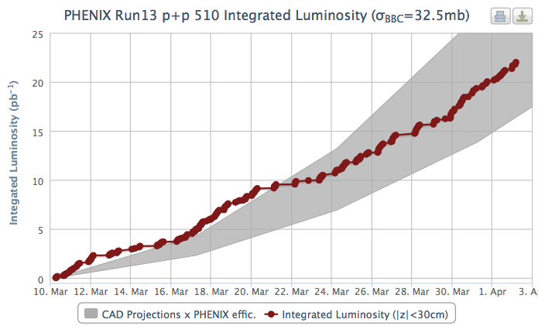
Luminosity to date

Slide 4
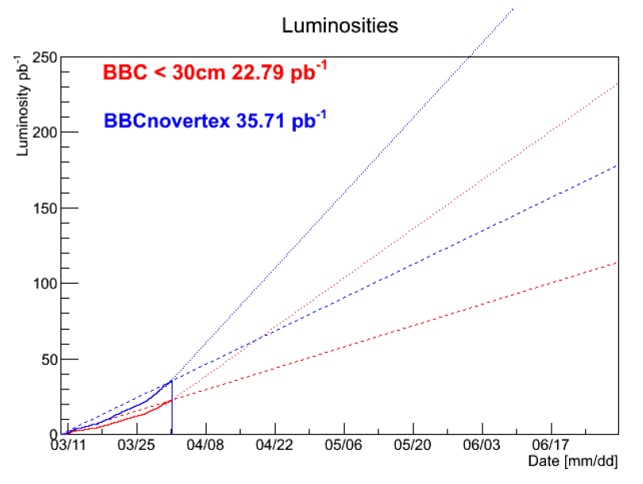
Projection with current conditions
Come close to the target by the end of June

Slide 5
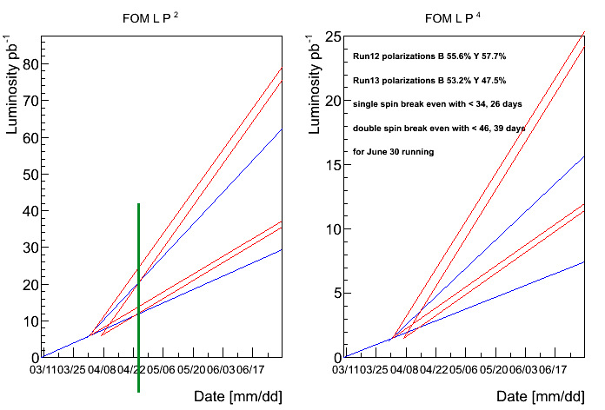
Projection, Run-12 conditions
If 5 days are lost to switchover, break-even occurs in ~3 weeks
Blue: current pol
Red: run-12 pol

Slide 6
-

