Slide 1
STAR Status Report for Run 13
Pibero Djawotho
Texas A&M University
2 April 2013

Slide 2
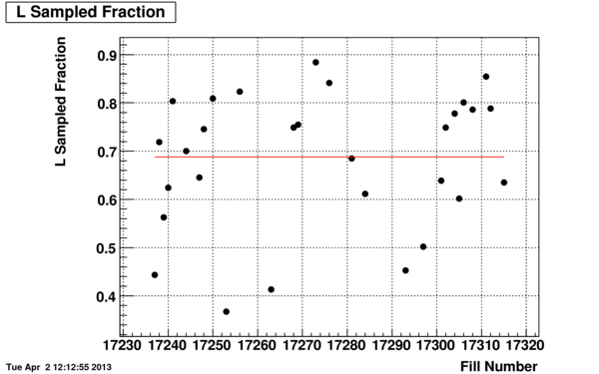
Efficiency of sampling luminosity

Slide 3
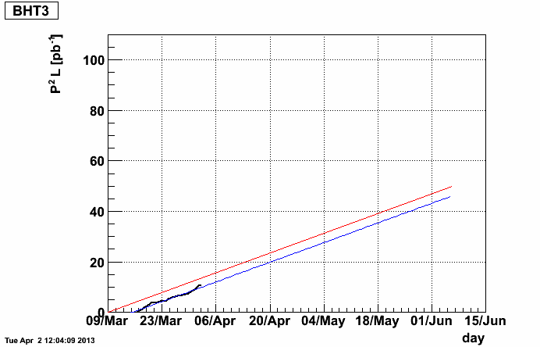
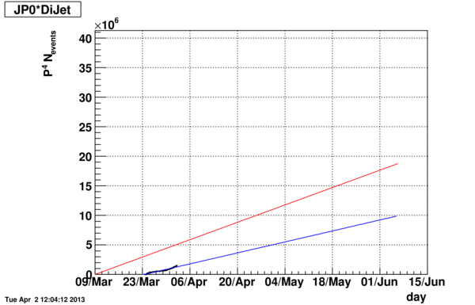
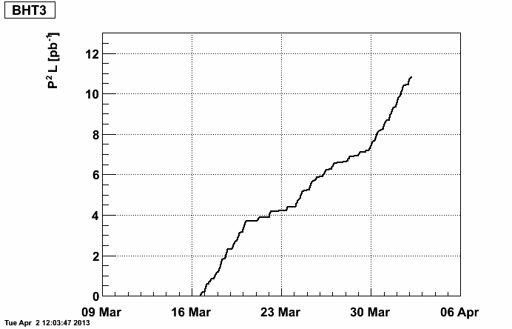
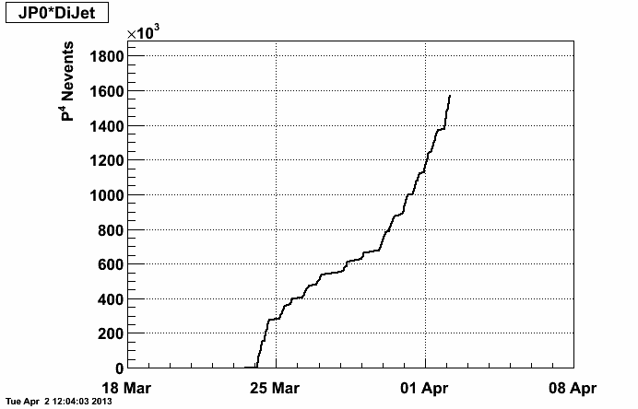
Luminosity tracker

