Slide 1
Take 5 for Safety
Danger Tags and Locks
Picture of the Week
Collider-Accelerator Department
4-2-2013

Slide 2
Use of LOTO Danger Tags and Locks
While the OSHA standard does not specifically mandate colors to be used on accident prevention tags, the following color scheme is recommended by OSHA for meeting the requirements on the use of Danger tags:
  "DANGER" - Red, or predominantly red, with lettering or symbols in a contrasting color
Does the OSHA LOTO standard apply to general industry service and maintenance operations?
The OSHA LOTO standard applies to the control of hazardous energy when employees are involved in service or maintenance activities such as constructing, installing, setting up, adjusting, inspecting, modifying, and maintaining or servicing machines or equipment (OSHA 3120, Control of Hazardous Energy, Lockout/Tagout)
Requirements for LOTO are in the BNL SBMS Subject Area Lockout/Tagout
Subject Area establishes safe lockout/tagout procedures (e.g., lock, tag, try)
Training is required prior to performing LOTO

Slide 3
NIOSH LOTO Study Case No. 1 Uncontrolled Kinetic Energy
A 25-year-old male worker at a concrete pipe manufacturing facility died from injuries he received while cleaning a concrete mixer. This worker’s daily tasks included cleaning out the concrete mixer at the end of the shift. The clean-out procedure was to shut off the power at the breaker panel (approximately 35 feet from the mixer), push the toggle switch by the mixer to make sure that the power was off, and then enter the mixer to clean it.
No one witnessed the event, but investigators concluded that the mixer operator had shut off the main breaker and then made a telephone call. The worker did not know that the operator had de-energized the mixer at the breaker. Thinking he was turning the mixer off, he activated the breaker switch and energized the mixer. The worker then entered the mixer and began cleaning without first pushing the toggle switch to make sure that the equipment was de-energized.
The mixer operator returned from making his telephone call and pushed the toggle switch to check that the mixer was de-energized.

Slide 4
NIOSH LOTO Study Case No. 2 Uncontrolled Electrical Energy
A 53-year-old journey man wireman was electrocuted when he contacted two energized, 6.9 KV buss terminals. The wireman was installing electrical components of a sulfur dioxide emission control system in a 14-compartment switch house.
The circuit breaker protecting the internal buss within the switch house had been tripped out and marked with a tag, but it had not been secured by locking. This procedure was consistent with the hazardous energy control procedures of the power plant.
The wireman was wiping down the individual compartments before a pre-startup inspection by power plant personnel. Without the knowledge of the wireman, power plant personnel had energized the internal buss in the switch house. When the wireman began to wipe down one of the compartments at the south end of the switch house, he contacted the A-phase buss terminal with his right hand and the C-phase buss terminal with his left hand. This act completed a path between phases, and the wireman was electrocuted.

Slide 5
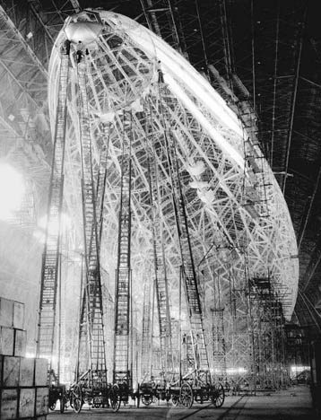
Picture of the Week – Ladder Heaven
Picture of USS Macon under construction in 1933
USS Macon was a rigid airship and was operated by the United States Navy
The wheels on the bottoms of the ladder carriages add more risk

