Slide 1
Time Meeting April 9, 2013
Agenda
Safety
Schedule
Machine and system reports

Slide 2
Safety and training
Ed Lessard

Slide 3
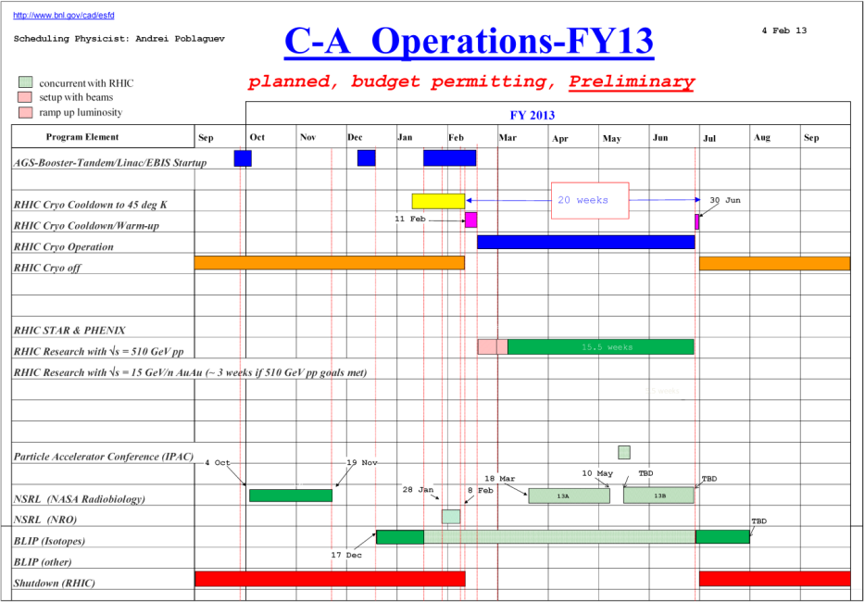
Schedule
Continue to follow the preliminary schedule
BLIP Run continues
NSRL Run13A continues
RHIC run Physics
(beam development continues)
April 4: Switched to the 2012 lattice.
April 10: APEX (8:00 – 24:00)
April 17: Scheduled Maintenance (8:00-16:00)

Slide 4
Schedule
Monday | April 8 | 00:00 - 24:00 | Run Physics*
Tuesday | April 9 | 00:00 - 24:00 | Run Physics*
Wednesday | April 10 | 00:00 - 08:00 08:00 - 24:00 | Run Physics* APEX
Thursday | April 11 | 00:00 - 24:00 | Run Physics*
Friday | April 12 | 00:00 - 24:00 | Run Physics*
Saturday | April 13 | 00:00 - 24:00 | Run physics*
Sunday | April 14 | 00:00 - 24:00 | Run Physics*
Monday | April 15 | 00:00 - 24:00 | Run Physics*
Tuesday | April 16 | 00:00 - 24:00 | Run Physics*
Wednesday | April 17 | 00:00 - 06:00 06:00 - 18:00 18:00 - 24:00 | Run Physics* Maintenance Run Physics*
* 8-hour stores, Beam development between stores

Slide 5
Machine and system reports
RHIC pp Run13 Vahid Ranjbar
STAR Salvatore Fazio
PHENIX Hubert van Hecke
BLIP Leonard Mausner
AGS Haixin Huang
APEX Mei Bai
Operations Peter Ingrassia
RCF Michaels Ernst

Slide 6
Next Time Meeting
Next Time Meeting: Tuesday, April 16
1:30PM, Snyder

