Slide 1
PHENIX Run-13 status
Hubert van Hecke
for the PHENIX collaboration

Slide 2
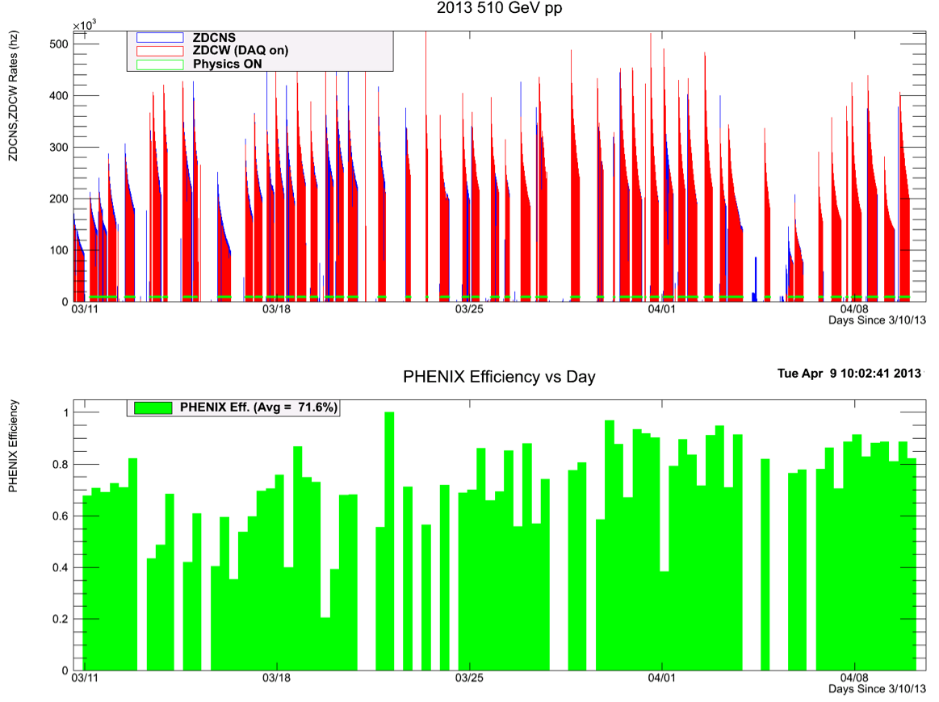
Phenix efficiencies

Slide 3
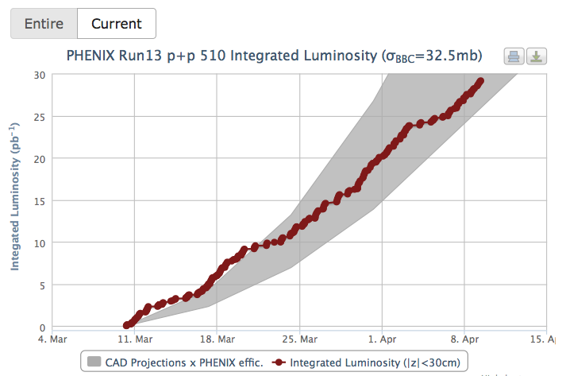
Luminosity to date

Slide 4
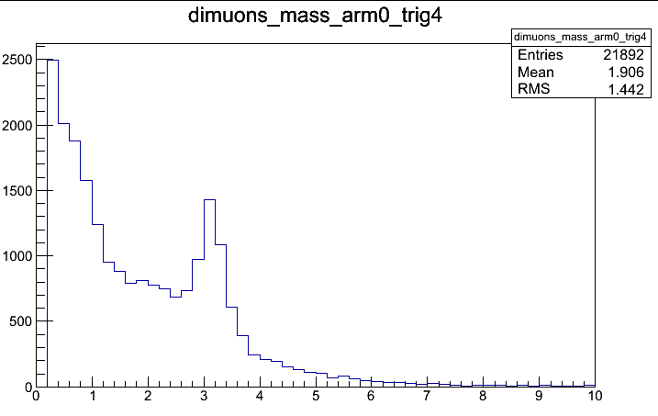
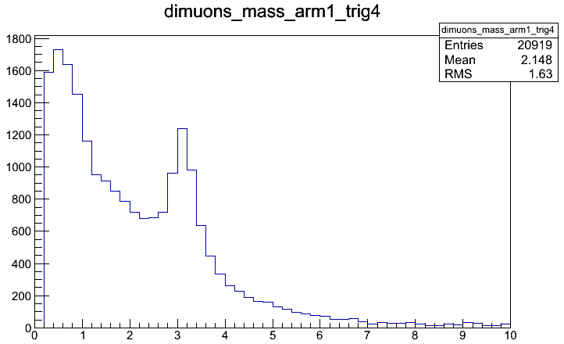
J/Psi with our new triggers
Trigger: SG1+RPC1(C)&MUIDLL1_N||S
South
North
From Francesca Giordano

Slide 5
Backup

Slide 6
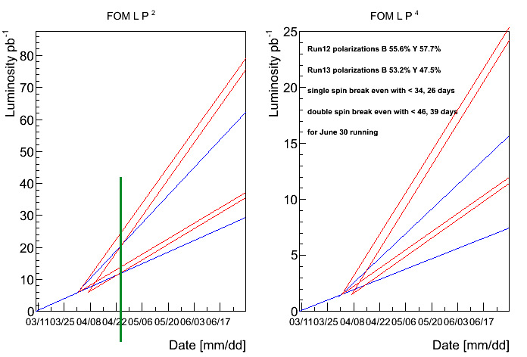
Projection, Run-12 conditions
If 5 days are lost to switchover, break-even occurs in ~3 weeks
Blue: current pol
Red: run-12 pol

