Slide 1
Take 5 for Safety
Training
Pictures of the Week
Collider-Accelerator Department
4-9-2013

Slide 2
Training
Training may help but it is not the key to safe operations
Training information in the workplace is remembered for only a few seconds unless constantly repeated
According to John Medina, the author of Brain Rules, if you want to extend remembering to a few minutes or even an hour or two, you will need to consistently re-expose yourself to the information
BNL LOTO training cannot be repeated at the rate required; however, supervisors could make LOTO awareness a frequent safety topic at meetings during the year
There are other ways to extend remembering such as use of dramatic stories (e.g., BNL training videos like Charlie’s Story); using visuals during presentations because we learn best through pictures; keeping presentations to less than 10 minutes because your audience checks out without new stimulus

Slide 3
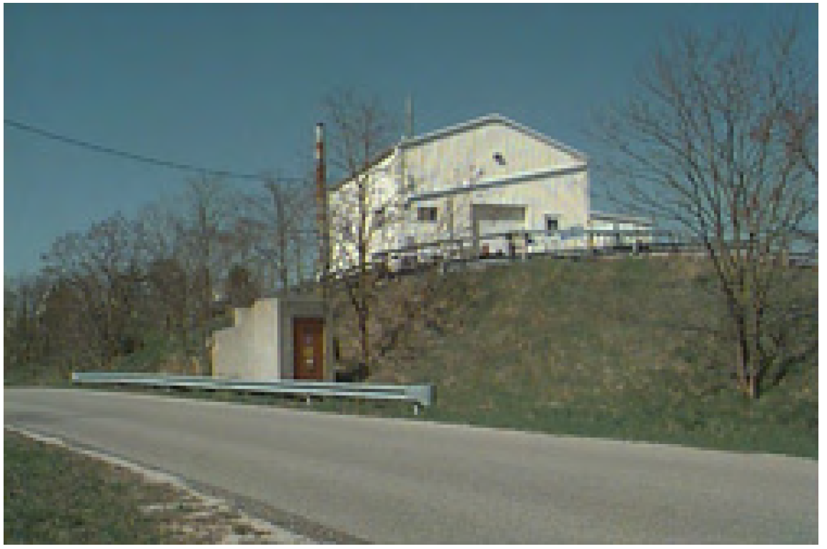
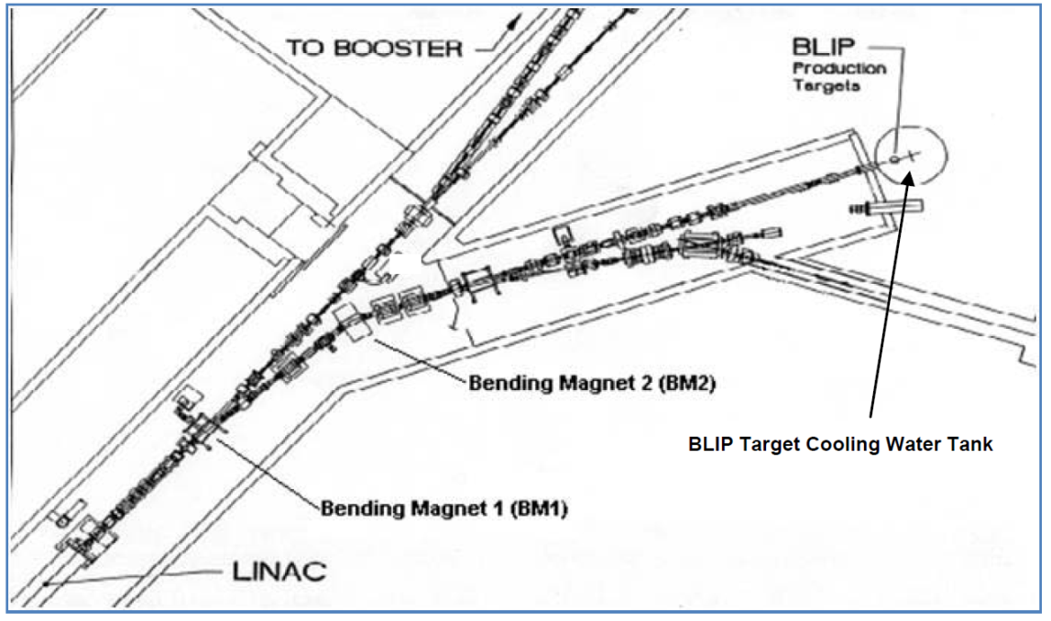
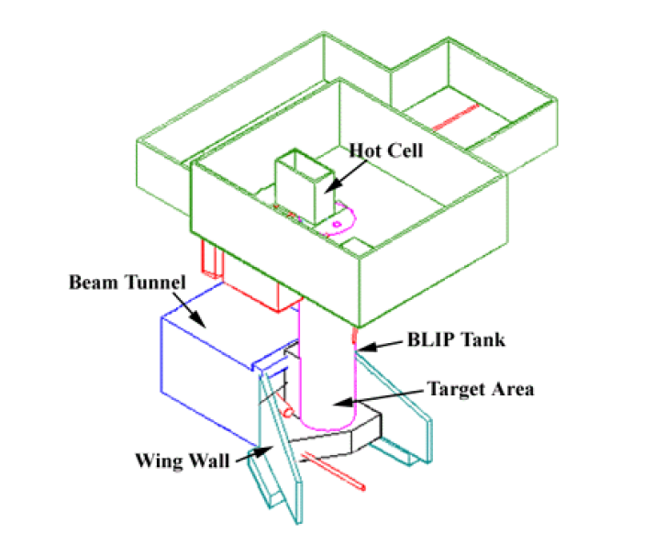
BLIP Shielding Event

Slide 4
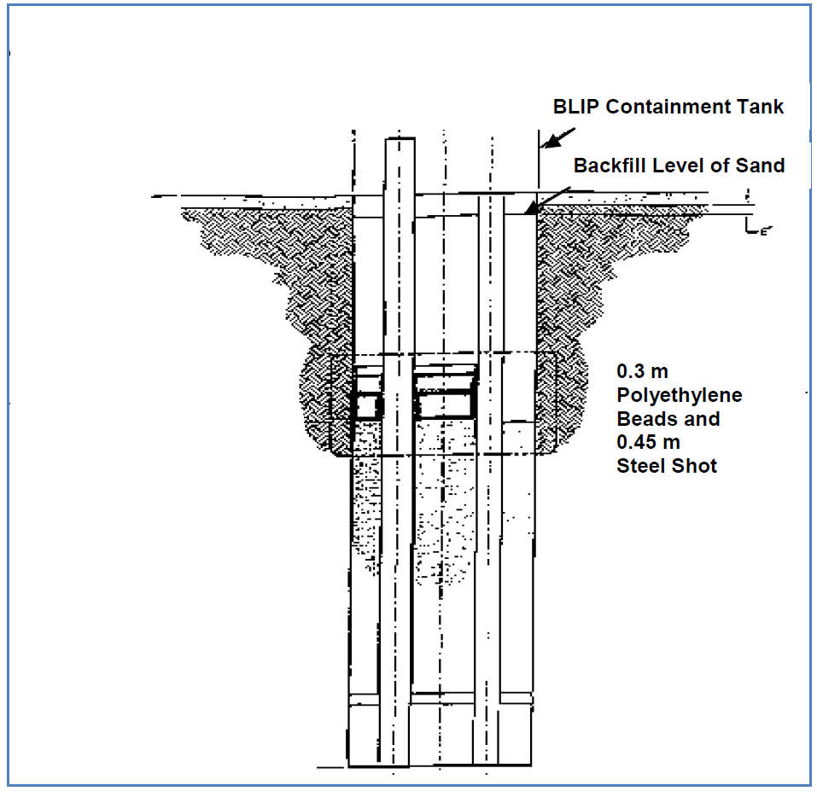
BLIP Shielding Event
Irradiated Target at Void Position
Missing Sand

Slide 5
BLIP Shielding Event

