Slide 1
AGS/Booster PP Status
Haixin Huang
April 16, 2013
Time Meeting

Slide 2
Status
Pulse power supply group fixed G10. Improved the AtR efficiency after April 8.
AGS continued to provide near 70% polarization for RHIC injection.
The Booster h=2 was tested in the Booster with higher bunch intensity (near 2*10¹¹, 6*10¹¹ Booster input ). Lower polarization with h=2 (66.2+-0.9) than h=1 (71.4+-1.1), as we sacrificed on the vertical scraping in the Booster. Vertical emittance is about 10% higher in h=2 case, but no difference seen in horizontal. Longitudinal remittance is reduced from1.04 eV-s to 0.77eV-s.
Longitudinal emittance increased from .63eV-s to 1.04eV-s on the ramp. RF group removed the bunch oscillation at injection. Keith tuned transition jump.
With modest quad pumping, the bunch length at AGS extraction can be reduced to 23.7ns from 29ns. We will try that for next RHIC fill.
There is a plan to do 2.5GeV setup next week (after NSRL operation during day).

Slide 3
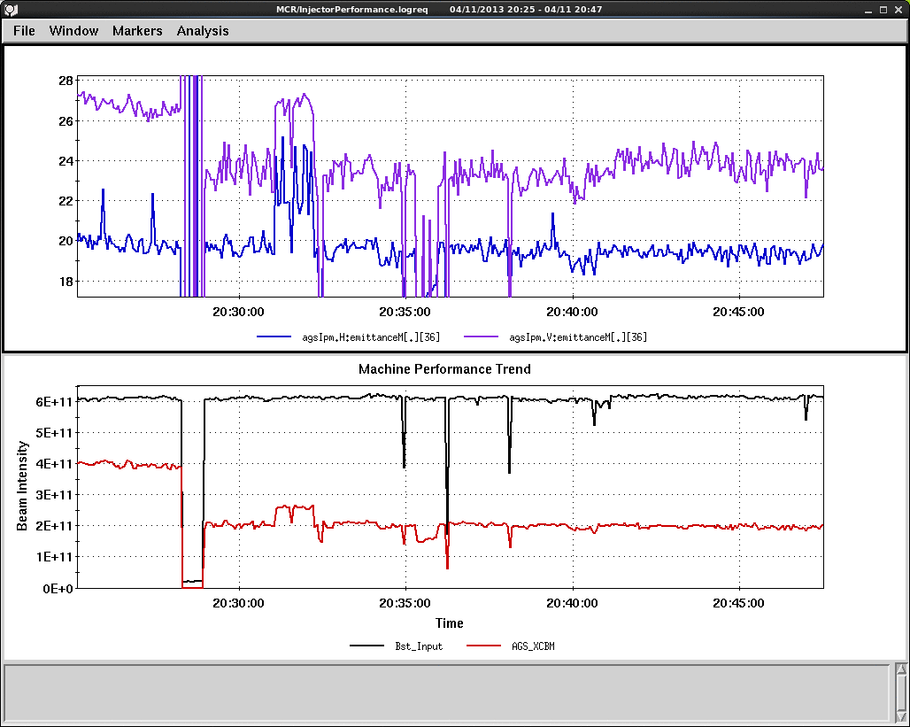
AGS Flattop Remittance for h=2 and h=1
H=1
H=2
AGS bunch intensity was 2*10¹¹. Different scraping in the Booster. Vertical remittance is larger with h=2.

