Slide 1
BLIP Operations April 1-15, 2013
Routine production of Sr-82 and Ge-68 at 117 MeV continued.
Momentary (~0.5s) high gamma radiation levels during target insertion and removal operations were detected on the afternoon of April 2 and BLIP shutdown to investigate.
Video surveillance of under floor sand shielding showed a 4-6” gap had opened around the water filled target tank. The sand appears to have shifted, either due to compaction of buried polyethylene beads or vibration over time. Additional administrative access controls were implemented and restart was approved by DOE on the afternoon of April 5. A shielding fix will be installed in the summer shutdown.
Average beam on time was down to 100.6 hr/wk due to investigation and needed restart approval. Average beam current was 95.0µA.
Operations from April 5-15 have been uneventful at 117 MeV, with average current up to ~100µA.
A short test irradiation at 66 MeV is scheduled for April 18.

Slide 2
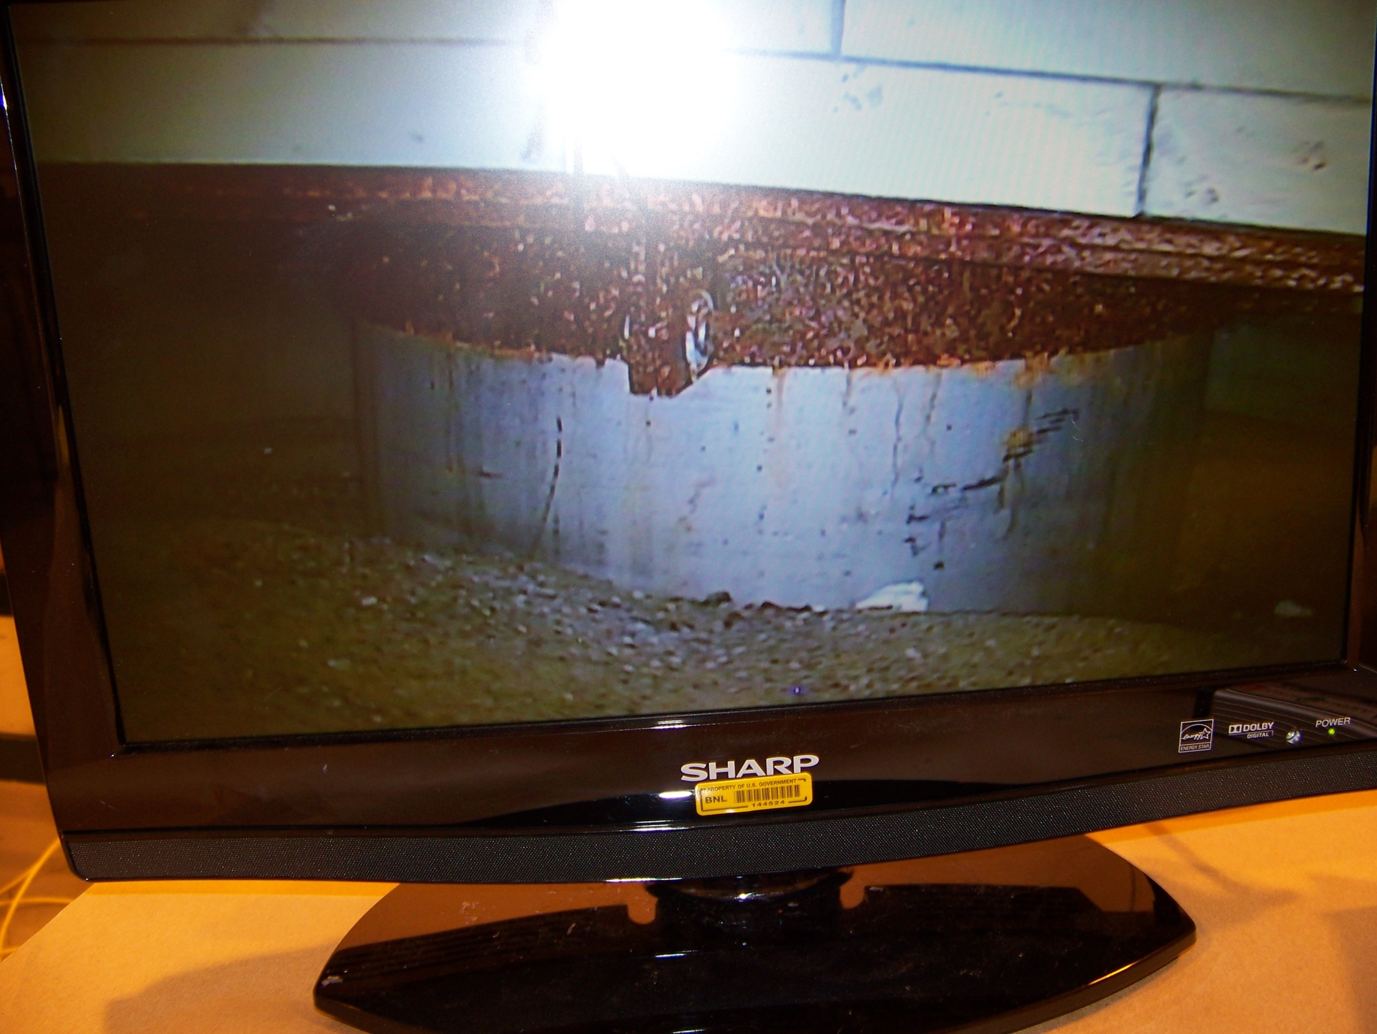
Lead
Lead
Water filled target shaft
Sand

