Slide 1
Take 5 for Safety
Improving Recollection of Complex LOTO Training
Collider-Accelerator Department
4-16-2013

Slide 2
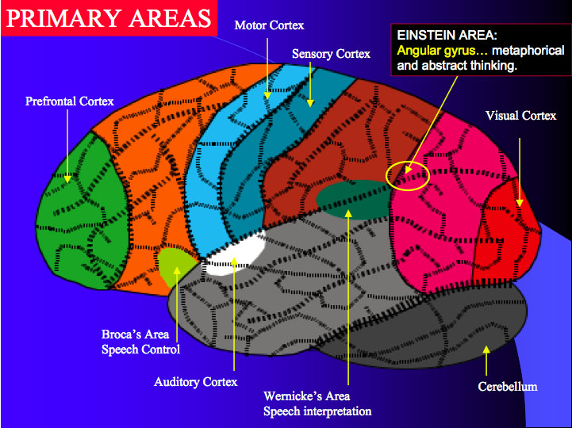
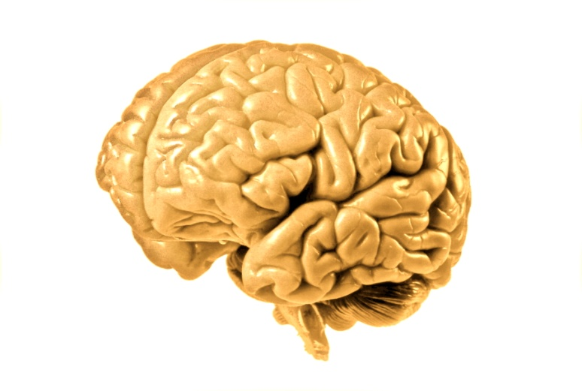
Improving Recollection of Training
Memories are made by converting external sources of energy into electrical patterns recognized by the brain (e.g., photons into the eye convert to electrical patterns in the visual cortex)

Slide 3
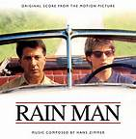
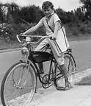
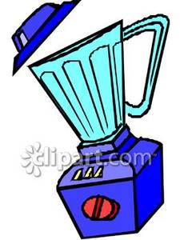
Improving Recollection of Training
Y_ _r d_g ch_s_d th_ c_t
illustrates “binding problem”
Using several senses to create a memory (rock concert vs. password)
and using spaced repetition improves recall

Slide 4
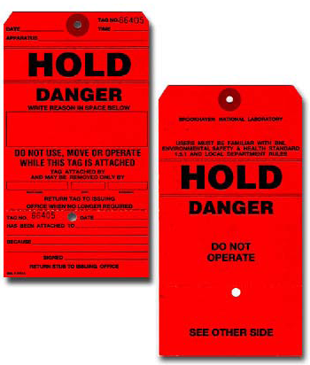
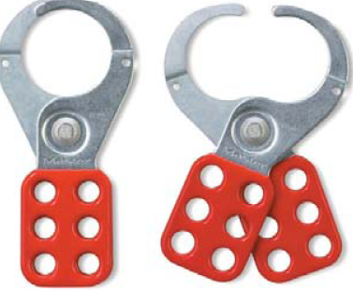
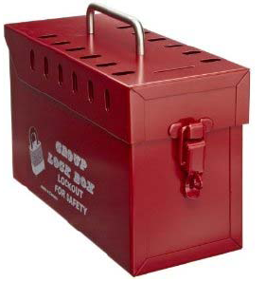
Examples of Complex LOTO
More than 1 source of hazardous energy
More than 1 isolation point
More than 1 craft applying LOTO
More than 1 work location
Both BNL and non-BNL workers are applying LOTO
More than 1 crew is applying LOTO
More than 1 disconnecting means
A particular sequence that is out of the ordinary, is required for LOTO
Piece of equipment involved cannot be locked

Slide 5
Complex LOTO OJT Training
A supervisor must instruct each worker on job-specific requirements and procedures that need to be followed for a complex LOTO
Best training approach: observe the worker performing the LOTO so that the worker creates a memory using several of their senses
When confident of a worker’s practical skills and job knowledge, the supervisor may authorize each worker to lock and tag equipment unsupervised
Supervisors should repeat OJT periodically – repetition at infrequent intervals improves recall

