Slide 1
Time Meeting April 23, 2013
Agenda
Safety
Schedule
Machine and system reports

Slide 2
Safety and training
Ed Lessard

Slide 3
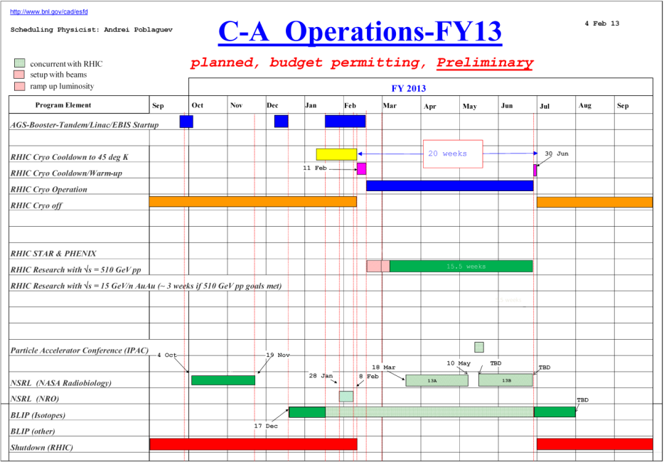
Schedule
Continue to follow the preliminary schedule
BLIP Run continues
NSRL Run13A continues
RHIC run Physics
(beam development continues)
15 Cryo weeks end on May 27. A few weeks of AuAu run are being discussed. A decision is expected next week.
April 24: APEX (8:00 – 24:00)
May 1: Long Maintenance (8:00-24:00) (preliminary: depends
on STAR readyness to install new detector)

Slide 4
Schedule for the week
Monday | April 22 | 00:00 - 24:00 | Run Physics*
Tuesday | April 23 | 00:00 - 24:00 | Run Physics*
Wednesday | April 24 | 00:00 - 08:00 08:00 - 24:00 | Run Physics* APEX
Thursday | April 25 | 00:00 - 24:00 | Run Physics* | Machine development studies (6 hours)
Friday | April 26 | 00:00 - 24:00 | Run Physics*
Saturday | April 27 | 00:00 - 24:00 | Run physics*
Sunday | April 28 | 00:00 - 24:00 | Run Physics*
Monday | April 29 | 00:00 - 24:00 | Run Physics*
Tuesday | April 30 | 00:00 - 24:00 | Run Physics*
Wednesday | May 1 | 00:00 - 06:00 08:00 - 24:00 | Run Physics* Maintenance
* 8-hour stores, Beam development between stores

Slide 5
Machine and system reports
RHIC pp Run13 Vahid Ranjbar
STAR Salvatore Fazio
PHENIX Hubert van Hecke
BLIP Leonard Mausner
AGS Haixin Huang
APEX Mei Bai
Operations Peter Ingrassia
RCF Michaels Ernst

Slide 6
Next Time Meeting
Next Time Meeting: Tuesday, April 30
1:30PM, Snyder

