Slide 1
PHENIX Run-13 status
Hubert van Hecke
for the PHENIX collaboration

Slide 2
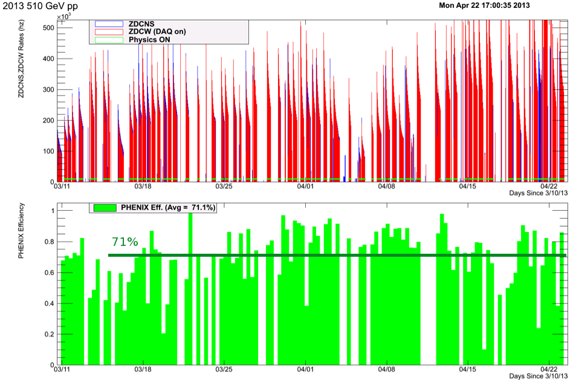
Phenix efficiencies

Slide 3
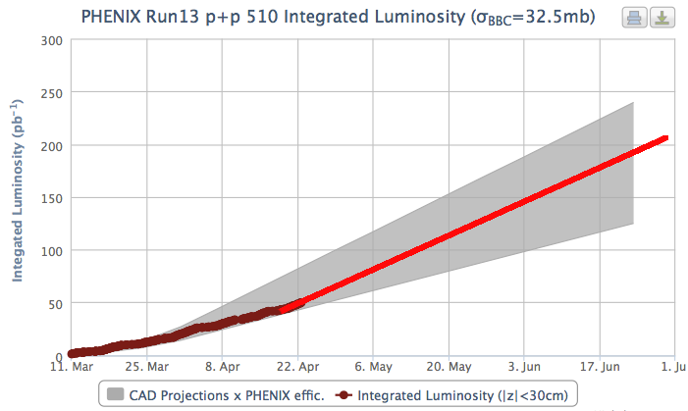
Luminosity to date
50
Projection: take the slope from the last ~5 days

Slide 4
FOM, with projections

Slide 5
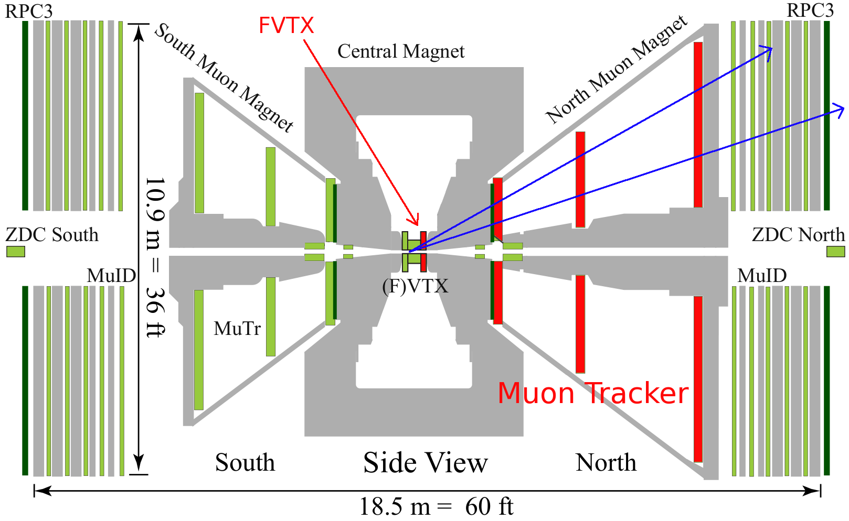
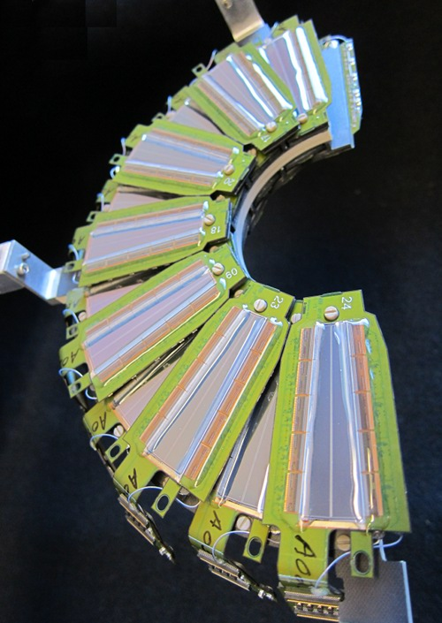
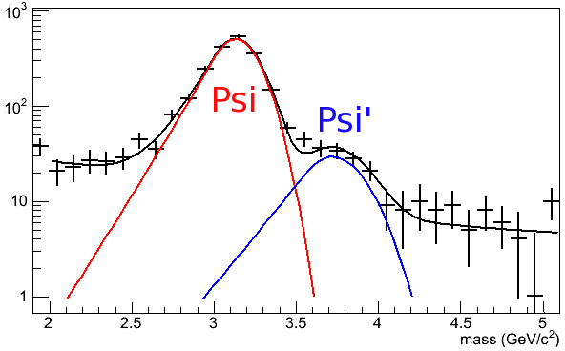
Highlight new system: FVTX
Psi->μ⁺μ⁻
FVTX: Forward Silicon Vertex Detector
High-resolution tracking near the event vertex
FVTX half-disk (1 of 16)
Using the FVTX+Muon Tracker, we can now resolve Ψ and Ψ’

