Slide 1
STAR Status Report
Salvatore Fazio
BNL
Time meeting – 23 April 2013

Slide 2
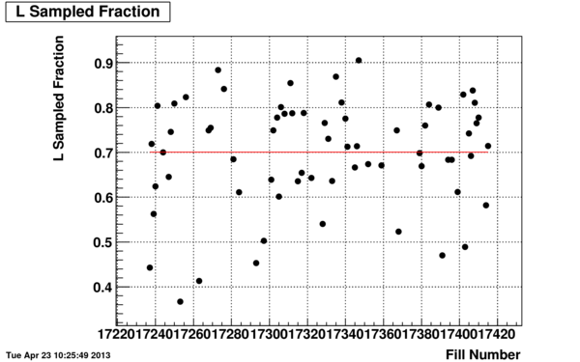
Efficiency of sampling luminosity
STAR has been running smoothly the past two weeks

Slide 3
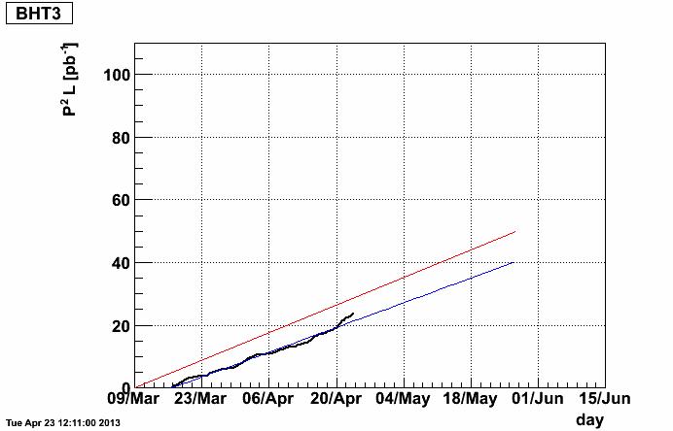
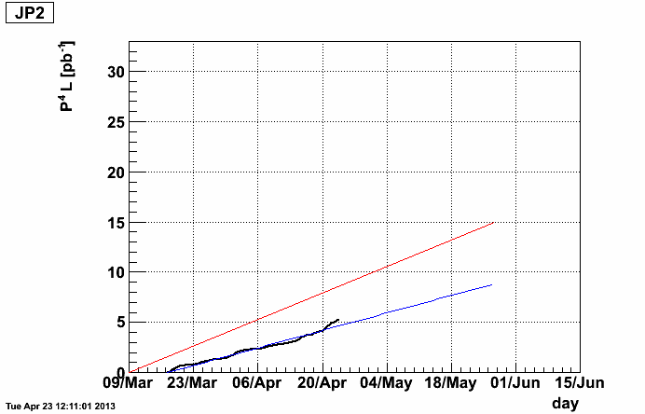
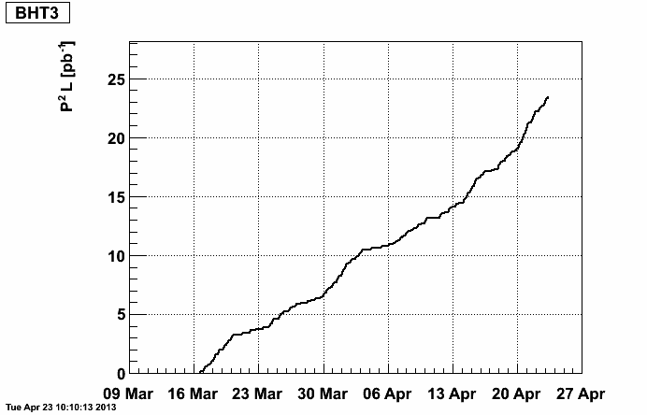
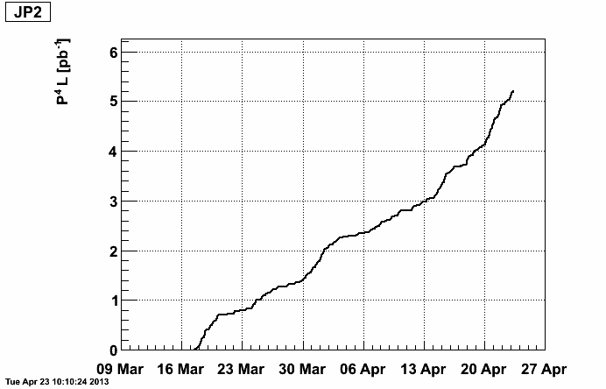
Luminosity tracker
Red line -> 2013 goal
Blue line -> latest projection
W - A_{L}
Jet - A_{LL}
Great improvement of the figure of merit since weekend!
Projected end of the p-p run now changed to May 27th from June 6th

