Slide 1
PHENIX Run-13 status
Hubert van Hecke
for the PHENIX collaboration

Slide 2
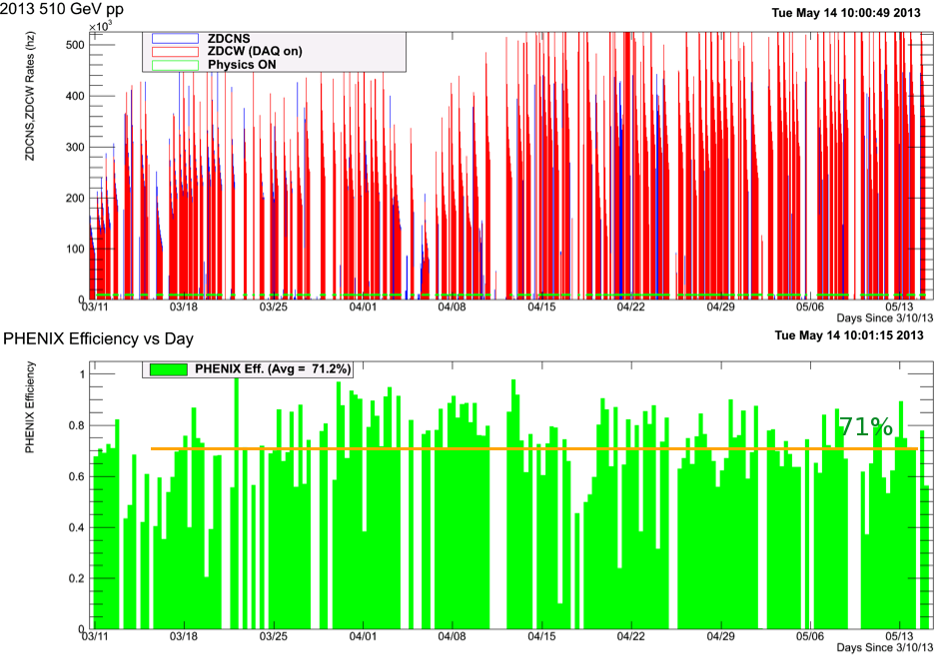
Phenix efficiencies

Slide 3
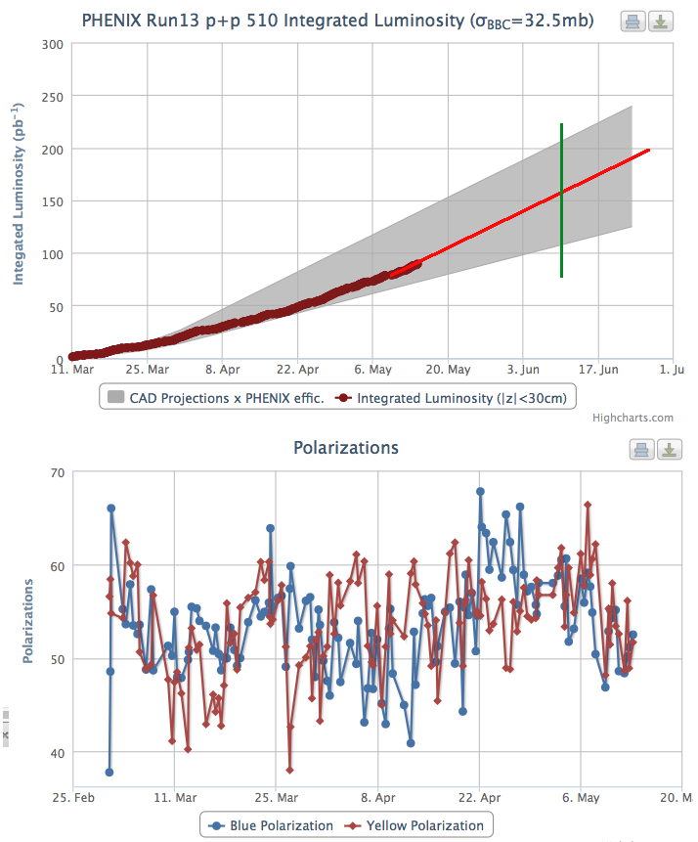
Luminosity to date

Slide 4
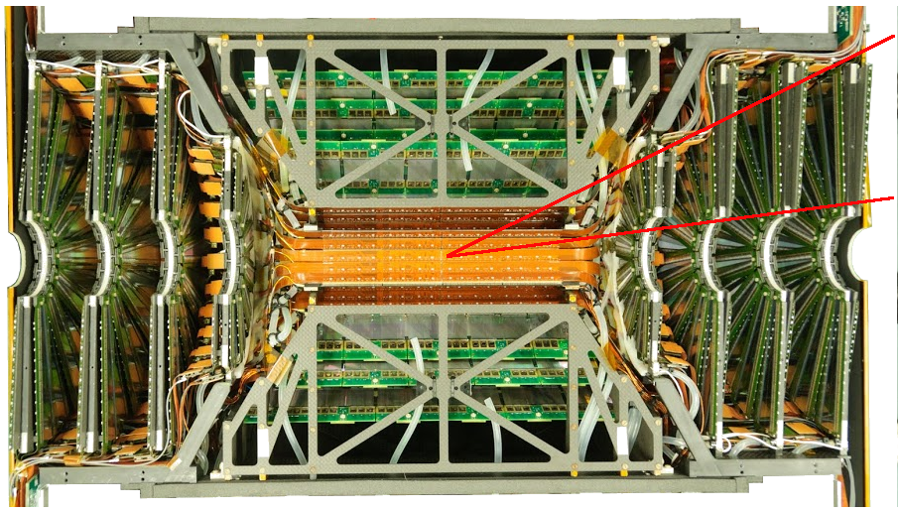
Silicon luminosity counters
1.2<eta<2.4
48 segments in phi
2 segments in z
Can select single hits in a phi segment,
Or hit pairs in a phi segment
How it is done: self-triggered data streams into
FPGAs (max 2Tbits/s), where hits are formatted for the event data stream.
There is enough space left in the FPGAs to split the incoming stream and set up luminosity counters.
Empty bunches
RHIC abort gap
RHIC abort gap
Stat error<10⁻⁴
Run13 √S = 510 GeV p-p Data
Hit-scaled scalars
Run13 √S = 510 GeV p-p Data
Two station coincidental scalars

