Slide 1
Time Meeting
May 21, 2013
Agenda
Safety
Schedule
Machine and system reports

Slide 2

Safety and training
Ed Lessard

Slide 3
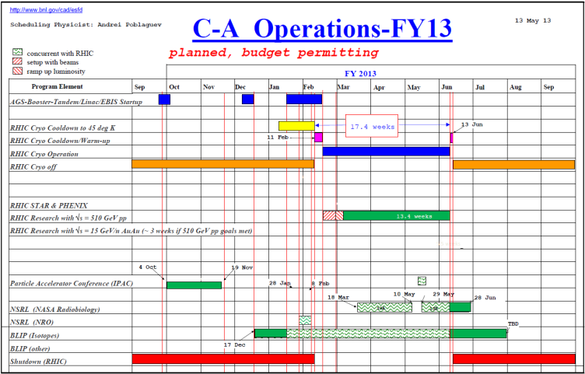
Schedule
BLIP Run continues
RHIC run Physics
(beam optimization continues)
May 22: Scheduled Maintenance
May 29: NSRL Run 13B begins
May 30: APEX for 5.86 GeV protons
June 10: End of RHIC Run

Slide 4
Schedule for the week
Monday | May 20 | 00:00 - 24:00 | Run Physics*
Tuesday | May 21 | 00:00 - 24:00 | Run Physics*
Wednesday | May 22 | 00:00 - 08:00 08:00 - 16:00 16:00 - 24:00 | Run Physics* Maintenance Run Physics*
Thursday | May 23 | 00:00 - 24:00 | Run Physics* | Beam development studies ( 3 hour)
Friday | May 24 | 00:00 - 24:00 | Run Physics*
Saturday | May 25 | 00:00 - 24:00 | Run physics*
Sunday | May 26 | 00:00 - 24:00 | Run Physics*
Monday | May 27 | 00:00 - 24:00 | Run Physics*
Tuesday | May 28 | 00:00 - 24:00 | Run Physics*
Wednesday | May 29 | 00:00 - 24:00 | Run Physics* | Beam development studies (4 hour)
Thursday | May 30 | 00:00 - 08:00 08:00 – 24:00 | Run Physics* APEX | 5.86 GeV protons tests
* 8-hour stores, Beam optimization between stores

Slide 5
Machine and system reports
RHIC pp Run13 Vincent Schoefer
STAR Martin Codrington
PHENIX Hubert van Hecke
BLIP Leonard Mausner
AGS Haixin Huang
Maintenance Paul Sampson
Operations Peter Ingrassia
RCF Michaels Ernst

Slide 6
Next Time Meeting
Next Time Meeting: Tuesday, May 28
1:30PM, Snyder

