Slide 1
PHENIX Run-13 status
Hubert van Hecke
for the PHENIX collaboration

Slide 2
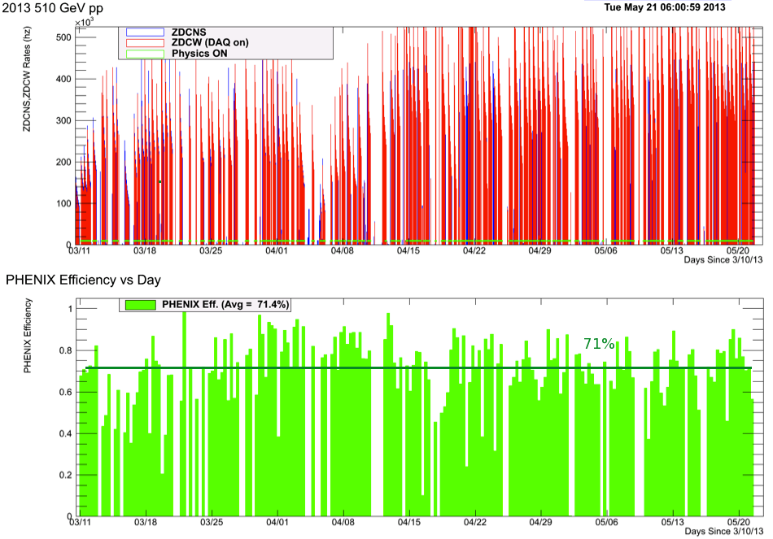
Phenix efficiencies

Slide 3
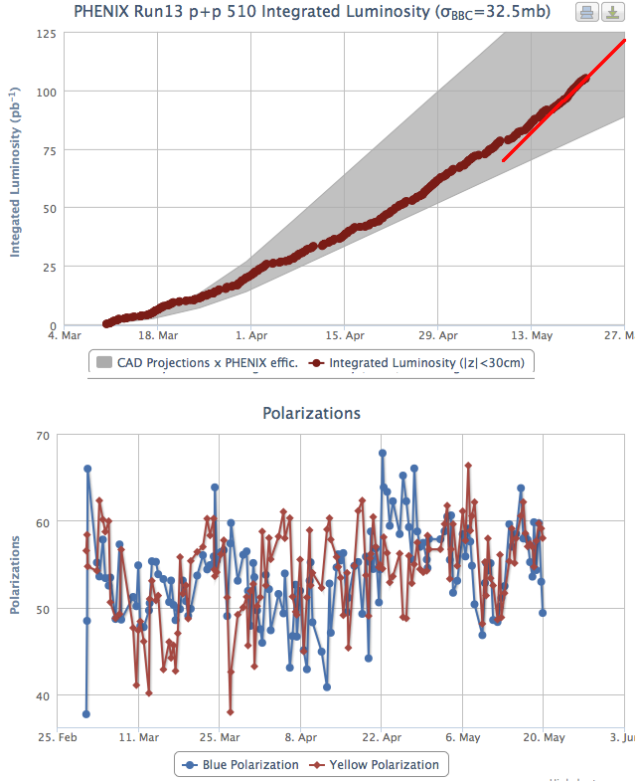
Luminosity to date

Slide 4
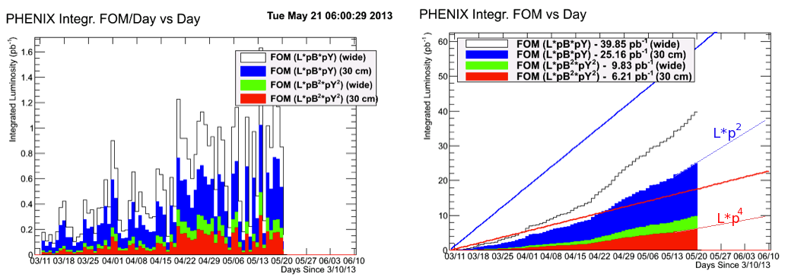
Figures of merit

