Slide 1
RHIC Status
Time Meeting 5/21/31
Store configuration: 1.8e11/bunch at lower vertical store tune
  Decreases luminosity from the run peak, but lower vertical store tune is necessary to maintain polarization
  Yellow emittance still subject to growth at these tunes
Polarization in yellow is in the high 50’s, blue in the low 50’s since the source repair
  Some indication that blue problem is at store. Will try an (even lower) Qy in blue
    There is no emittance blowup in blue to date
Store orbit control converging on a solution
Dump quenches
Reliability: Many stores (about half) taken out by variety of failures at 3-5 hours.
Thursday: Machine development, continue longitudinal stability threshold studies, periodic transient beam loading code test

Slide 2
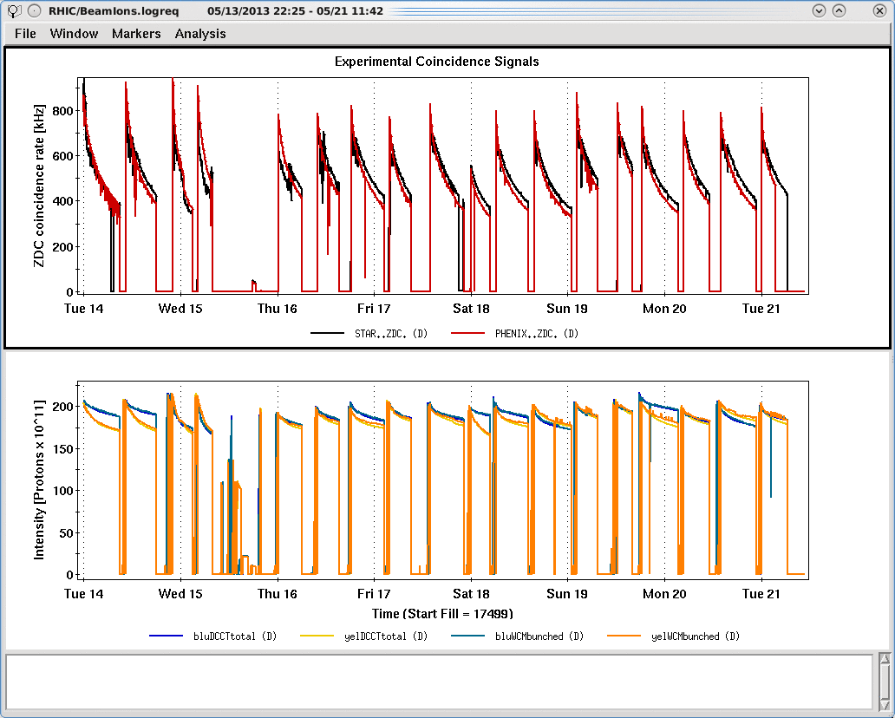

Slide 3
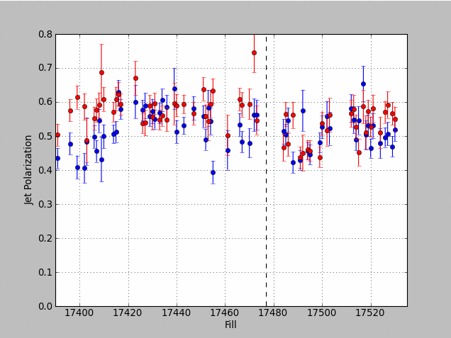
Blue
Yellow
Source problem starts

