Slide 1
STAR Operations Status Report
Time Meeting 05/21/2013
M.J.M. Codrington
STAR Period Coordinator

Slide 2
Sampling Eﬃciency
Average: 73% (+1% since last Time Meeting)

Slide 3
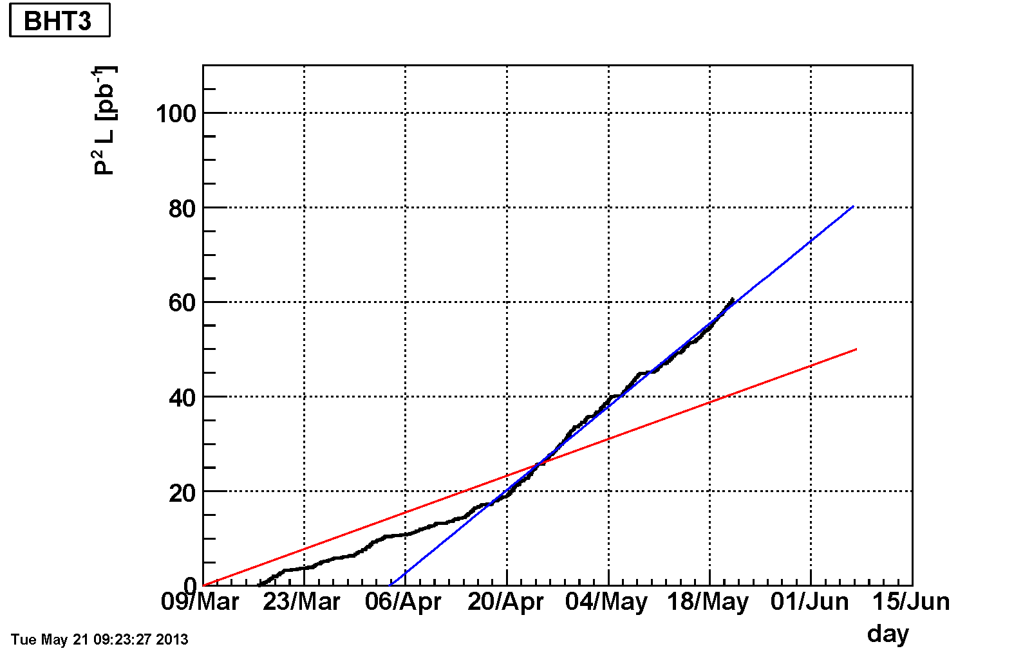
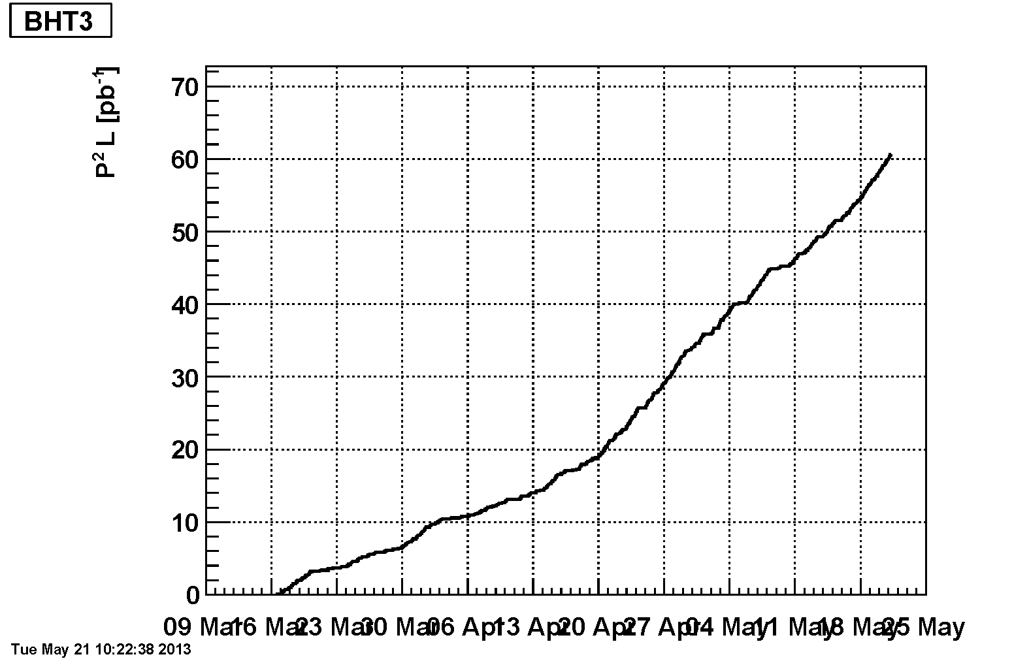
BHT3 (Single Spin Asymmetry)

Slide 4
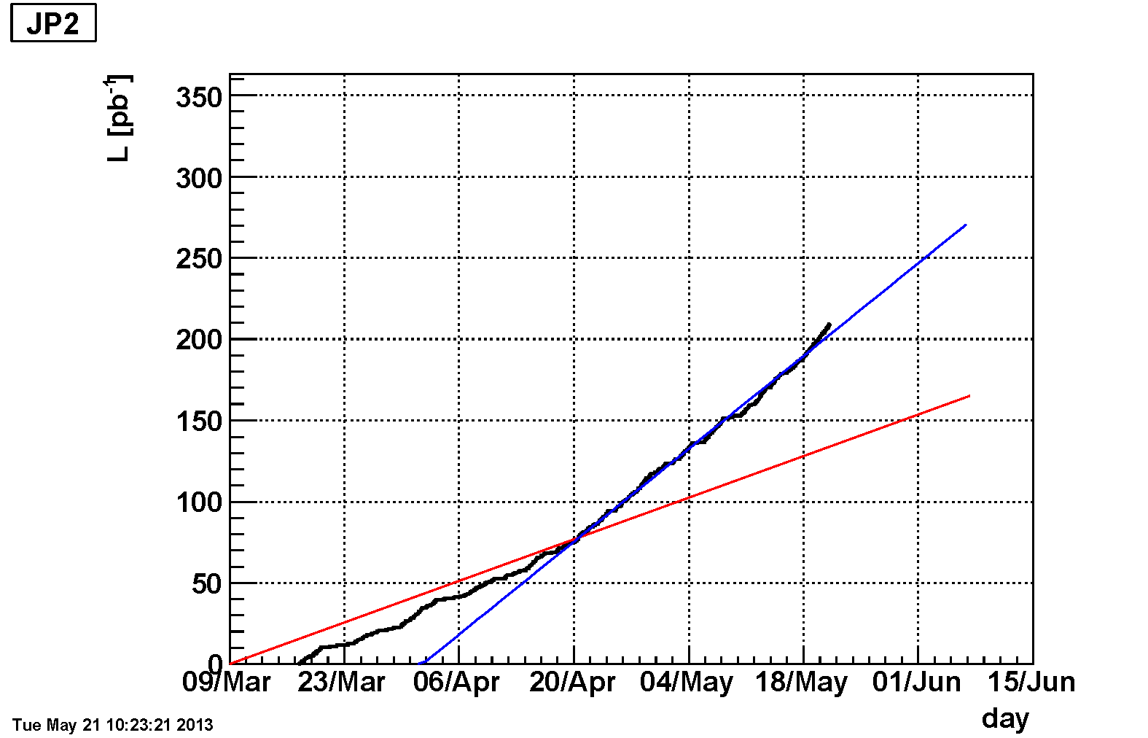
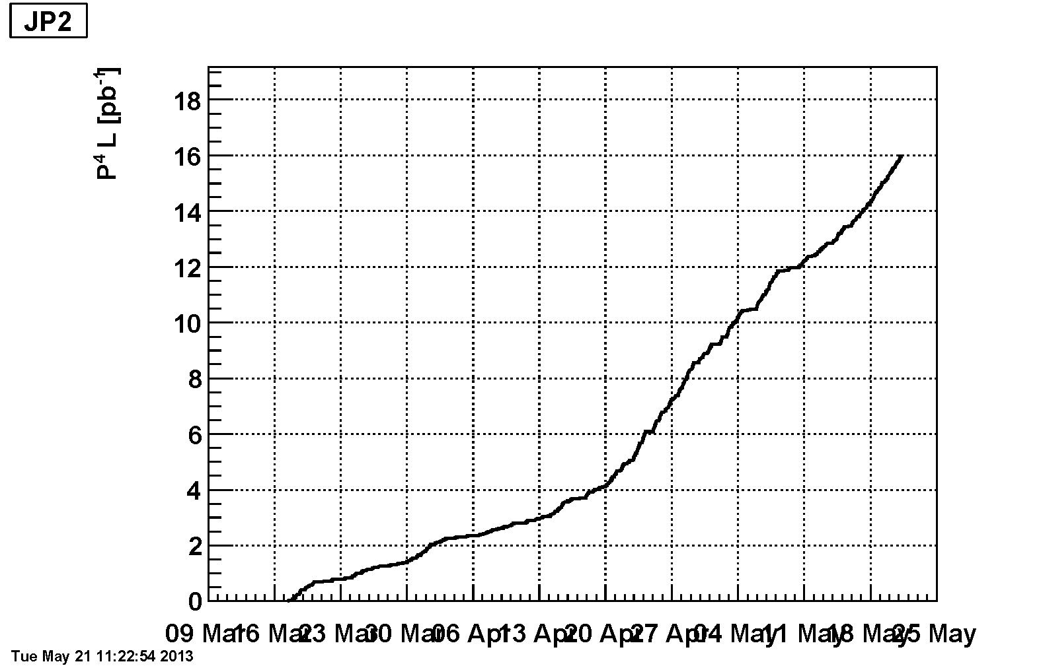
JP2 (Double Spin Asymmetry)

Slide 5
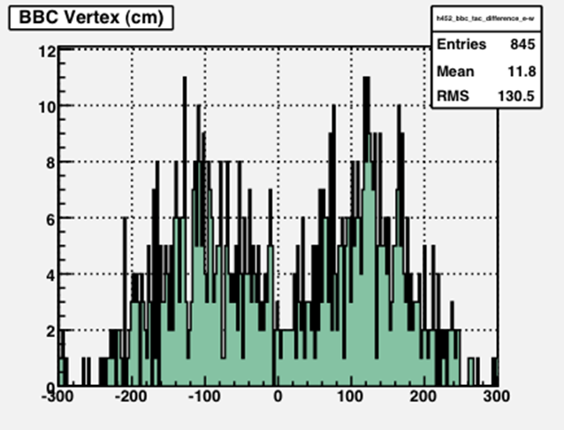
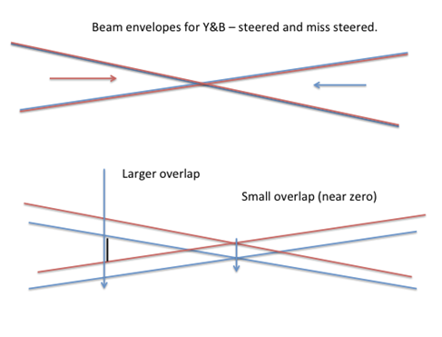
HFT PXL First Low Luminosity Run
Friday May 16, 2013 (Plots Flemming Videbaks)
Thanks to CAD for the work with the beam mis-steering! (We will request again [Thursday?])
The ZDC rates were ~4.2kHz
The detuned beam have the BBC distribution shifted to large |z| (arising from the z-dependence of the beam profile due to the small beta* (~0.8)?)
Note to CAD: Soon we will be requesting 10 min period at the end of fill where one beam is dropped…

