Slide 1
Take 5 for Safety
Electrical Safety for Non-Electrical Workers
Picture of the Week
Collider-Accelerator Department
5-21-2013

Slide 2
Overview
Just because you aren’t an electrician or electrical worker does not mean that you are exempt from electrical hazards
Painters, tree trimmers, industrial machine installers, and others have all been killed from electricity
This electrical safety topic is designed to increase awareness among workers who are not considered electrical workers because the hazards are potentially higher for them

Slide 3
Fatalities, 2003- 2010, Over 65% of Workers In The Selected Occupational Group Who Died Were NOT Electrical Workers
Occupational Groups Selected Occupations |  | Total
Construction Trades Workers Electricians Construction Laborers Roofers Painters, construction and maintenance Carpenters | 300 146 43 39 32 | 642
Installation, Maintenance, and Repair Occupations Electrical Power-Line installers and repairers Industrial Machinery Installation, Repair, and Maintenance Workers Heating, Air Conditioning, and Refrigeration Mechanics and Installers Telecommunications Line Installers and Repairers | 132 71 55 24 | 366
Grounds Maintenance Workers Tree Trimmers and Pruners Landscaping and Groundskeeping Workers | 79 29 | 113
Transportation and Material Moving Occupations Drivers/Sales Workers and Truck Drivers Material Moving Workers | 50 44 | 108
Other Management Occupations |  | 76
Agricultural Workers |  | 43
Subtotal Percent of Electrical Workers | 1044 44% | 1348 34%
Source: Electrical Safety Foundation International
Notes:
Emphasis on the fatalities of non-electrical workers.

Slide 4
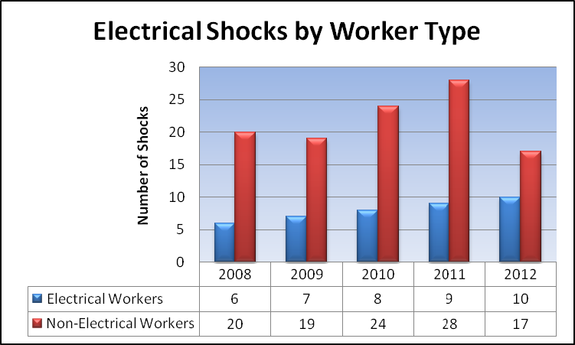
DOE Shock Statistics

Slide 5
Causes of Shocks
Faulty Equipment
Attention to Task
Overhead power lines
Plugging and unplugging equipment
Situational Awareness
Inadequate procedures
Lack of training/qualification for assigned task
Scope creep
Inadequate Planning
Inadequate/untested PPE
Lack of preventive maintenance

Slide 6
Some Lessons Learned
Look before you leap
Is the equipment listed by a Nationally Recognized Testing Lab such as UL, or otherwise approved?
Are there hidden hazards that your work may inadvertently access during your activity?
Routine activities – plugging and unplugging equipment, picking up electrical devices, etc. require that you pay attention to what you are doing

Slide 7
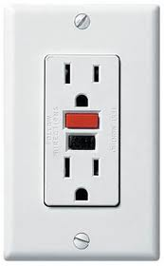
Some Lessons Learned
Use a GFCI for additional protection, especially when working outdoors or in damp/wet locations
Many DOE sites require a GFCI be used with portable power tools
The Consumer Product Safety Commission believes that GFCI receptacles are responsible for saving thousands of lives since they became required in residential and commercial buildings
GFCI receptacles limit the potential current to a safe value – if you get shocked, you still need to report it, but you won’t be seriously injured
Garages are another place you should always use a GFCI
TEST your GFCI’s monthly for operability. While many have fail-safe circuits now, many GFCI receptacles have been in use for 15 or 20 years, and may not function as designed

Slide 8
Summary
Remember – just because you aren’t an electrician or an electrical worker, electricity can still find – and kill – you or a coworker
Maintain a healthy respect for the electrical equipment you use
Pay attention to seemingly low-risk, routine activities
People are shocked, sometimes severely, when plugging and unplugging equipment from wall outlets and power strips
Maintain your electrical equipment
Test your GFCI receptacles
Look at your power tool cords for signs of wear before each use

Slide 9
