Slide 1
Time Meeting May 28, 2013
Agenda
Safety
Schedule
Machine and system reports

Slide 2
Safety and training
Ed Lessard

Slide 3
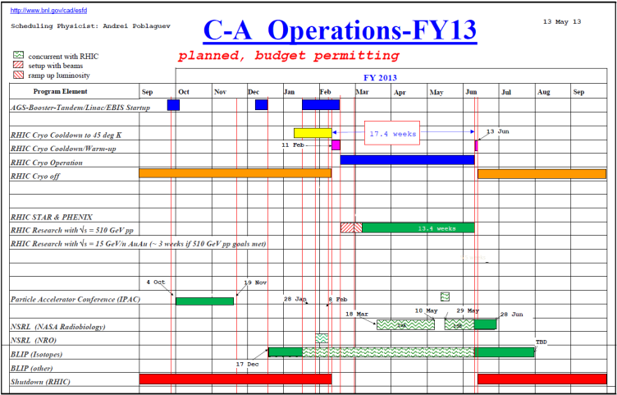
Schedule
BLIP Run continues
RHIC run Physics
(beam optimization continues)
May 29: NSRL Run 13B begins
May 30: APEX for 5.86 GeV protons
June 10: End of RHIC Run

Slide 4
Schedule for the week
Monday | May 27 | 00:00 - 24:00 | Run Physics*
Tuesday | May 28 | 00:00 - 24:00 | Run Physics*
Wednesday | May 29 | 00:00 - 24:00 | Run Physics* | Beam development studies (4 hour)
Thursday | May 30 | 00:00 - 08:00 08:00 – 24:00 | Run Physics* APEX | 5.86 GeV protons tests
Friday | May 31 | 00:00 - 24:00 | Run Physics*
Saturday | June 1 | 00:00 - 24:00 | Run physics*
Sunday | June 2 | 00:00 - 24:00 | Run Physics*
Monday | June 3 | 00:00 - 24:00 | Run Physics*
Tuesday | June 4 | 00:00 - 24:00 | Run Physics*
* 8-hour stores, Beam optimization between stores

Slide 5
Machine and system reports
RHIC pp Run13 Vahid Ranjbar
STAR Martin Codrington
PHENIX Hubert van Hecke
BLIP Leonard Mausner
AGS Haixin Huang
Operations Peter Ingrassia
RCF Michaels Ernst

Slide 6
Next Time Meeting
Next Time Meeting: Tuesday, June 4
1:30PM, Snyder

