Slide 1
STAR Operations Status Report Time Meeting 05/28/2013
M.J.M. Codrington
STAR Period Coordinator
HFT PXL commissioning on-going: low-lumi run 1hr at the end of fill once/day

Slide 2
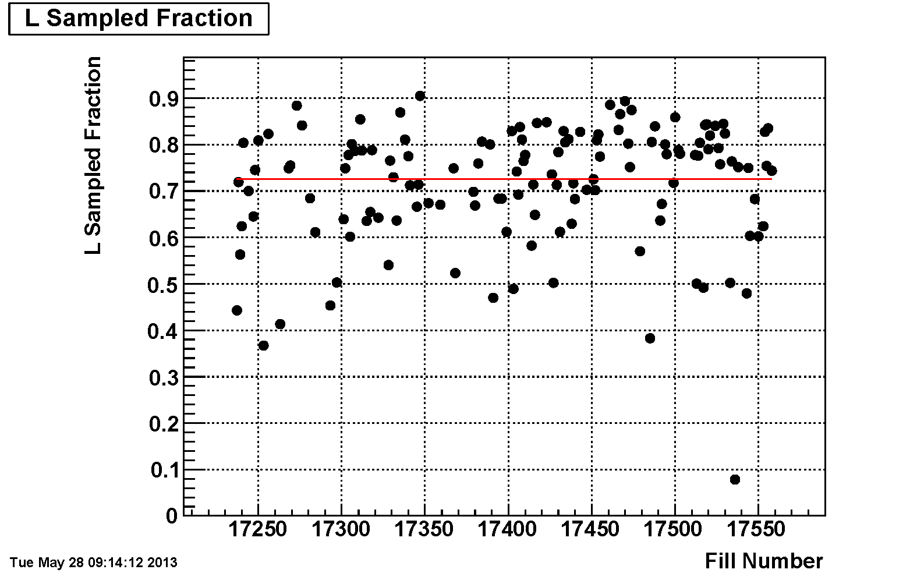
Sampling Eﬃciency
Average: 72.6% (-0.4% since last Time Meeting)

Slide 3
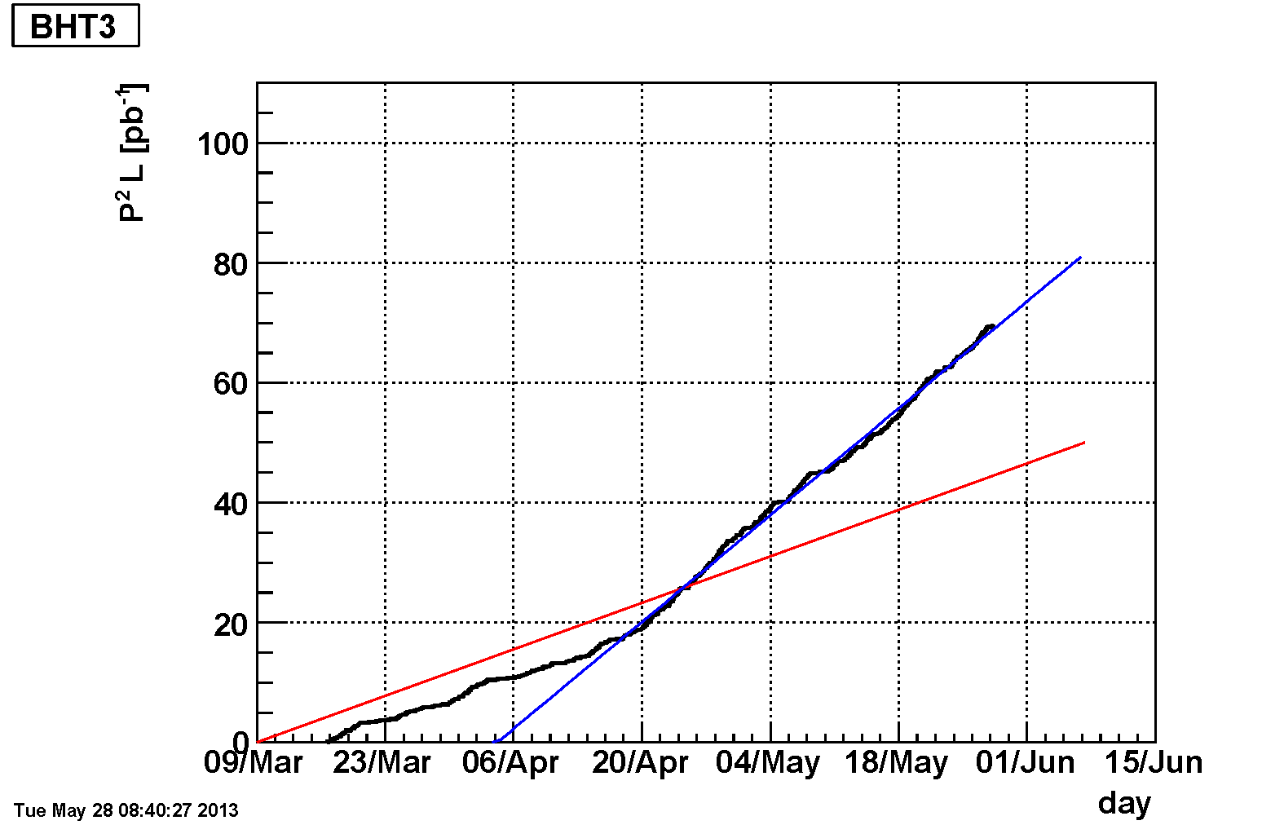
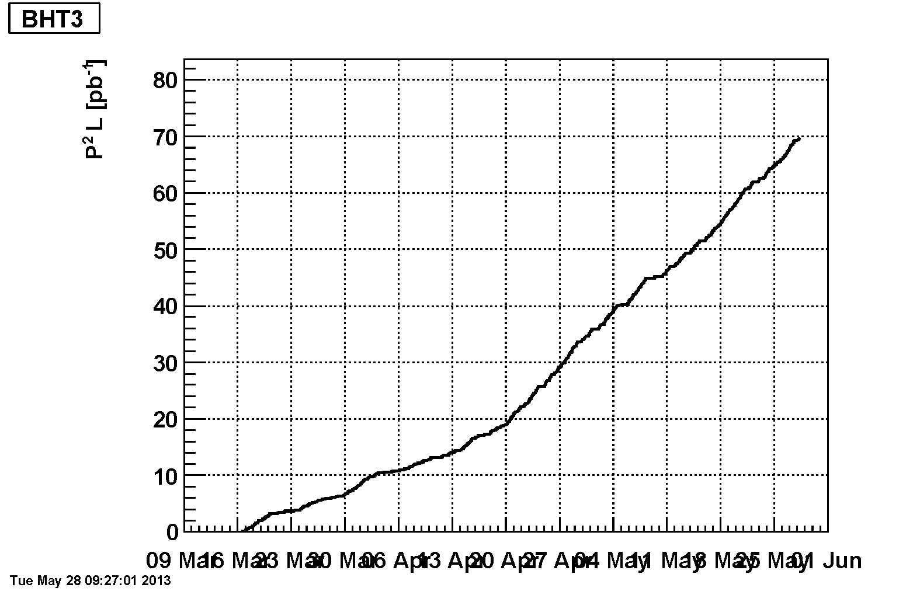
BHT3 (Single Spin Asymmetry)

Slide 4
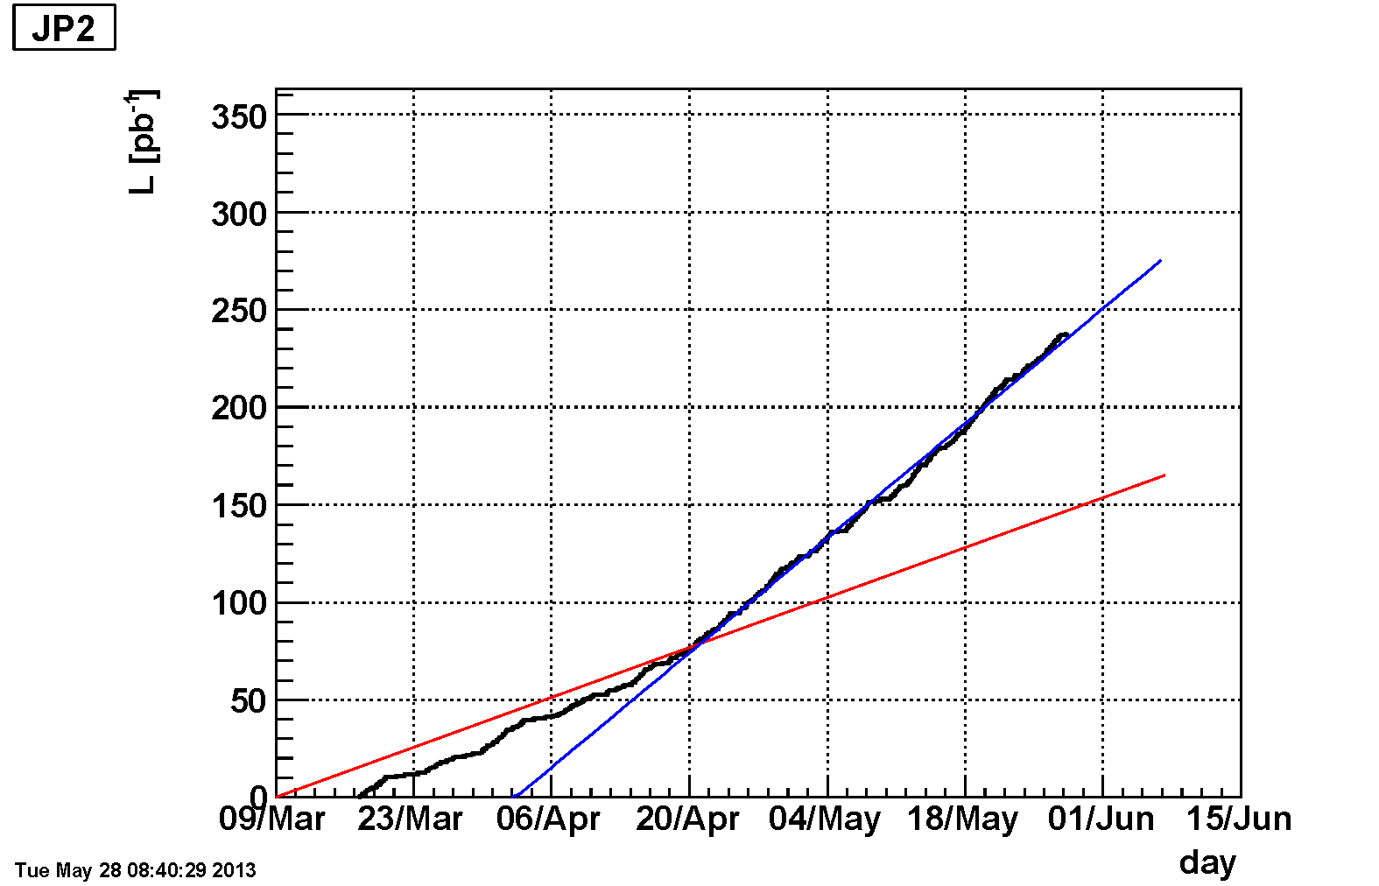
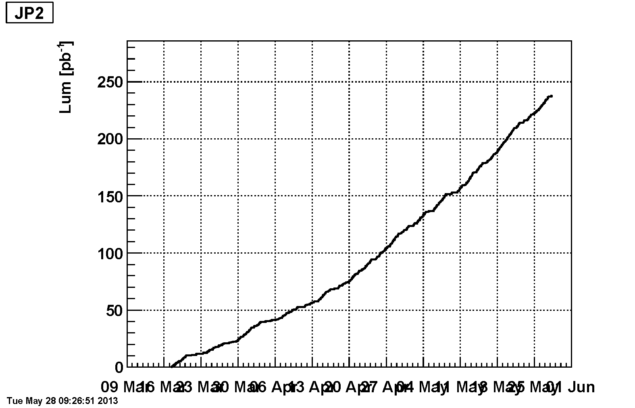
JP2 (Double Spin Asymmetry)

