Slide 1
Take 5 for Safety
J-PARK Event
Lessons Learned from Our Past
Collider-Accelerator Department
5-28-2013

Slide 2
Event at J-PARK
In the Hadron Experimental Facility, experiments were conducted with the elementary particles that had been generated by irradiating gold target with proton beams
The proton beam was extracted from the main ring (MR) within much shorter time than the normal operation due to the malfunction of the beam extraction system and the gold target was bombarded with very short pulsed beam
As a result, it was suspected that the beam spot of the gold target had been heated up spontaneously and the part of the gold target had sublimed
Radioactive materials that had been generated with proton beam irradiation leaked to the experimental hall and the experimenters in the hall were exposed to the radiation
The number of personnel who entered radiation controlled area and got close to the equipment was 55
All the accelerators and experimental facilities at J-PARC are shut down until further notice
The measurements of radiation exposure are being carried out for the experimenters and the maximal exposure was 1.7 mSv (17 mrem) so far
The contamination in the Hadron Hall is roughly 30 Bq/cm² (180,000 dpm/100 cm²)

Slide 3
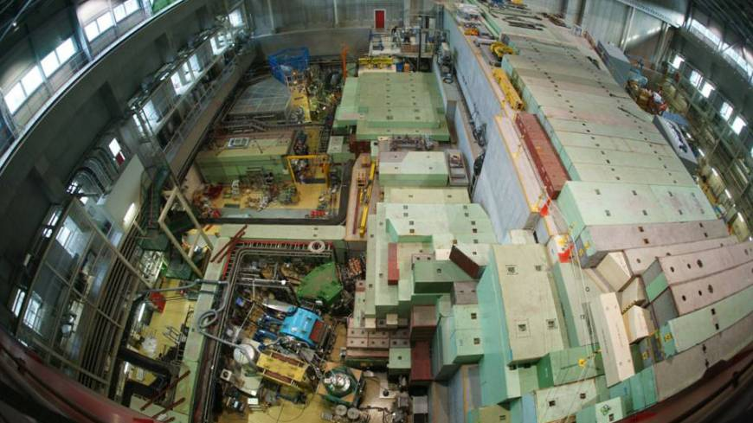
Ground Zero: The facility from which unnamed radioactive substances leaked during a nuclear experiment in Tokai, Ibaraki Prefecture, is shown in this undated photo. JAPAN ATOMIC ENERGY AGENCY/KYODO

Slide 4
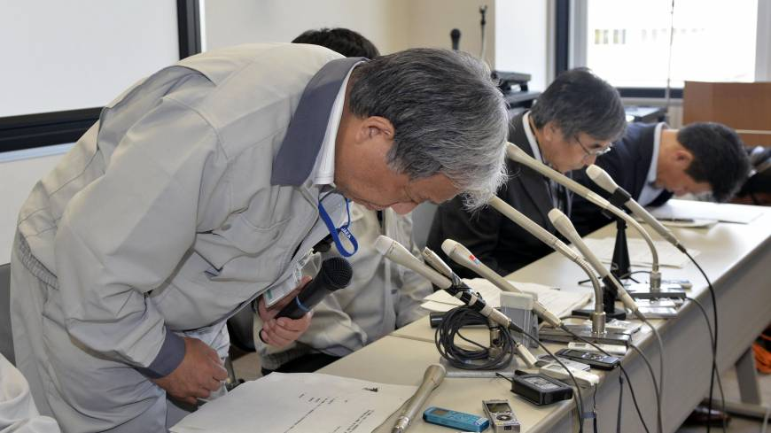
Ritual Regret: Japan Atomic Energy Research Institute chief Satoru Kondo apologizes at a news conference Saturday in the village of Tokai, Ibaraki Prefecture. KYODO

Slide 5
Some Lessons Learned from 1995 AGS Event
On March 17, 1995, the B5 target broke during a high intensity proton-beam run due to repeated thermo-mechanical stresses from the pulsed beam
On March 27, 1995, it was discovered that the gate leading to B5 target was contaminated at about 80,000 dpm/100 cm²
The first two sections of the five-section target broke off from the beryllium base; it was hypothesized that repeated expansion and contraction of the platinum target as it was hit 1000 times per hour with high-intensity pulses (25 TP) may have caused it to heat up and break
Daily contamination surveys in the area were set up to detect beta radiation; because pure photon emitters were not detected in the daily smear surveys, it was concluded that the osmium-185 contamination spread from March 17 to March 27
Thirty users were whole-body counted; the highest body burden was about 120 nanoCuries from osmium-185, and the highest dose was about 10 mrem
Lessons Learned: 1) temperature and intensity interlocks on targets; 2) heat transfer calculation and target confinement reviews by Radiation Safety Committee for all new targets

