Slide 1
PHENIX Run-13 status
Hubert van Hecke
for the PHENIX collaboration

Slide 2
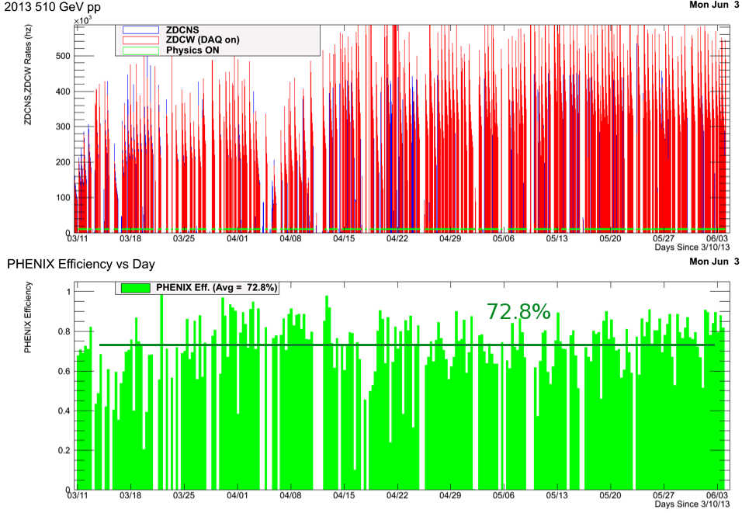
Phenix efficiencies

Slide 3
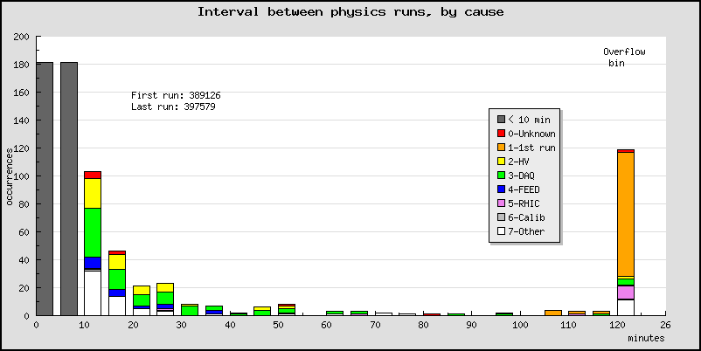
Phenix efficiencies (2)

Slide 4
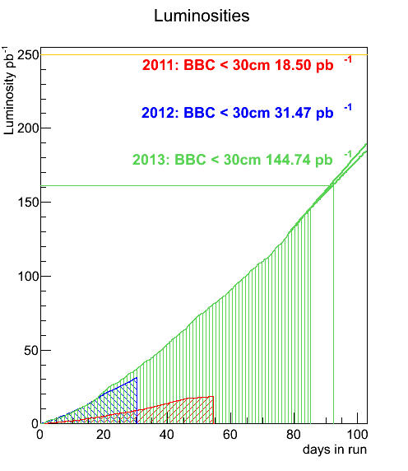
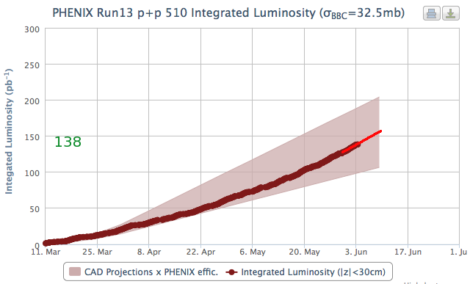
.
. Lumi to date
New target: 160 pb⁻¹

Slide 5
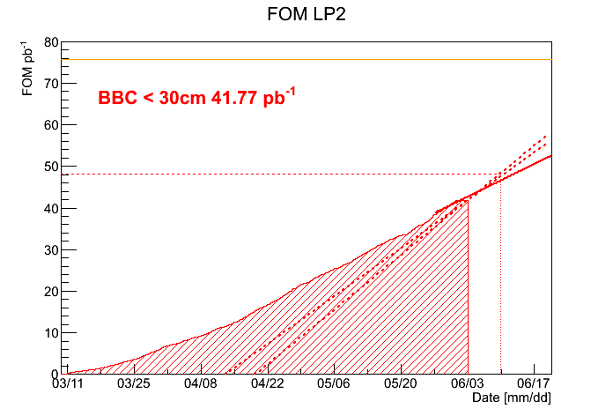
.
Figure-of-merit to date
64% of target

