Slide 1
STAR Operations Status Report Time Meeting 06/04/2013
M.J.M. Codrington
STAR Period Coordinator

Slide 2
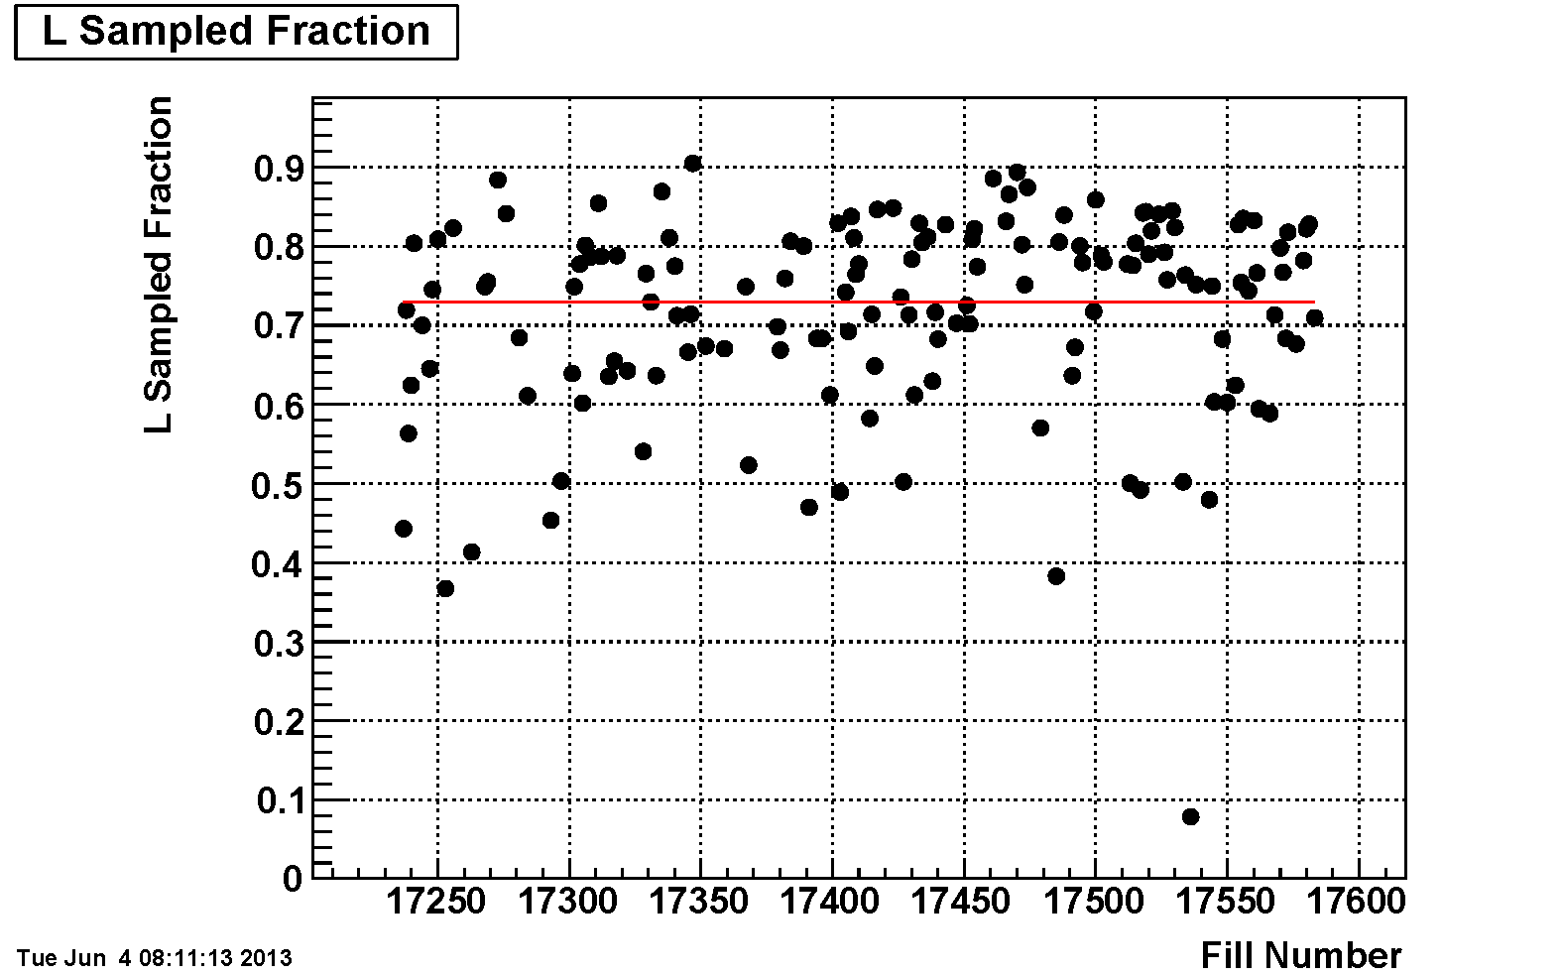
Sampling Eﬃciency
Average: 72.9% (+0.3% since last Time Meeting)

Slide 3
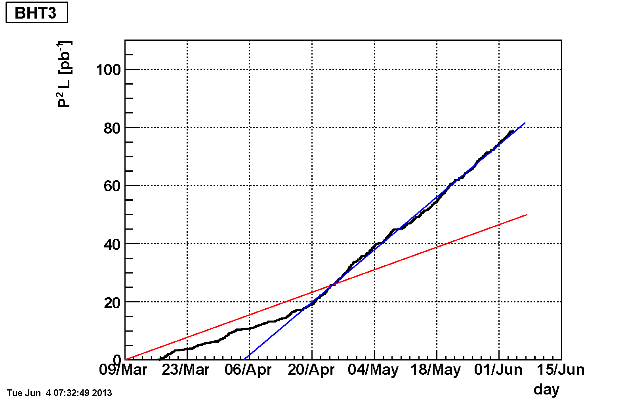
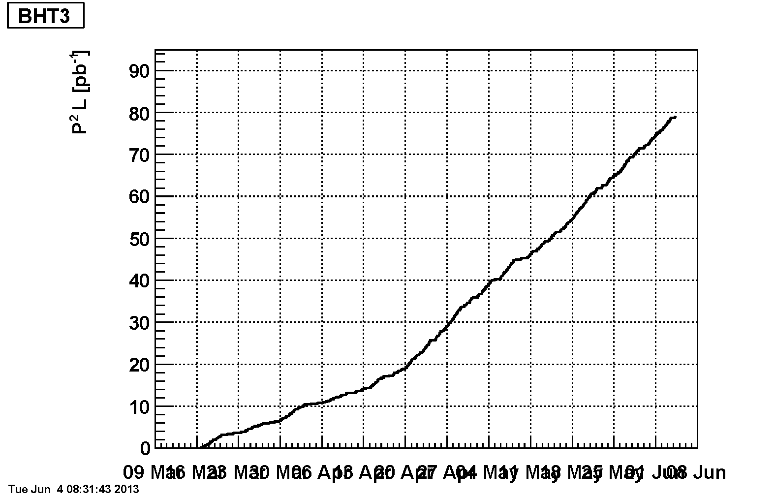
BHT3 (Single Spin Asymmetry)

Slide 4
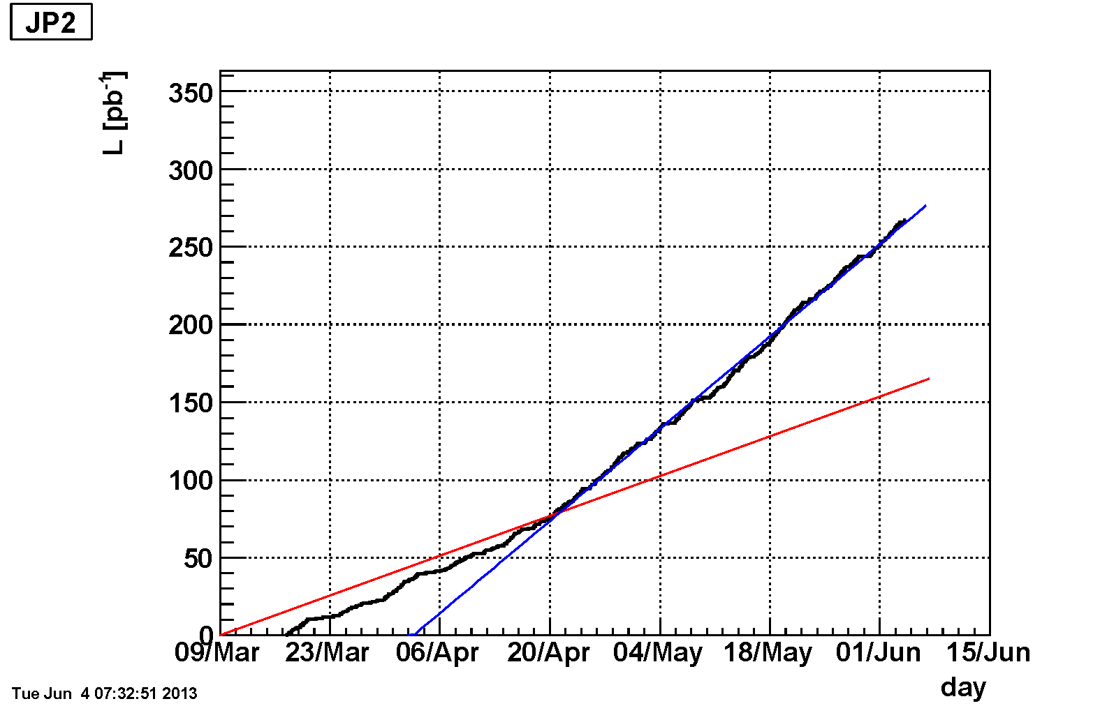
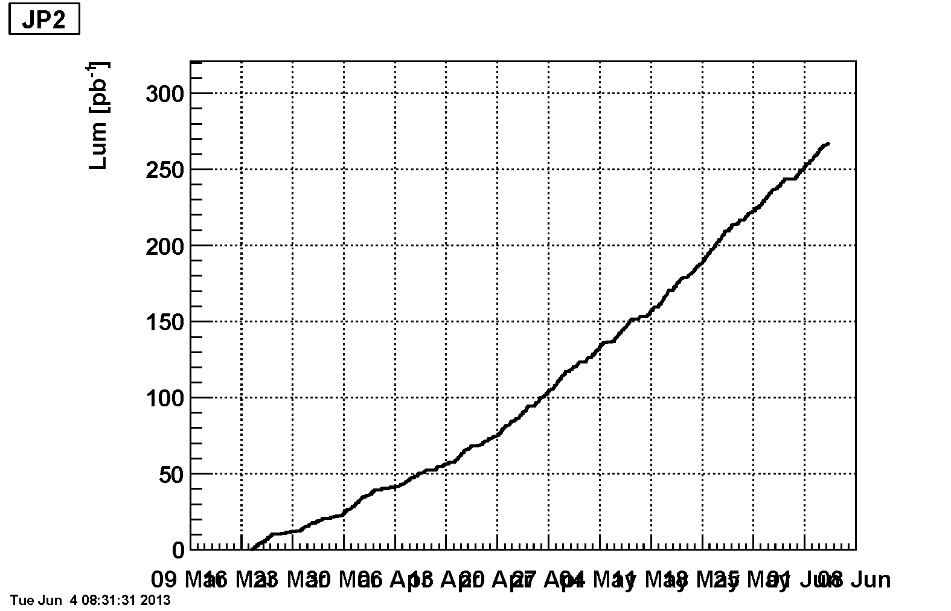
JP2 (Double Spin Asymmetry)

