Slide 1
CeC PoP Experiment
July 28, 2020

Slide 2
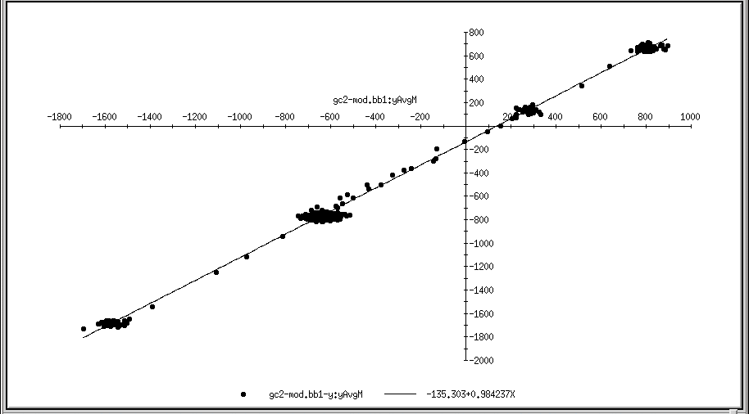
Current Status
We found offsets for the electron BPMs corresponding to the hadron beam on axis
We have measured electron beam emittance with common section solenoid. Normalized emittances are 2.6 mm mrad for each plane (requirement < 5 mm mrad)
We found laser phase oscillations with 0.25 Hz frequency and working on its elimination
Power dip damaged oscilloscope (will be replaced)
Thursday dedicated shift was interrupted by gun vacuum fault

Slide 3
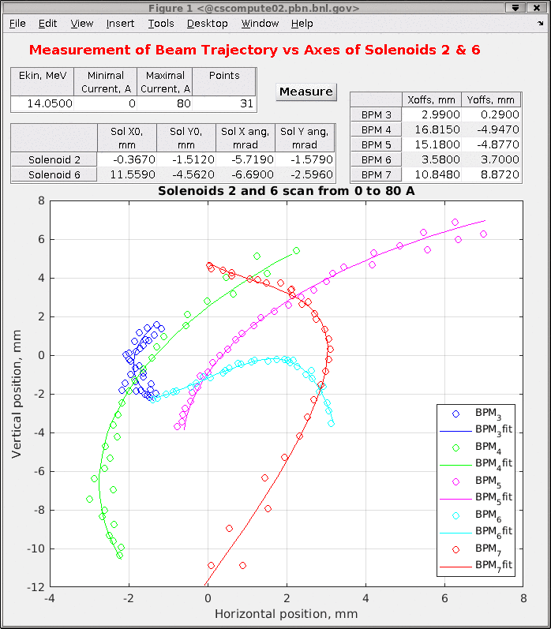
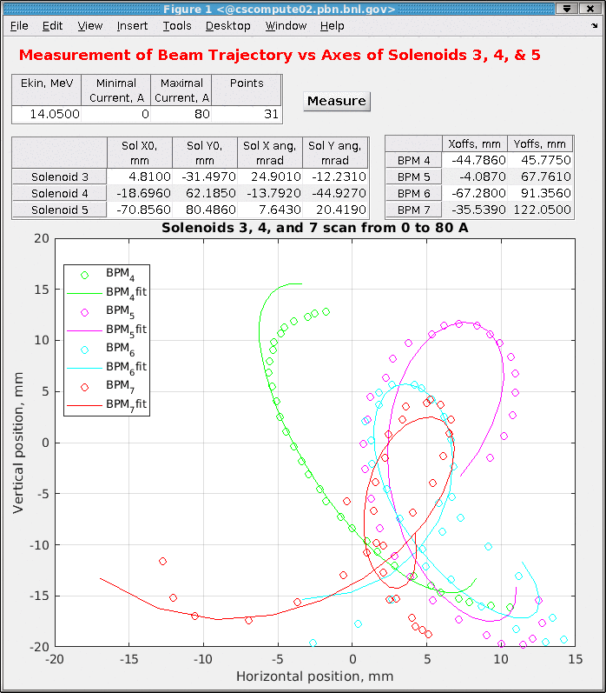
Solenoid BBA for the family

Slide 4
Near Future Plans
Align orbit of the hadrons and electrons in the common section
Continue work on beam (setting PCA lattice and hadron imprint observation)

