Slide 1
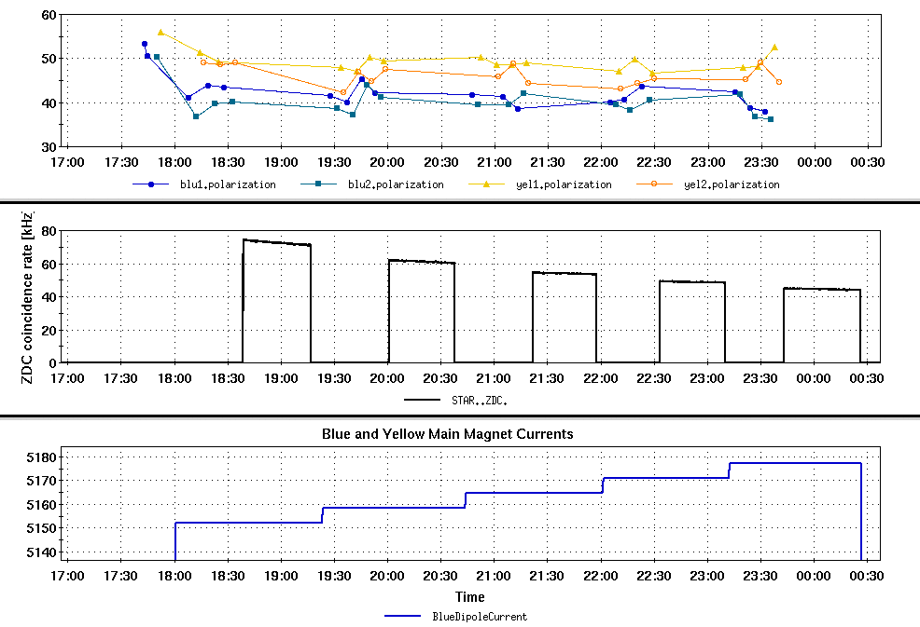
RHIC Run 22 Run Status 1/4/2022
RHIC Energy Scan
Operation continue with partial blue snake at bi9
Energy scan for stable spin direction
Change to 254.21 GeV
General RHIC performance
Plans

Slide 2
RHIC Store energy scan : Fill 32920
RHIC Energy Scan
Energy scan fill 32920:
Gg=485 to 487 (nominal flattop is Gg=487)
Goal was to measure rotation of stable spin direction at STAR and the pC polarimeters to minimize longitudinal component
Address both the intrinsic non-vertical spin direction resulting from a partial snake in blue and residual spin tilt from orbit imperfections (present in blue and yellow)

Slide 3
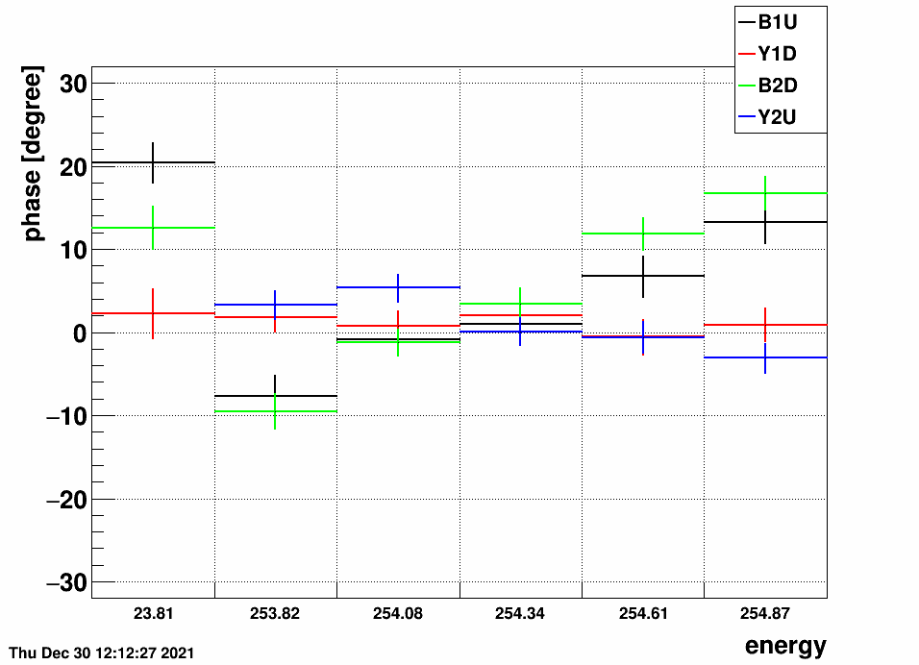
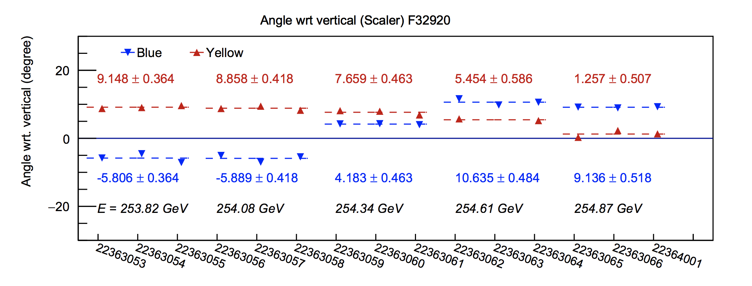
RHIC Store energy scan : Fill 32920
Transverse tilt angle measured as a function of energy at both pC and STAR
Minimum transverse component at both pC and for blue beam at STAR near 254.2 GeV.
Remaining residual in yellow, particularly at STAR
Running with this energy since fill 32934
Constant asymmetry implies that the rotation is not between radial and longitudinal (to within uncertainties)
Not what the accelerator model would predict
Small longitudinal component needs to be verified. Rotator power supplies being prepared tomorrow in prep for a test measurement of spin direction
pC polarimeter
STAR local polarimeter

Slide 4
RHIC Store energy scan : Fill 32920
Transverse spin tilts
Blue
pC |  | STAR
Energy GeV: 255 | 254 | 255 | 254
Angle (deg): 18 | 0 | 5 | 0
Yellow
pC |  | STAR
Energy,GeV : 255 | 254 | 255 | 254
Angle(deg) -1 | 5 | 5 | 7

Slide 5
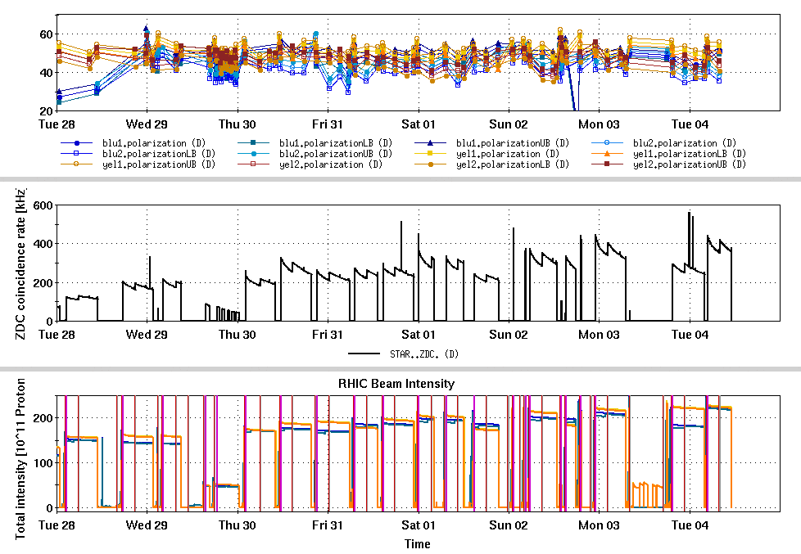
RHIC Performance
Luminosity increasing to required levels
Emittance control
AGS to RHIC transfer improvements
Ramp chrom adjustments
Polarizations 45-50%
Similar in blue and yellow (!)
Still polarization loss in injectors, low P0 (inferred polarization at zero emittance)

Slide 6
Plans
Rotator power supply preparation tomorrow
Likely to have Blue STAR rotators ready after maintenance tomorrow
Preparing a ramp:
Rotators take vertical polarization to longitudinal
An ‘invisible’ longitudinal component rotates into a visible radial component
Complete CeC BBA work this week

