Slide 1
Run 22 APEX Beam Time Request
Coordination Meeting, Jan. 11, 2022

Slide 2
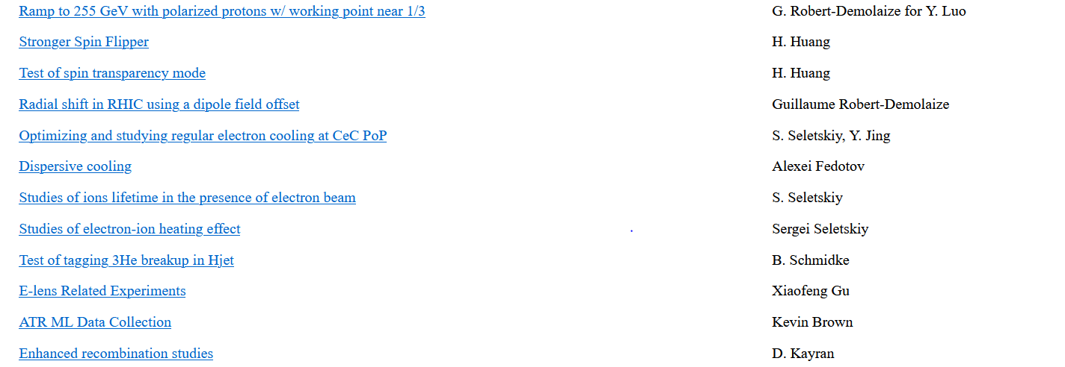
Proposal List for Run 22
https://www.c-ad.bnl.gov/BeamEx/

Slide 3
Proposal | Spokesperson | Beam time request (h)
Radial shift test in RHIC | Guillaume | 32
E-cooling with CeC PoP | S. Seletskiy, Y. Jing | 22
Dispersive cooling | Alexei Fedotov | 18
Ion lifetime in presence of electrons | S. Seletskiy | 16
Electron-ion heating study | S. Seletskiy | 16
Tagging 3He breakup in H-jet | B. Schmidke | 10
E-lens experiments | X. Gu | 30
Test of spin transparency mode | H. Huang | 18
Stronger Spin Flipper | H. Huang | 10
ATR ML Data collection | K. Brown | ( 8, ATR)
Enhanced recombination study | D. Kayran | 4
Ramp to 255GeV with near 1/3 working point | Guillaume | 20 (?)
Total : ~180 hours

Slide 4
Readiness:
1) LeREC related experiments:
Per Alexi, for LEReC-based experiments we are waiting on 3.85GeV Au setup in RHIC.
Once Au setup in RHIC is developed, we would like to request 5 hours to check electron beam
in cooling sections, establish high-current running and establish cooling with new RHIC RF setup.
After cooling is successfully established, we should be able to request time for LEReC-based cooling experiments.
2) E-lens related experiment:
Per Xiaofeng, “ Elens is not ready until now. Will check tomorrow.”
3) Radial shift test and ramp development near 1/3 tunes
Per Guillaume, “Regarding both the Radial Shift and 255 GeV 1/3 tune experiments: both of these require extensive lattice and ramp development setup, which had to take a backseat to solving Run22 issues. I am reviewing what we have now and what remains to be done.”
We will have an APEX bi-weekly meeting on Friday, where we will look int possibility to have an APEX session on Jan. 19.

