Slide 1
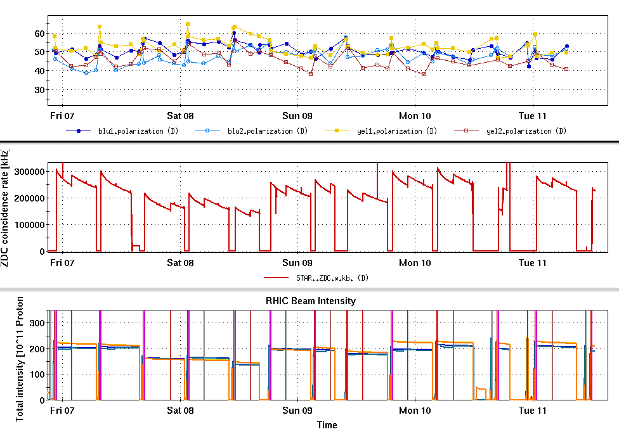
RHIC Run 22 Run Status 1/11/2022
Operation continues with partial blue snake at bi9
Energy 254.21 GeV (modified for stable spin direction)
Peak luminosity is about 60% of target
Recent lumi limitations
Loss on blue snake early in ramp
Erratic blue injection lifetime
Polarization in both rings 45-50%
Run 17 average was 55%
Rotator based check of stable spin direction at STAR planned for Thursday.
Low lumi fills for
detector commissioning

Slide 2
H-Jet measured beam polarization
Low lumi fills for
detector commissioning
Run 17 avg

Slide 3
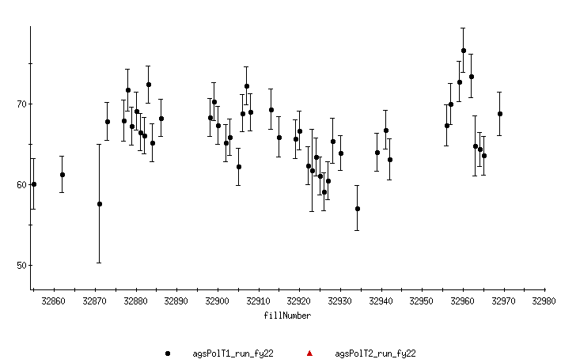
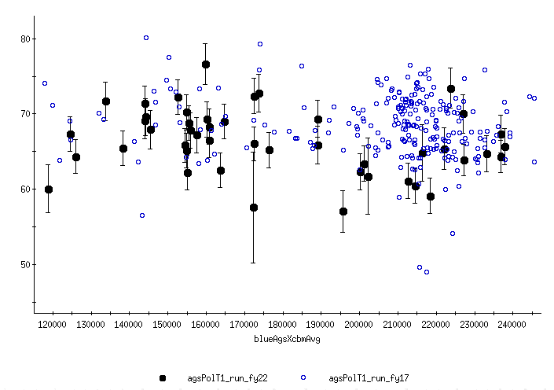
AGS Polarization by Fill
AGS Polarization by Intensity (Run 22 and Run 17)
Run 22
Run 17

