Slide 1
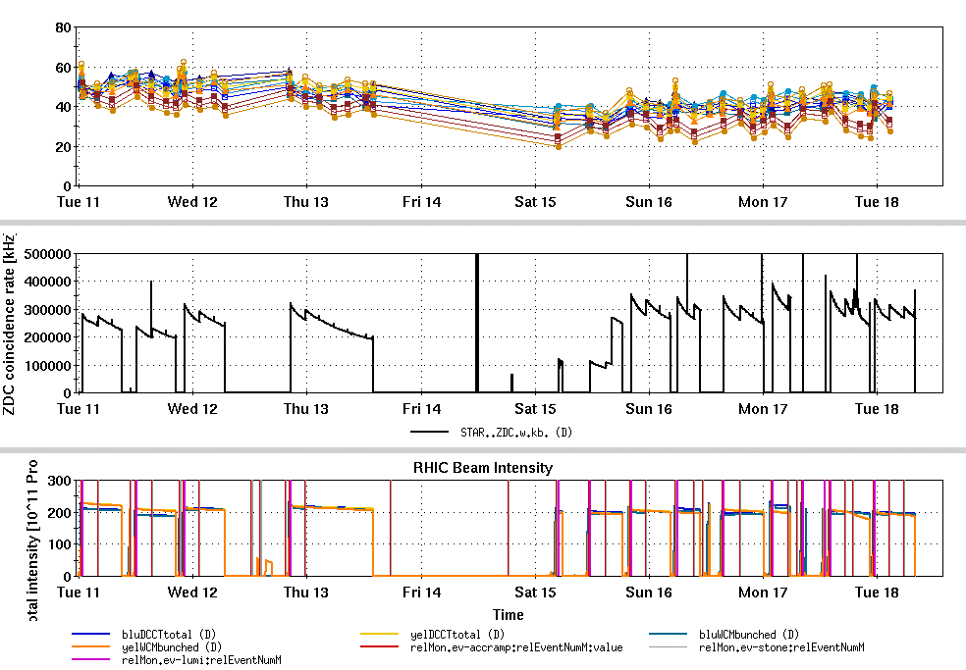
RHIC Run 22 Run Status 1/18/2022
AGS Siemens motor generator failed evening Wed Jan 12
Investigation of the extent of the equipment damage continues
Switch to Westinghouse motor generator
Beam back at AGS extraction evening of Jan 14, RHIC stores back by morning of Jan 15.
Factor of 2 slower ramp rate
Polarization with Westinghouse:
AGS 56%, without tune jump quads
At 2.2 x 10¹¹ per bunch
RHIC: low 40%’s
Rotator based check of stable spin direction at STAR planned for Thursday.

Slide 2
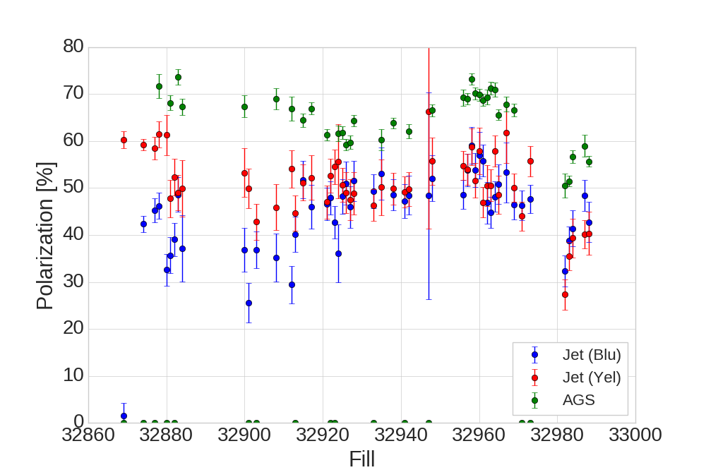
RHIC and AGS polarization (by fill)

Slide 3
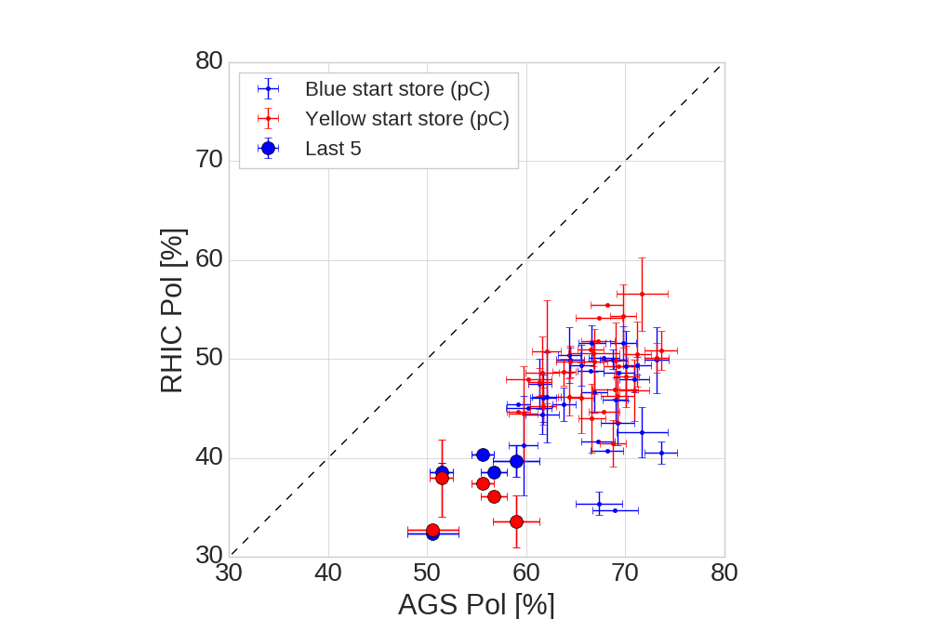
RHIC and AGS polarization

Slide 4
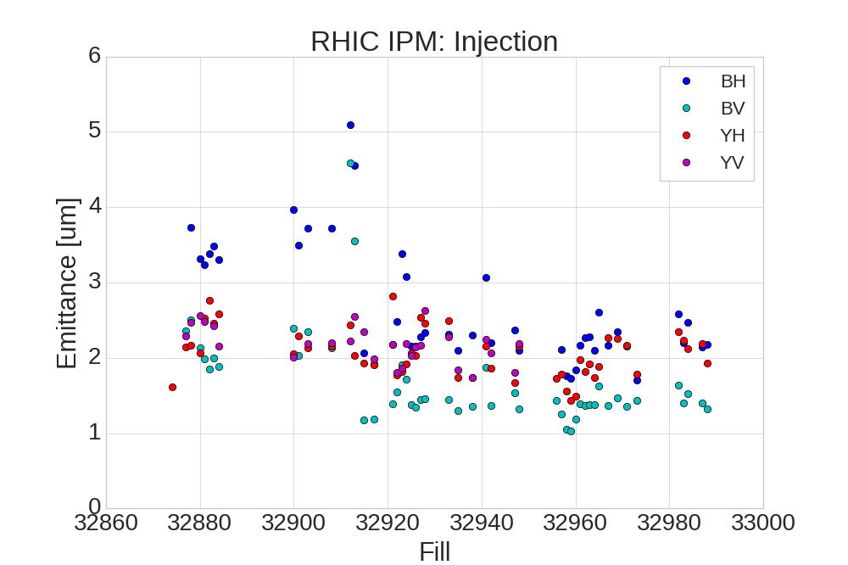
RHIC Injection emittance
Westinghouse

Slide 5
Assessment and plans
Westinghouse last used for pol. protons in Run 13
At the time 2-3% relative drop in polarization at 1x10¹¹
Jump quads more important at lower acceleration rate
Relative gain factor for polarization 1.15 instead of 1.1
Needs power supply work to accommodate long function
Priority is to get good jump quad functioning today
Activities for polarization development
Test ramp without tune meter excitation (todyay - emittance improvement? Polarization?)
Ramp orbit imperfection tests (RHIC polarization transmission)
Still need to do other tasks (in addition to polarization recovery):
Rotator check of STAR spin direction (tomorrow, Wed 1/19)
AGS Au setup (Friday 1/21, 0800-2000)
Low luminosity stores for STAR calibrations (tentatively this weekend).

