Slide 1
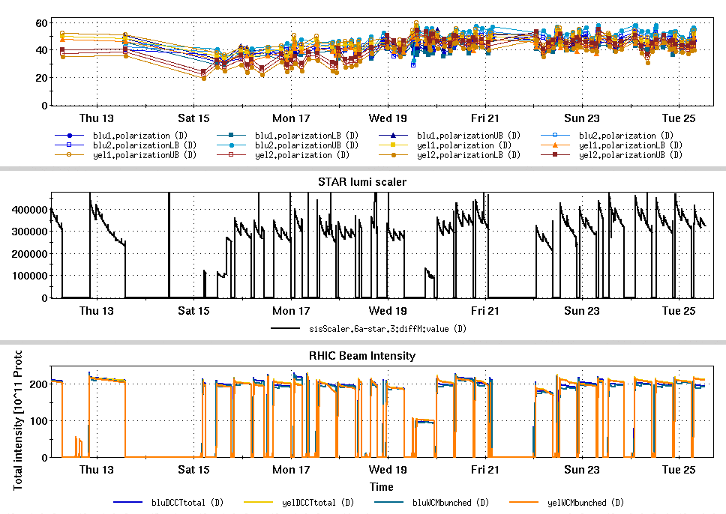
RHIC Run 22 Run Status 1/25/2022
Recovery from switch to Westinghouse
3-4 days to get back to similar collider performance
Moved the first beta squeeze from 1.5 -> 1.2 m immediately to start of store to gain peak lumi
Squeezing to 1 m at 3 hr mark.
Stop gap measure to increase luminosity while we work on emittance improvements
Jet dissociator cooling problem to be addressed on Wed maintenance
No Jet data for these fills, pC operating and scaled to Jet
Au to flattop (12 bunches) for CeC dedicated physics program (Fri 1/21)
Westinghouse changeover
Rotator test
Au ramps for CeC

Slide 2
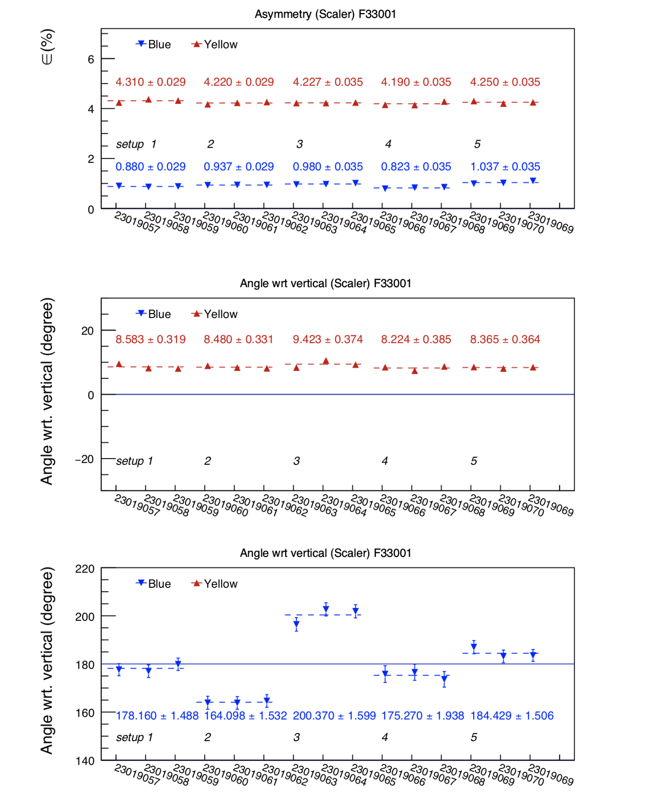
Spin rotator test
Rotator based check of stable spin direction Wed Jan 19th
Showed a vertical component to the spin direction with the rotators on
Implies an (invisible) longitudinal component of about 5% in the normal physics mode (rotators off)
Plans to use rotators to correct the residual longitudinal component
Yellow rotators being prepared for similar check
Pure vertical component with rot on
Implies longitudinal component with rot off

Slide 3
