Slide 1
CeC PoP Experiment
February 1, 2022

Slide 2
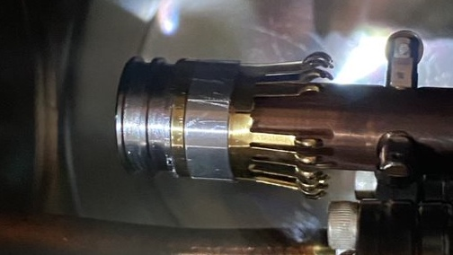
CeC Operation
Alignment of IR optics on bolometer was adjusted
Cathode was changed during maintenance day but we experienced significant problems with gun. Attempts to condition it were unsuccessful.
On Monday we withdraw the cathode from the gun and found that two RF fingers are missing. We need to remove the long manipulator and replace end effector (3-4 weeks).
We continue gun conditioning

