Slide 1
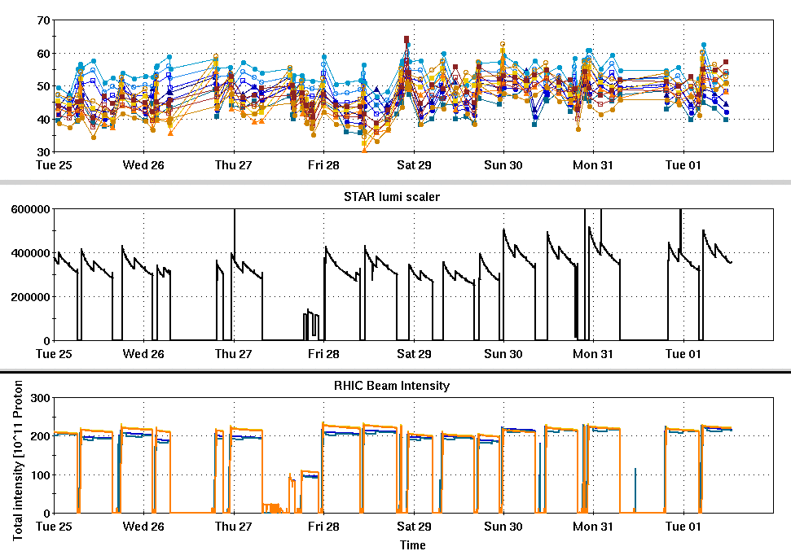
RHIC Run 22 Run Status 2/1/2022, V. Schoefer
Stores with immediate beta squeeze from 1->1.2 m now meet per store STAR lumi goals (last 5 fills)
Improvement largely due to injection efficiency improvement
Inj efficiency still just about 90% with many adjustments and large injection bumps (should be >95% with protons without any closed orbit adjustment)
RHIC injection kicker angle appears to be low, yellow appears to be weakening with time
Thurs Jan 27: Successful measurement of spin direction with yellow rotators on, analysis to infer orientation with rotators off ongoing, plans for corrective measures.
RHIC pC [%]
STAR ZDC [Hz]
RHIC Intensity [1e11]

Slide 2
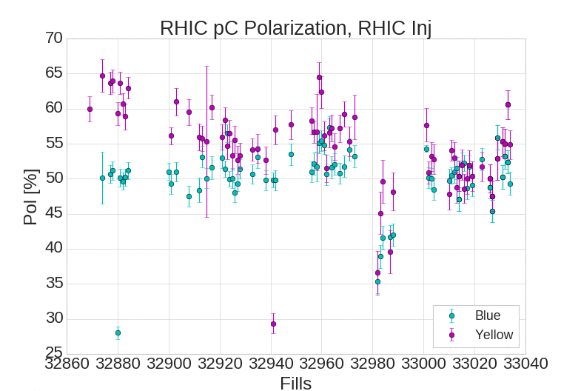
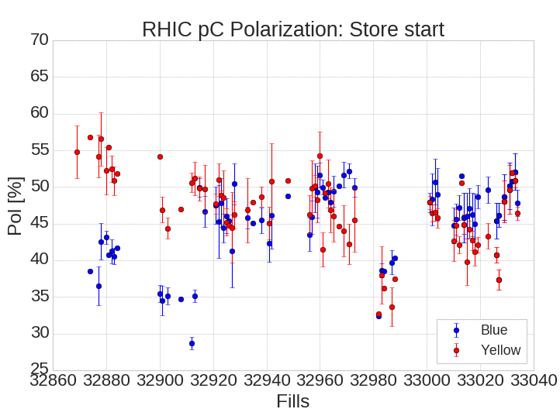
RHIC pC polarizations

Slide 3
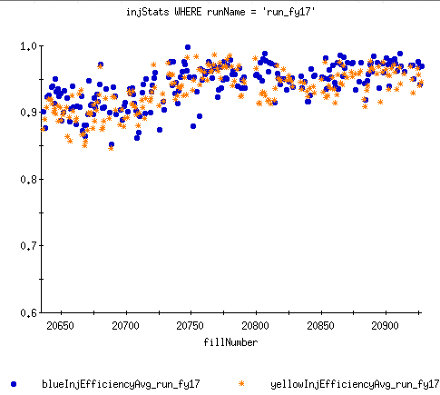
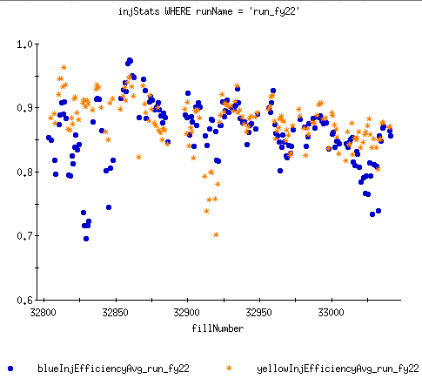
RHIC Injection Efficiencies
RHIC Injection difficult essentially from start of run.
Declining consistently with periodic improvements from rounds of tuning
Most improvements come from changes that reduce necessary injection angle
Run 17
Run 22

Slide 4
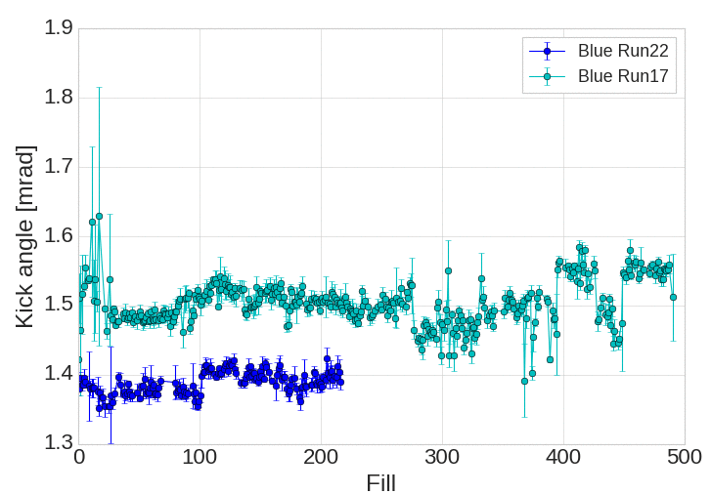
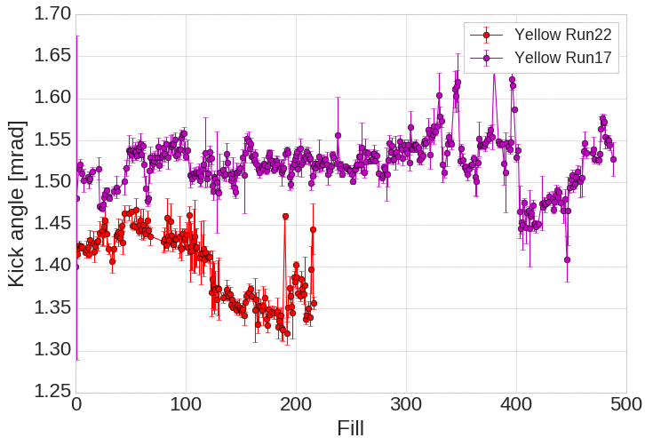
Injection kicker angle
Early run RHIC transverse emittance a factor of two over expectation
Investigated and found both injection kickers lower than expected
Compensation
Recalibration of charging supply chain (around fill #100 in plots)
Installation of injection bumps in closed orbit (both)
Yellow angle has weakened since start of run.
Blue injection efficiency has never been at Run 17 levels (and not improving quickly anymore)
Requires taking more intensity out of AGS, impacts intensity, emittance and polarization in RHIC.
More investigation into causes is ongoing
Possible remediation:
Further closed orbit manipulations (limited by aperture)
One injection kicker = four modules. Two spare magnet modules available. Replacement possible (this week?)
Adjustment of IR6 injection optics to optimize deflection of incoming beam by Q8,Q9

Slide 5
Plans
Analysis of spin orientation at IP6 and calculation of corrections (e.g. small rotator current in physics stores)
Remediating measures for the injection kickers (including possible module replacement)
Imperfection corrections (scheduled for Friday, Feb 4th), aimed at improving RHIC polarization transmission

