Slide 1
CeC PoP Experiment
February 8, 2022

Slide 2
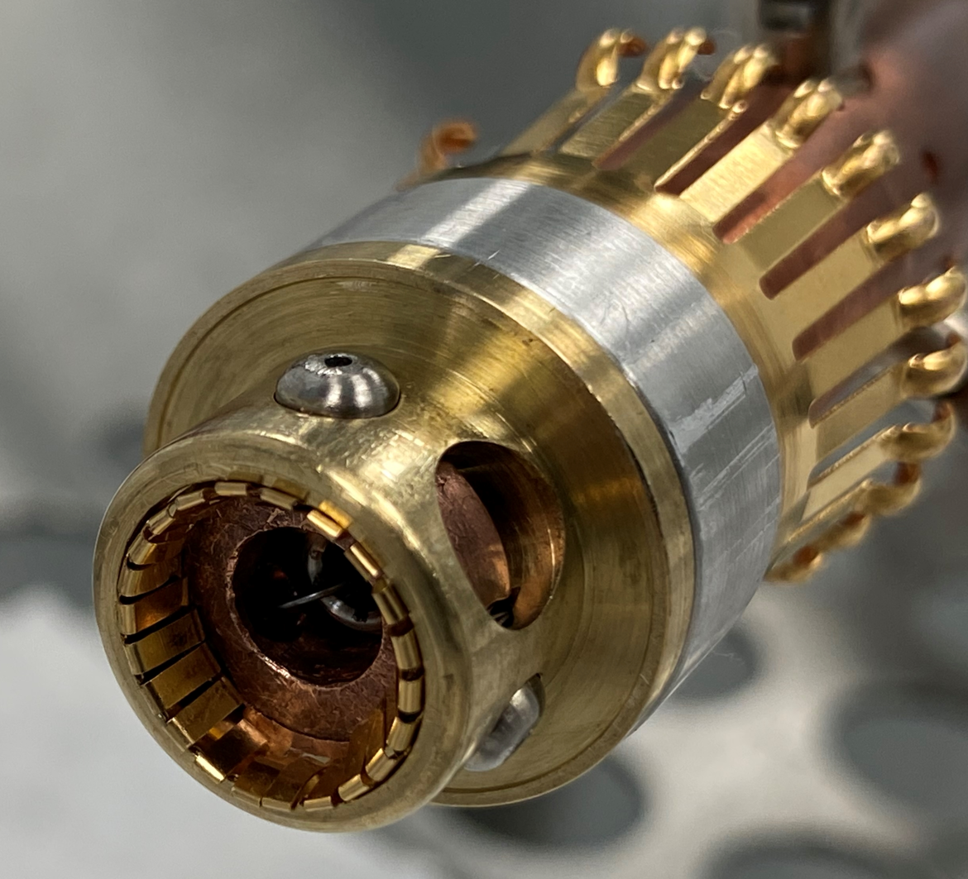
CeC Operation
Gun was conditioned to 1.5 MV in CW and 1.7 MV in pulsed modes
The long manipulator was removed on Friday
We started repairs of the end effector and long manipulator

