Slide 1
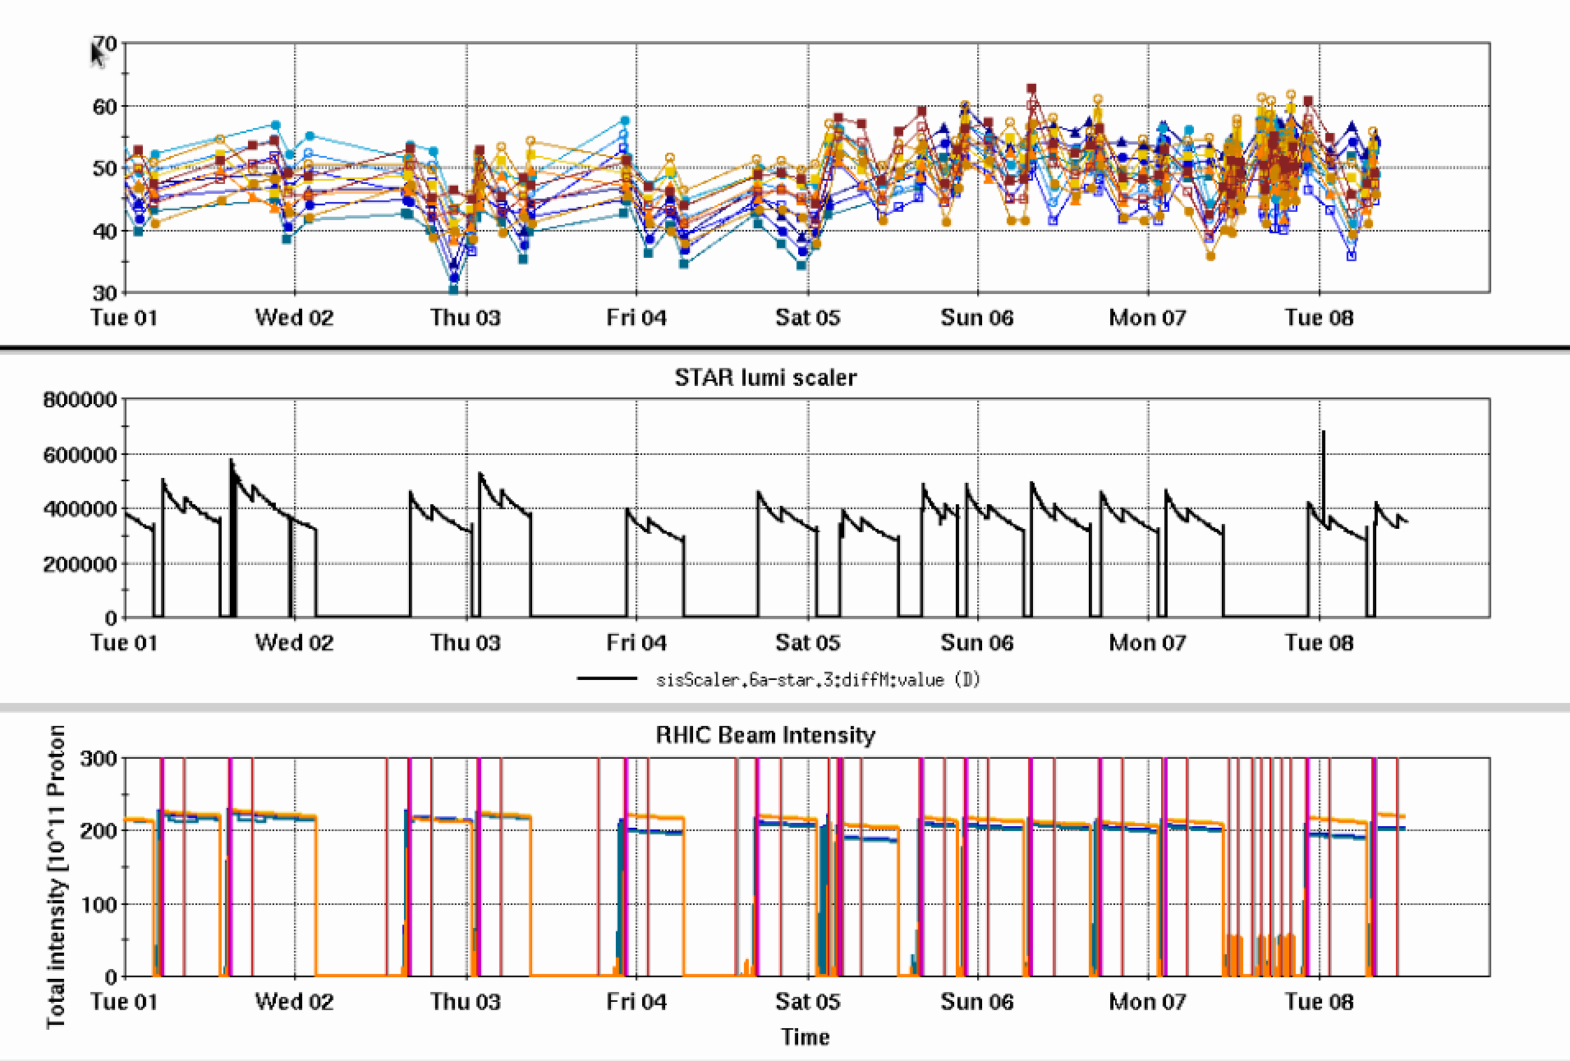
RHIC Run 22 Run Status 2/8/2022, V. Schoefer
Injection kicker ‘low kick’ problem solved
Incorrect terminating resistors installed (40 Ohm instead of 25 Ohm)
Kick angle consistently ~1.55 mrad (similar to Run 17)
AGS jump quad timing drifted
New times generated 2/5
Late acceleration energy looks shifted
Times were only ~2 weeks old, source of drift unclear
Imperfection bump scan yesterday
Targeted closed orbit distortion to improve polarization transmission through the RHIC ramp
RHIC pC [%]
AGS jump quad time update
STAR ZDC [Hz]
RHIC Intensity [1e11]
Booster RF leak
LEReC APEX
CeC/inj kicker
Imp. bump scan

Slide 2
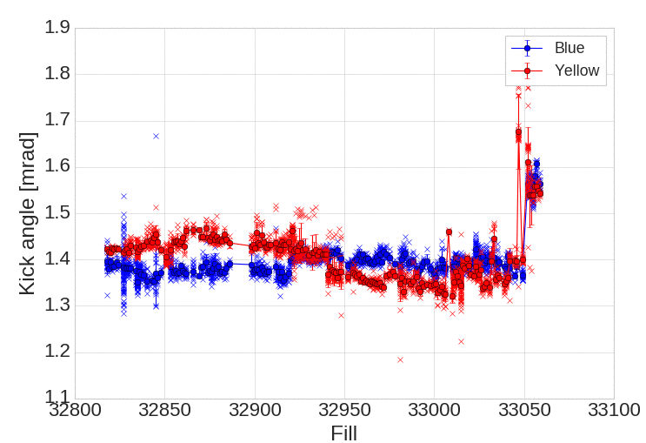
Injection Kicker Angle from TBT orbit
Low energy
APEX

Slide 3
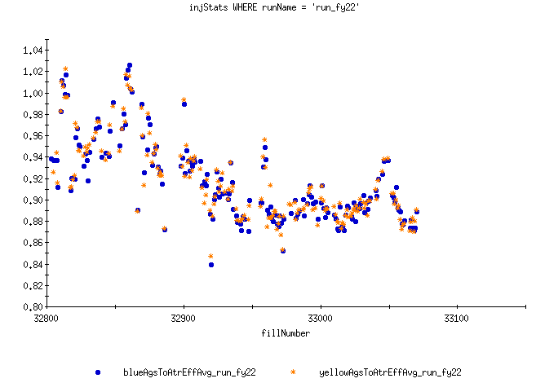
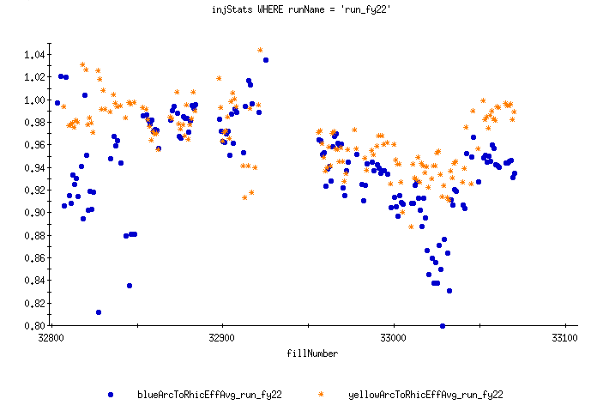
AGS to RHIC Intensity Transfer
X/Y arc to RHIC improved in level and stability since injection kicker resistor change (blue needs work)
AGS to U is still low: working on understanding current transformer calibrations/saturation and possibility of real loss
AGS to U-line Efficiency
X/Y arc to Efficiency

Slide 4
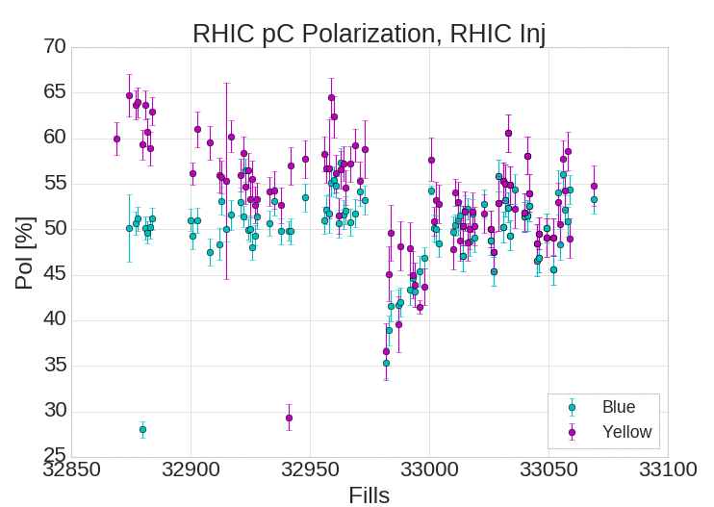
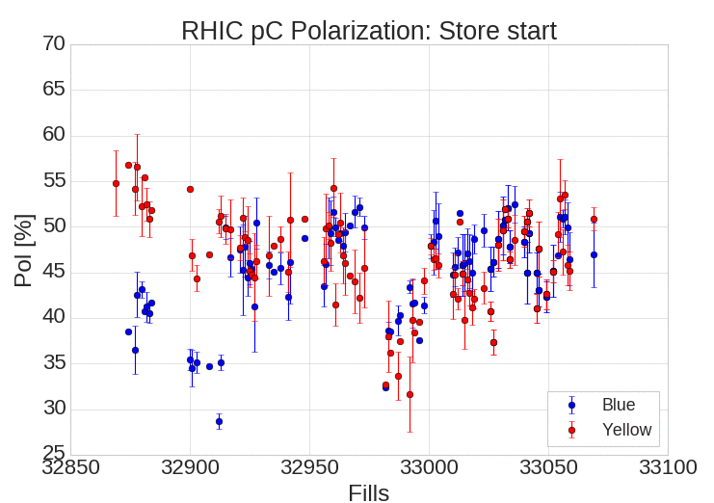
RHIC pC polarizations
Polarization decrease fixed with JQ retiming
Still analyzing what caused the shift

