Slide 1
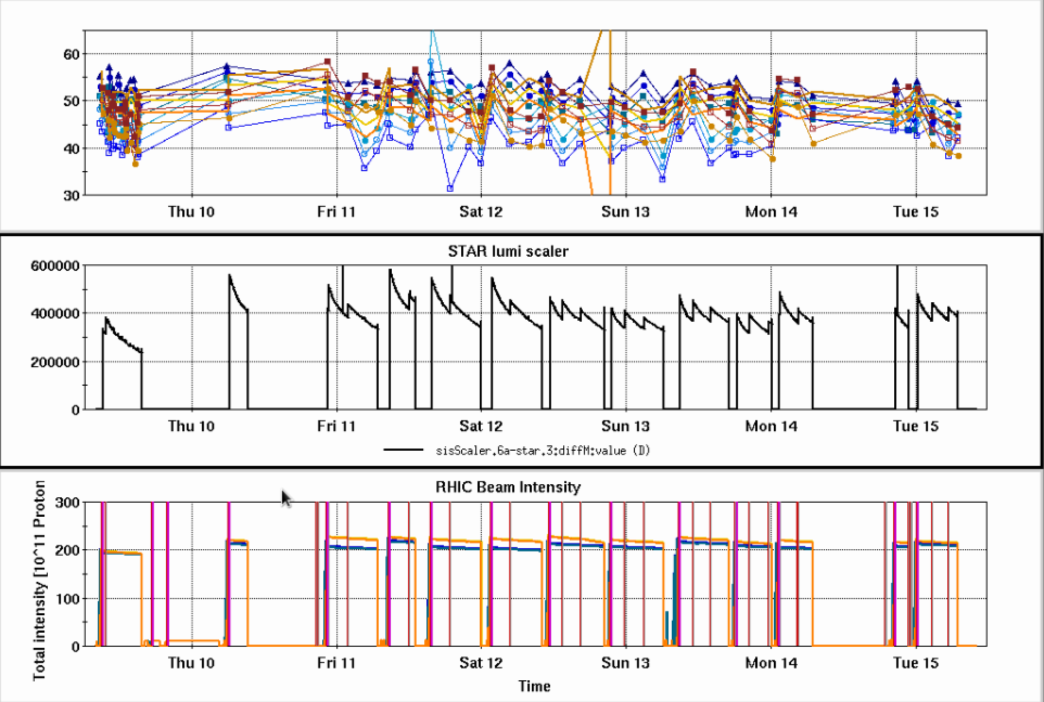
RHIC Run 22 Run Status 2/15/2022, V. Schoefer
Separated squeezes
AGS to RHIC transfer improved
Vertical orbit at extraction was causing coupling in the transfer via sextupole feed-down
Peak lumi improved: high enough to delay first squeeze for leveling
Polarization affected by stability of the Westinghouse
Current function during AGS acceleration changes, shifts resonance timing away from the tune jumps
RHIC pC [%]
STAR ZDC [Hz]
STAR cal
APEX
Maintenance
Maintenance
RHIC Intensity [1e11]

Slide 2
AGS Extraction Vertical sin9: 7 mm
AGS Extraction Vertical sin9: 0 mm
Nominal optics
Ver. Defocused
Nominal optics
Ver. Defocused

Slide 3
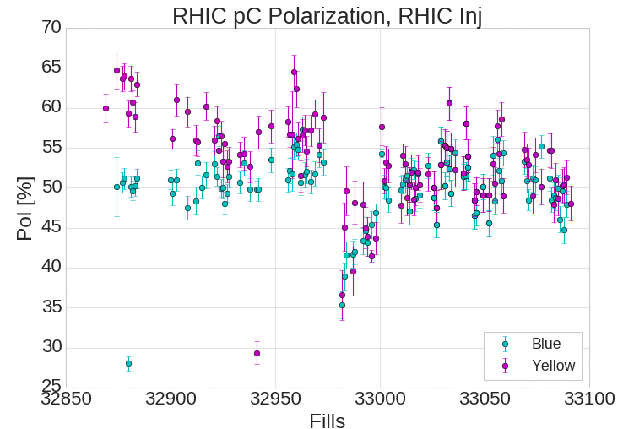
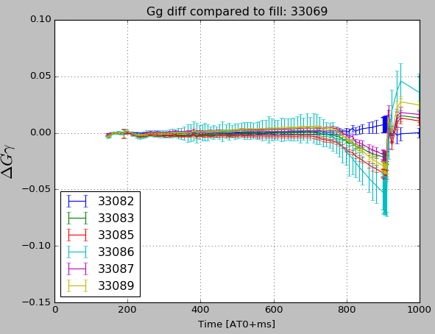
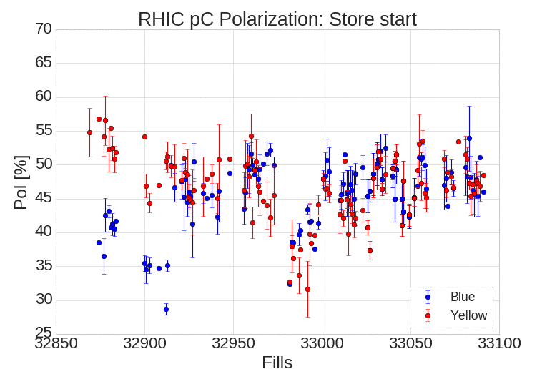
Westinghouse energy drift
Corresponds to dips in polarization
Main component of long term drift seems to come from the liquid rheostat (particular to Westinghouse)
Voltage loops adjusted this afternoon

Slide 4
Plans
Meeting tomorrow to discuss spin direction correction effort, parameter for scan planned for Thursday
AGS to RHIC transfer line measurements to address residual optical errors
Pending more diagnostics and decision about Siemens: proceed to split/merge setup with the Westinghouse

