Slide 1
RHIC Status
Haixin Huang
Feb. 22, 2022 Time Meeting

Slide 2
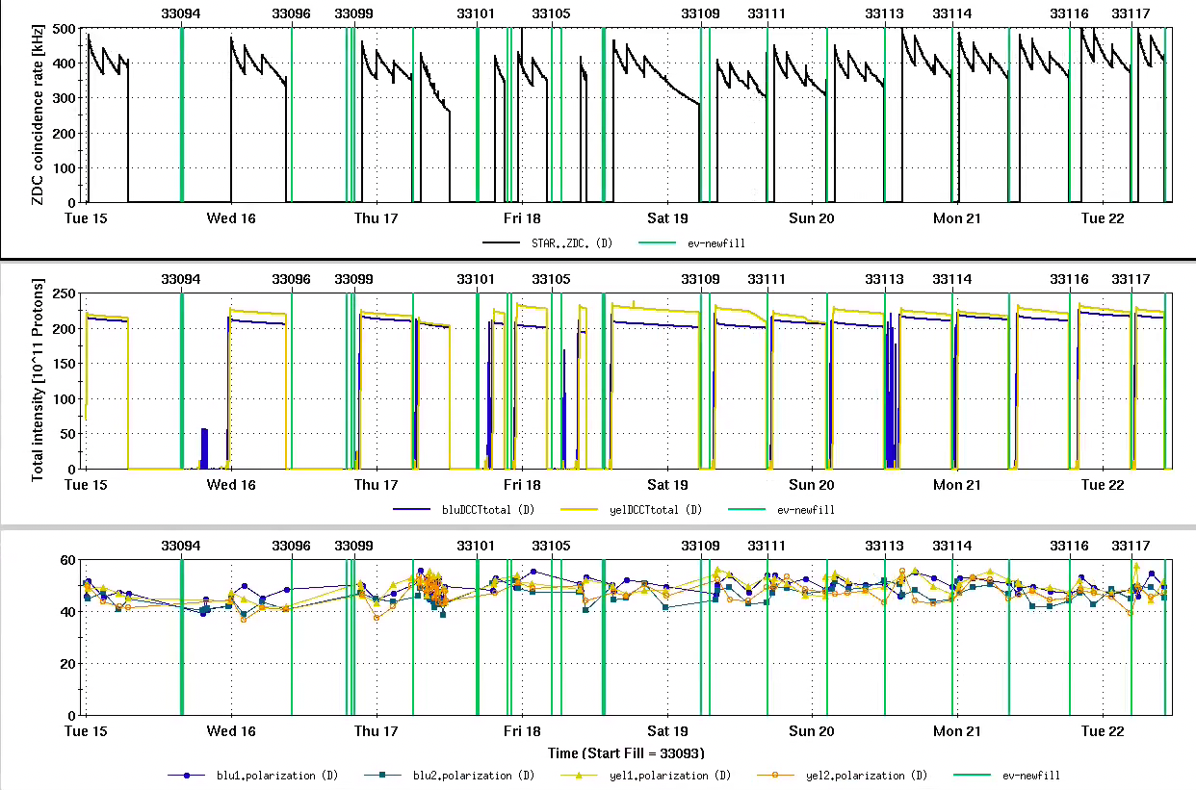

Slide 3
Status of RHIC Operation
In general, good lumi last week. Good polarization since Thursday after AGS Westinghouse work and new JQ timing.
Extended a store Friday night due to linac beam inhibit system problem.
Beam losses at blue snake is near the threshold. Permit was pulled several times during filling. Snake bump was decreased. The loss is still high in the last fill. Experts are working on to change the optics around the blue snake so that the orbit excursion will be reduced by ~1cm.
Snake current scan shows that the yellow needs some current adjustment at store. The plan is to implement that and check the outcome in a few stores. Only storage ramp and squeeze ramp need to be modified.
Some possible beam development work this week: bxb transverse damper work; spin tilt angle measurement at pC with large orbit angle. First to test the aperture. This can be end of store activity.

