Slide 1
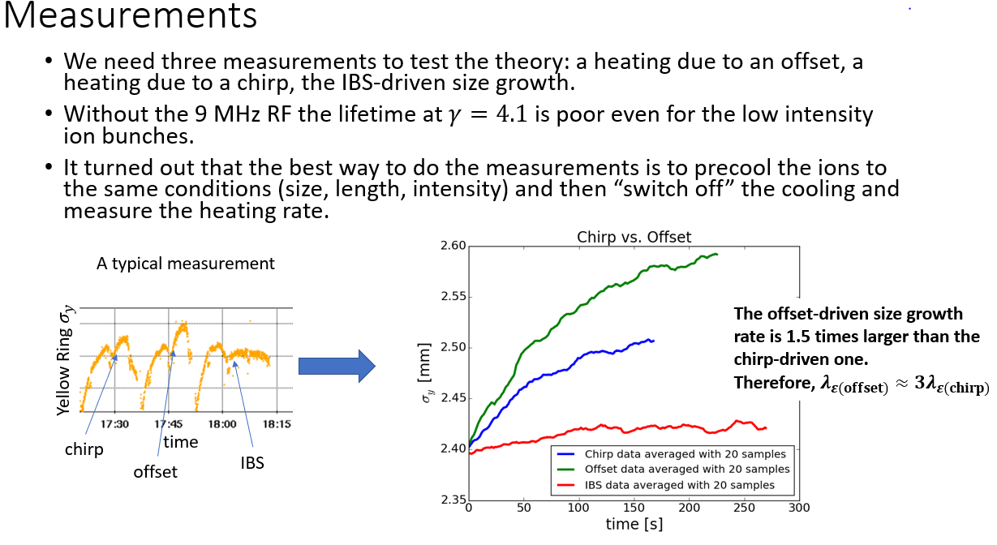
Results from electron-ion heating experiment: Sergei
Feb. 16 APEX Session

Slide 2
APEX Plan for March 2 & 4 , 2022
March 2, Wednesday : Session I
1) Impedance measurement
12-16pm, 4 hours, injection, both rings
Mike Blaskiewicz, Inst. experts, MCR
2) Injection damper test
16-17pm, 1 hour, injection, both rings
Zeyi (Tommy) Tang, Rob, Michiko, MCR
March 4: Friday: Session II
Spin transparency mode test
8am-14pm, 6 hours, injection, yellow ring
Haixin, Vasiliy, spin experts, MCR

