Slide 1
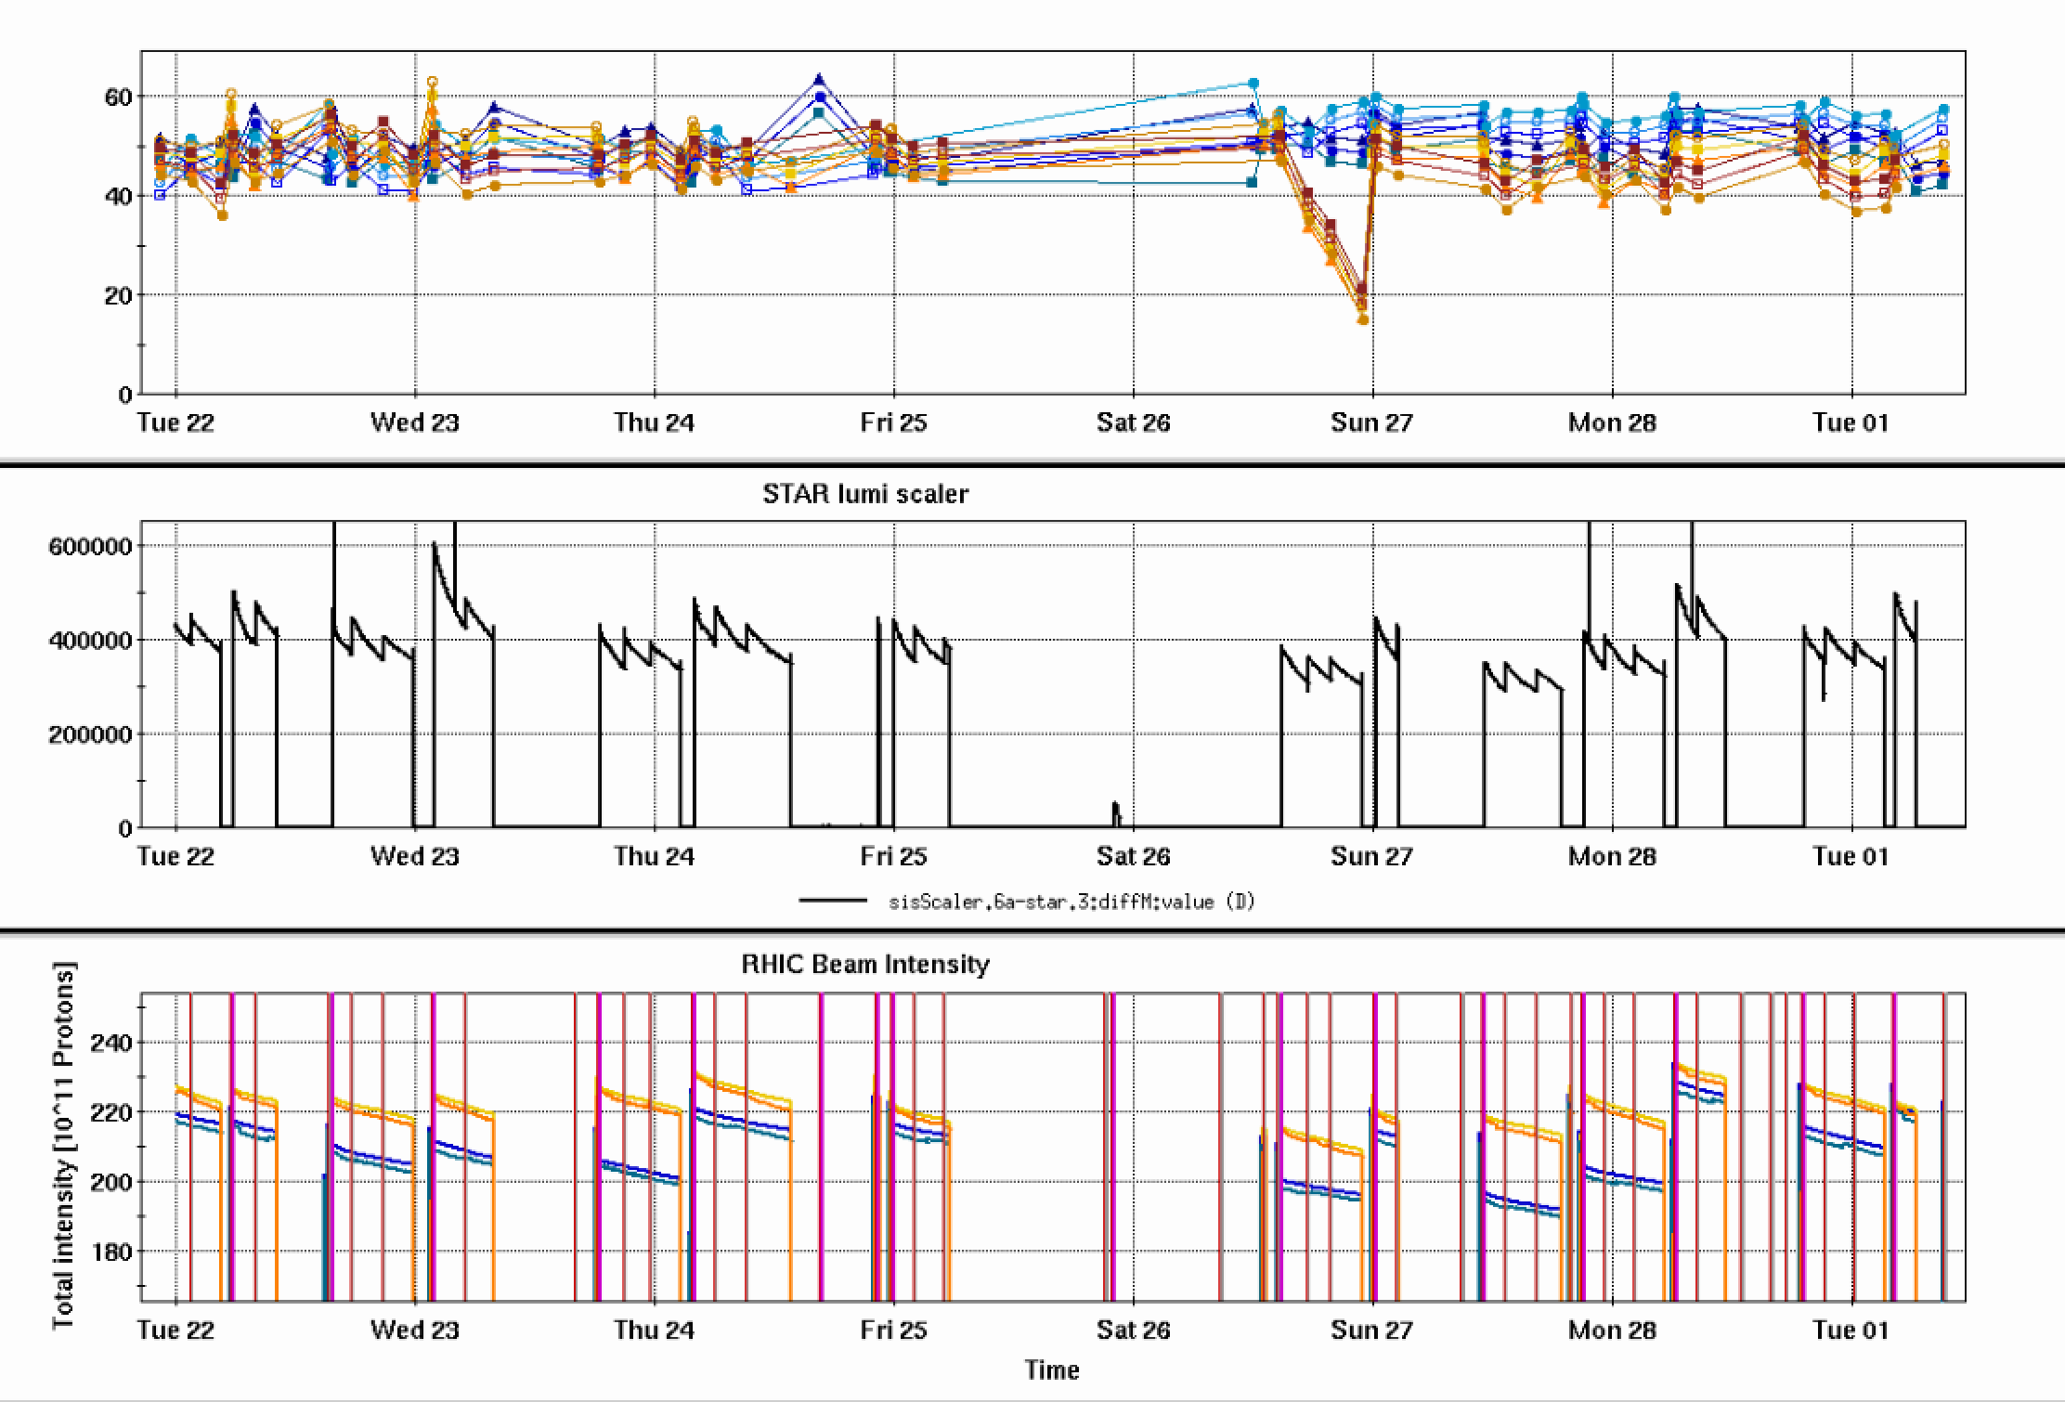
RHIC Run 22 Run Status 3/01/2022, V. Schoefer
RHIC pC [%]
Modifed Y9 snake cur
Limited uptime over the last week
Power dip 2/25: significant He purge from AGS cold snake, long cooldown
>24 hours without polarized beam
Multiple (possibly unrelated) abort kicker issues, mistimed pulses (thyratron replaced), several trips
AGS RF power amplifier fan failure 2/28:
Serious limitation to operations
< 1hr with AGS beam from completely cool to over temp limit
Spin direction
Fill 33130: altered Y9 snake current (based on earlier snake scan).
Bad pol lifetime, need to control spin tune better
STAR ZDC [Hz]
Y abort thyratron
CeC access/low lumi store
Maintenance
PASS failure/RHIC ps/AGS RFPA cooling
Power dip/
AGS CSNK
RHI tq failure
RHIC Intensity [1e11]

Slide 2
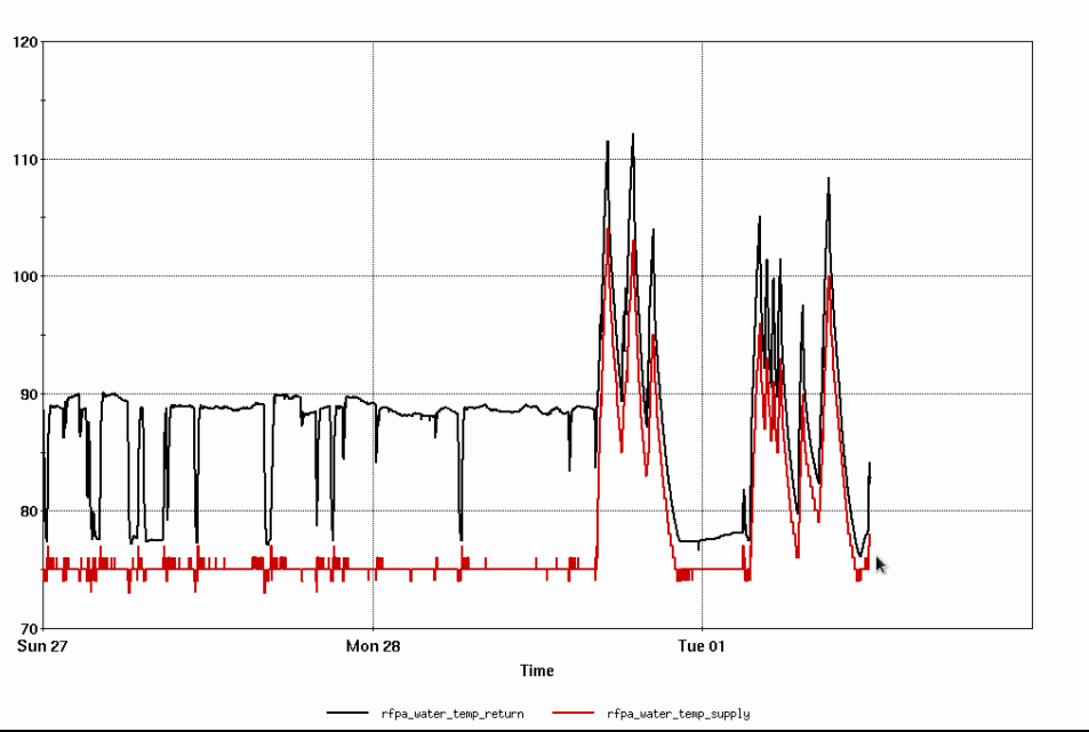
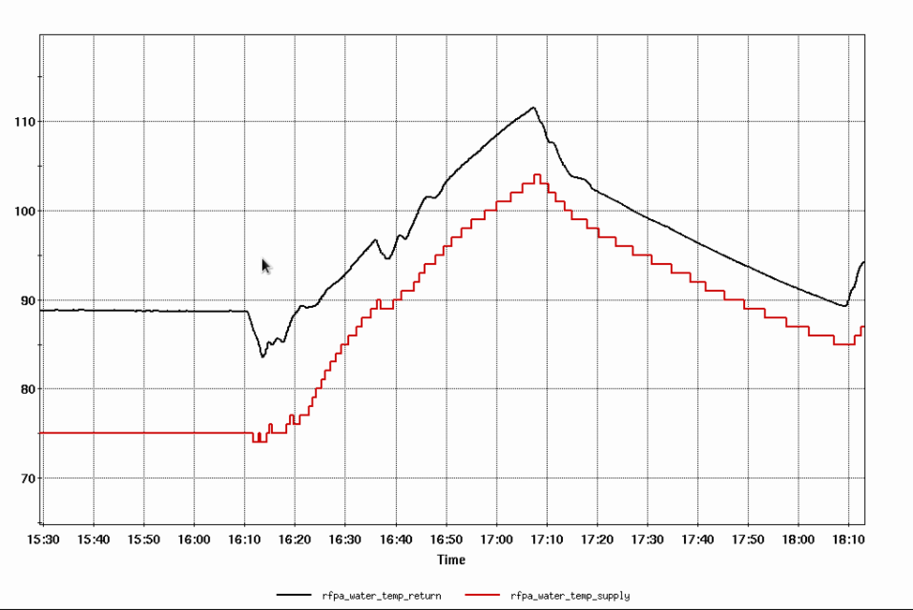
AGS RF PA cooling water temp
Alarm level
“Cold”
1 hour
Just filling takes ½ hour
Significantly slows AGS studies and prevents some altogether

Slide 3
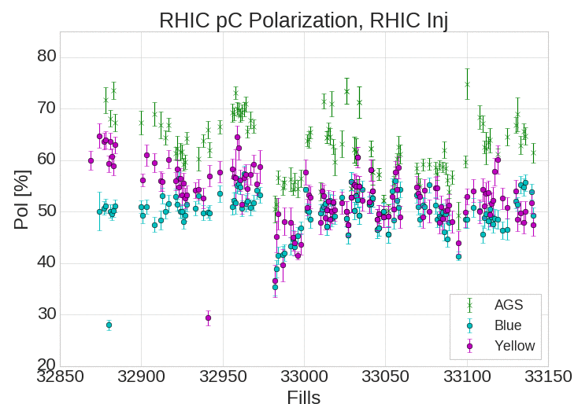
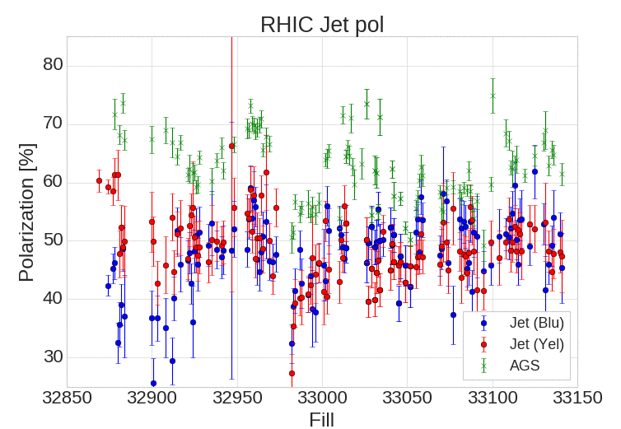
RHIC Polarization
Recent Jet polarization just under 50%
Reduced a few percent since the 2/25 power dip
Recent uptick in AGS polarization not reflected in RHIC (neither at injection nor store)
Probably reflective of target and analysis changes rather than change in polarization
Siemens <-
-> Westinghouse

Slide 4
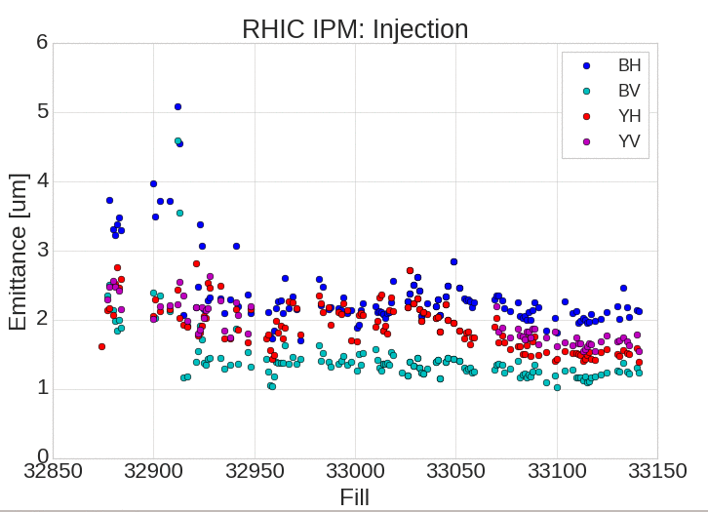
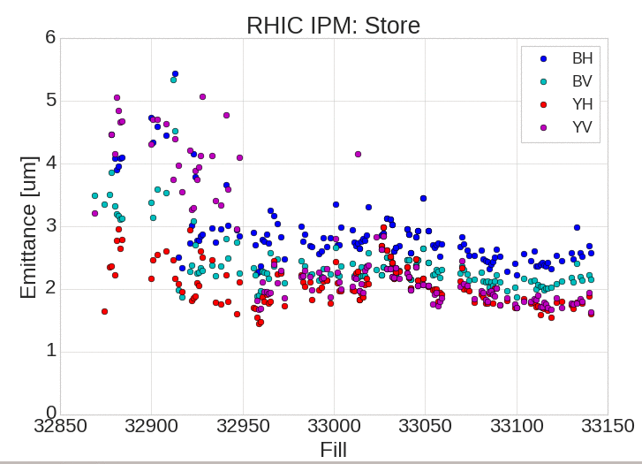
RHIC Emittance
Had been decreasing steadily
Trend has reversed, especially in blue over the last ~10 stores

