Slide 1
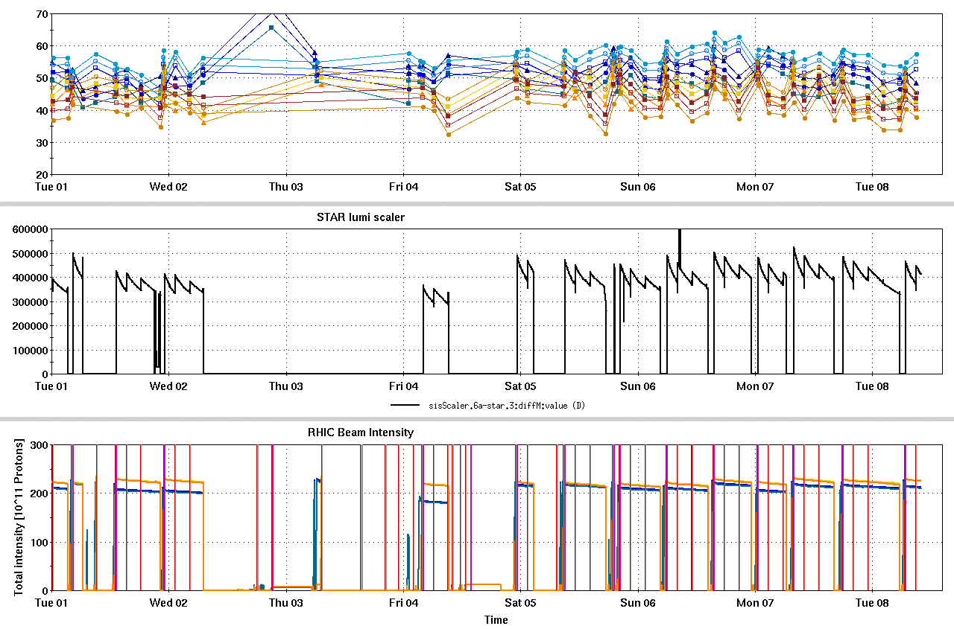
RHIC Run 22 Run Status 3/08/2022, V. Schoefer
RHIC pC [%]
Wed-Fri:low uptime
AGS RF amplifier cooling failure and repair
Repaired over two days 2/3 - 2/4
Injection main dipole adjustment 2/3
Injection conditions esp. blue have been very stable since then (fixed a large source of variation in store quality)
Peak lumi
Blue yellow polarization gap persists
STAR ZDC [Hz]
Low luminosity calibration
APEX
AGS RFPA cooling repair
Low luminosity calibration
RHIC Intensity [1e11]

Slide 2
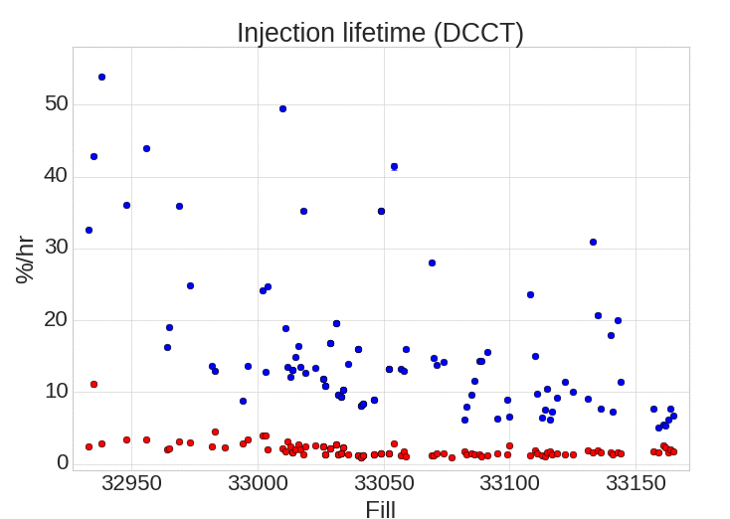
Injection lifetime
Improvement since dipole adjustment
Lifetime both better on average and far more stable fill to fill
Contributes to more consistent target average luminosity
Blue
Yellow
Dipole adjusted

Slide 3
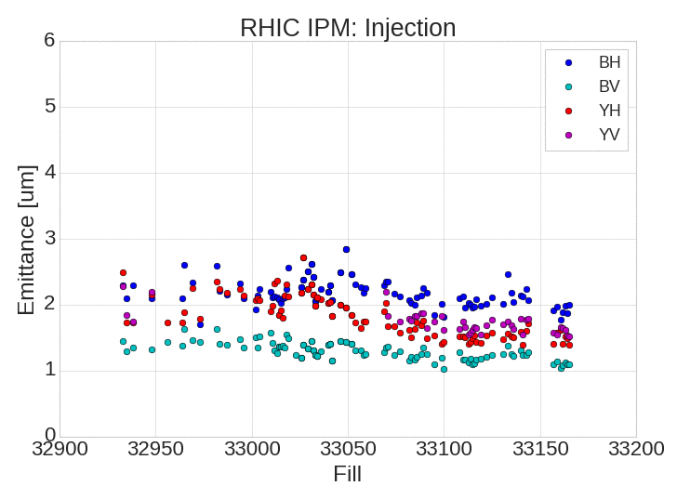
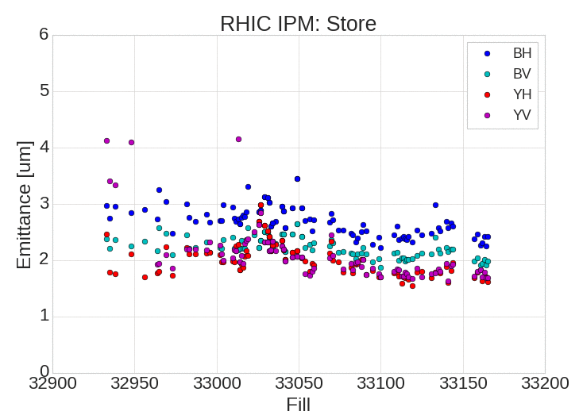
RHIC Emittance
Transverse emittances improved ~10% all planes for recent fills
Coincident with injection radius change (and the attention to injection that went with it).

Slide 4
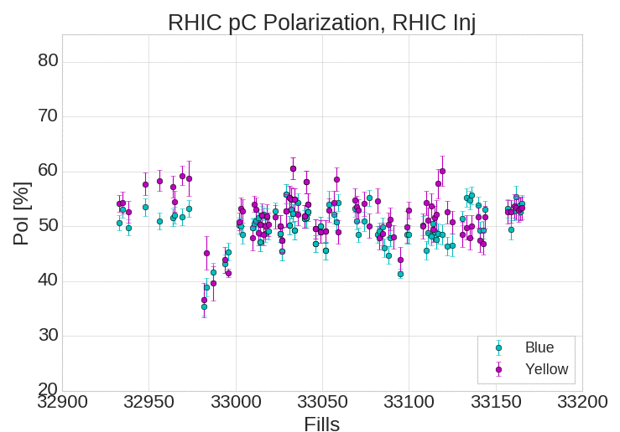
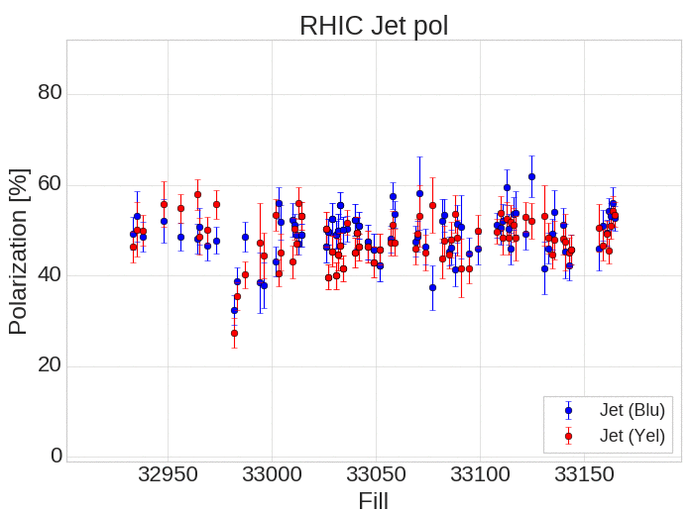
RHIC Polarization
Polarization for last few fills more consistent at injection, slightly higher average
Store jet polarization also higher on average
Jet hold field coil off, possibility of increased systematic error in recent measurements.

Slide 5
End of run priorities
Optimization of standard AGS setup for emittance and polarization (using Siemens)
Still taking 20% more intensity for RHIC fills relative to Run 17
Characterization of spin direction at pC/Jet
Necessary for assessment of overall run performance
Resolution of luminosity cross section
Blue,yellow polarization: including B-Y gap (if it persists on Siemens)
Chopping block (personal assessment, absolutely up for discussion)
Correction of STAR spin direction:
marginal benefit at this point?
Worth: limited focused attempts based on in-hand data (e.g. another attempt at a yellow snake fix)
Not worth: more shift+ measurements (except to verify vital data) or attempts at new techniques.
STAR can set priority.
Split/merge injector setup:
the cost to establishing and maintain top level basic setup performance?
What has the benefit been?
We have not been at Run 17 performance consistently on the basic setup.
Imperfection correction: small effect, possible to revisit as APEX during p-Au

