Slide 1
APEX Report
RHIC Time Meeting, March 16, 2022

Slide 2
RHIC Impedance Measurement, Mike Blaskiewicz

Slide 3
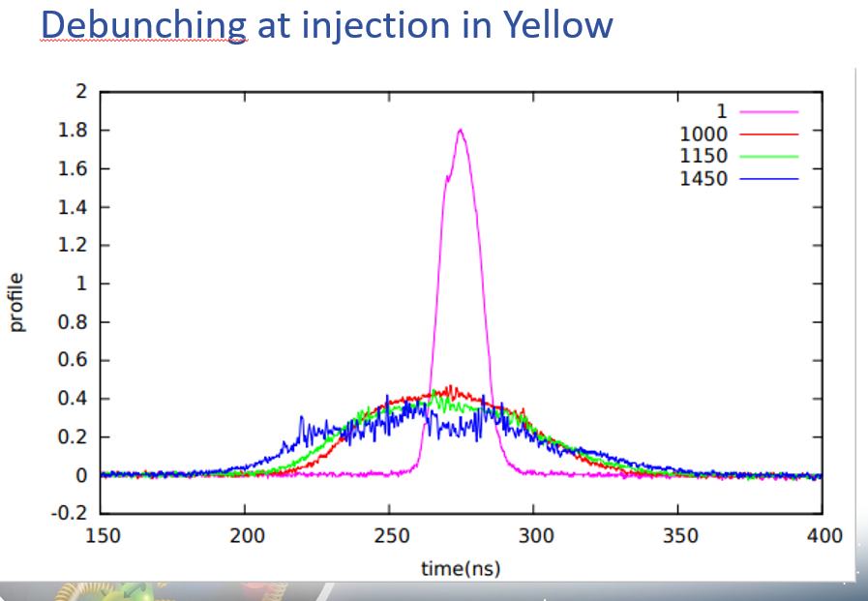
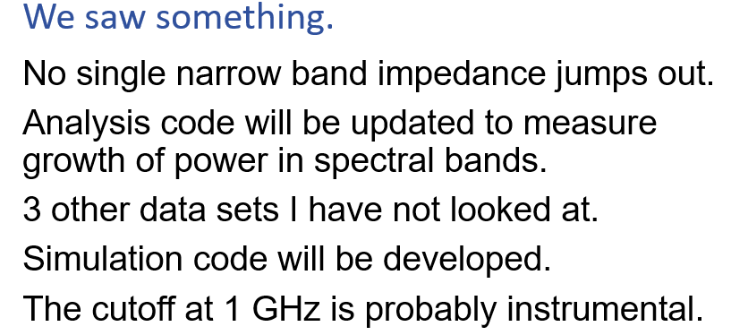
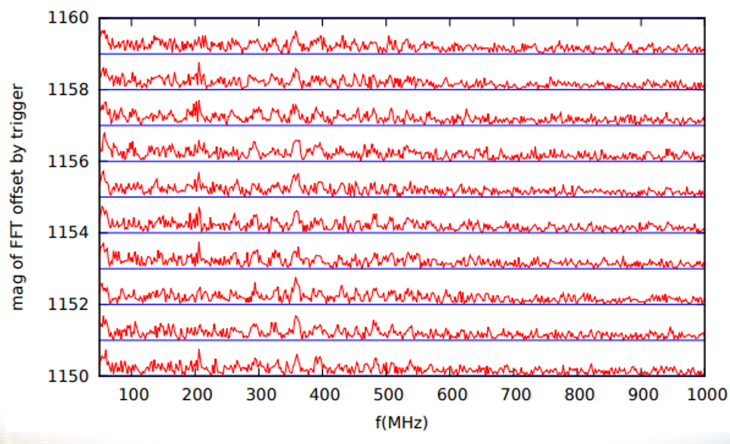

Slide 4
AEPX Schedule for March 16
March 16, 8am-16pm:
Spin transparency mode test
at injection, yellow ring, 110 bunches
Haixin, Vasiliy, Francois, Vincent,
other spin experts, MCR
Plan ( Haixin ):
We plan to use yellow ring at injection only. We will use 110 bunches of nominal intensity for polarization measurement with various snake settings.
The two yellow snakes will be ramped to current different from nominal values first (165A, 180A for snake 1, 184A, 200A for snake2).
The snake orbit bump will be modified to accommodate the orbit change.
After confirmed the orbit is OK, inject 110 bunches.
At the new snake current setting, we will ramp snake current “locally”, about +-20-30A. It will take ten steps.
In between steps, the orbit will corrected and polarization will be taken. At each step, six polarization measurements will be taken. Only yellow1 polarimeter will be used, as beam size is too large for horizontal target at injection.
If we have done all above, we will try spin flip by ramping the two snake current slowly. Polarization will be measured before and after.
Need from MCR: fill beam into yellow ring. Measure polarization between snake current changes. Only yellow1 polarimeter will be used.

