Slide 1
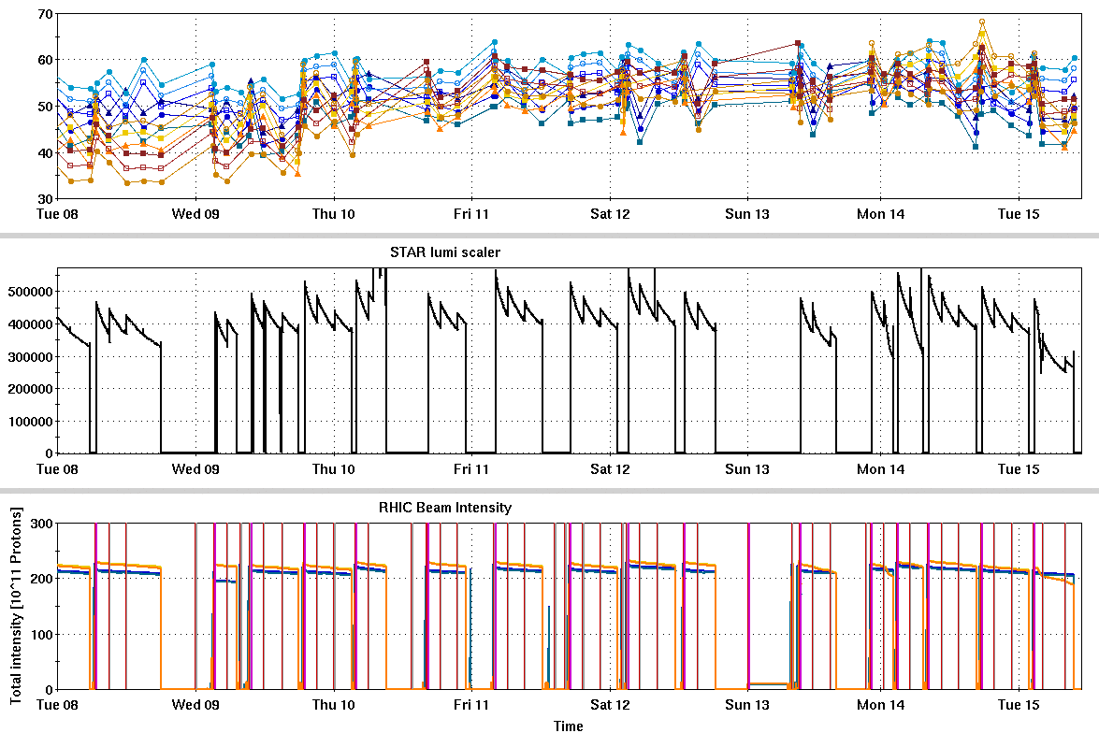
RHIC Run 22 Run Status 3/15/2022, V. Schoefer
Jump quads on w/ Siemens
Switch to Siemens, from Westinghouse was extremely smooth: no RHIC downtime
Polarization immediately after switch comparable to WH
With jump quads:
Polarization in both rings ~55% at store
Recent yellow sextupole trips (y09-sxd2)affecting both luminosity and polarization (via beam loss and emittance growth)
STAR magnet trips due to power distribution problem: multi-hour downtime
Plan to address behind APEX tomorrow
RHIC pC [%]
Y. Sext trips
STAR ZDC [Hz]
y. Dump kciker
STAR magnet/weather
STAR magnet
Q. Det/Y. Sext
RHIC Intensity [1e11]
Siemens->

Slide 2
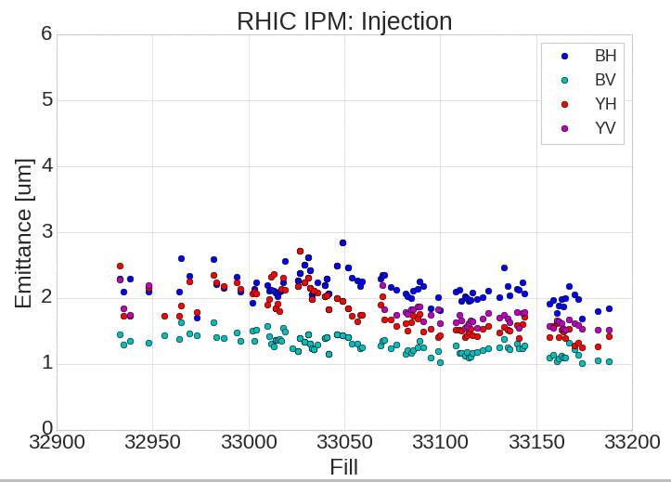
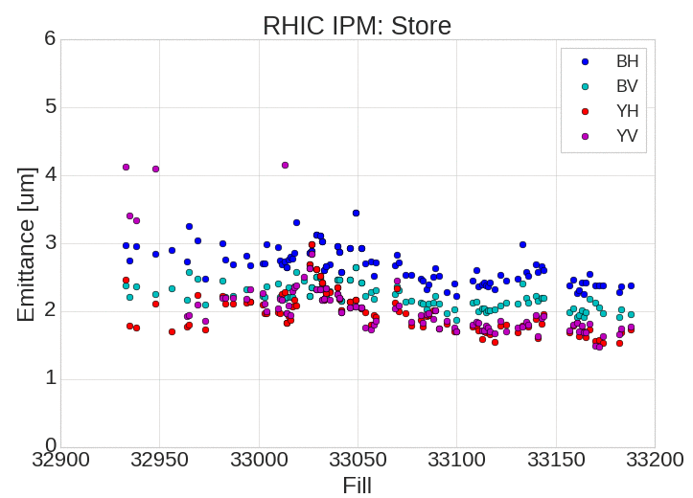
RHIC Emittance
RHIC emittance consistently low for fills in Siemens
More apparent at injection than store

Slide 3
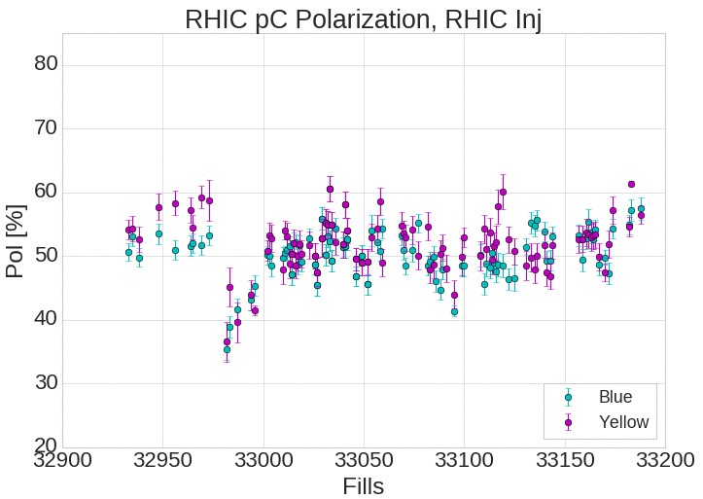
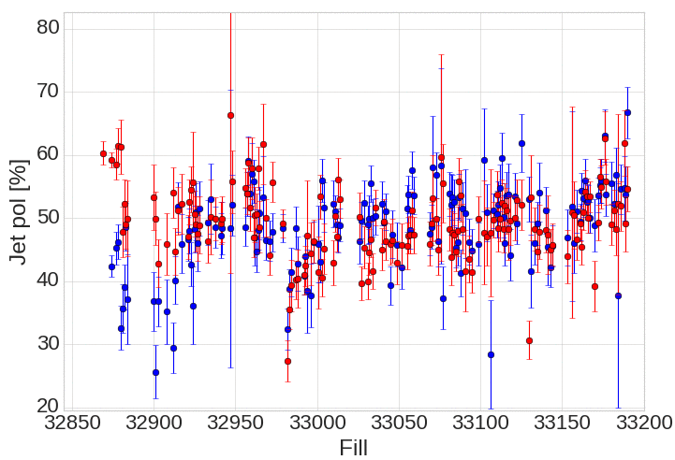
RHIC Polarization
Benefit of the Siemens from both higher average and more consistent polarization
Jet avgs since Siemens switch: (B,Y) = 55,54%
Jet avgs on Westinghouse: (B.Y) = 49,48%
Jet pol

Slide 4
Run extension
New run end data Apr 18th (instead of Apr 4th)
Previous schedule: Apr 4th end, 4 days of CeC →16 remaining days for physics
Extension schedule: Apr 18th end, 12 days of CeC → 22 remaining days for physics
Two week extension is a 6 day extension for the RHIC colliding beam physics program – Not enough to substantially alter plans for the remainder of the run.

Slide 5
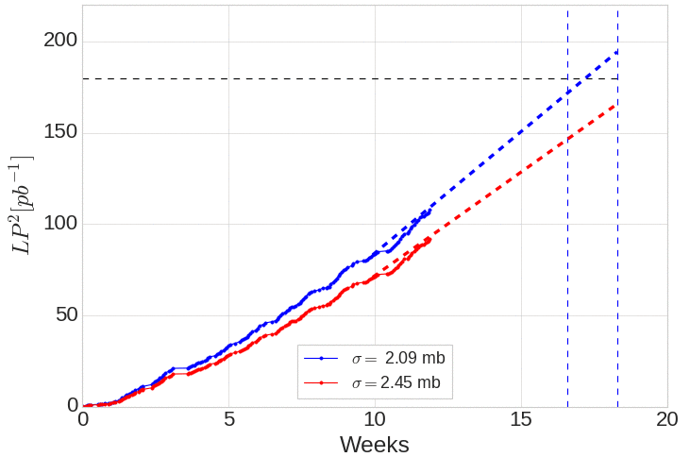
Projections for delivered Figure of Merit
Delivered target based on 120 pb-1 sampled target and factor of 0.7 between delivered and sampled (as defined by CAD and STAR respectively)
Fit projection based on last 2 weeks which includes: one week on Westinghouse with 2 full days of failure and last week on Siemens with no interruptions for APEX/Maintenance/Development
(Difficult to project when there are no normal weeks!)
April 18th is nominal end, April 6th is nominal end minus 12 days
Goal is barely achievable in the remaining time
Two week projection is extremely imprecise
Become likelier if the cross section is < 2.09 mb
Delivered FOM target = 180 pb⁻¹
April 6th
April 18

Slide 6
Plans for the week
Characterize stable spin direction at the pC polarimeter
Create largest allowable orbital angle at local of pC target (limited by aperture)
Scan angle and measure spin direction
Infer longitudinal component from projections with additional precession

