Slide 1
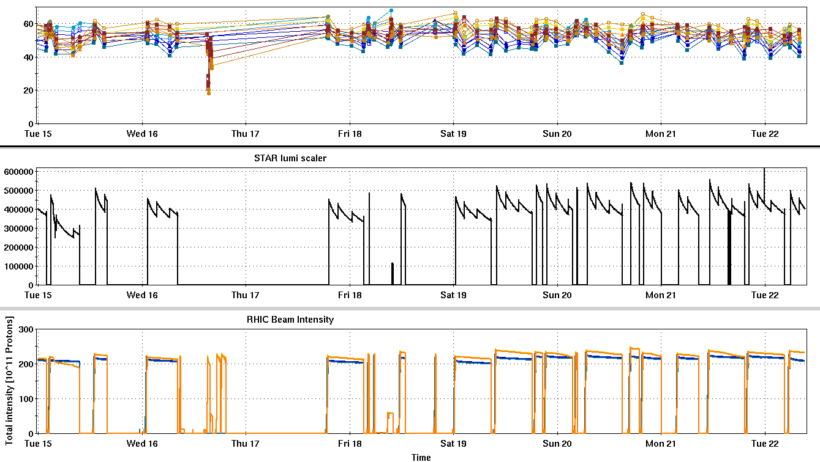
RHIC Run 22 Run Status 3/22/2022, V. Schoefer
Store quality very consistent since switch to Siemens
Polarization ~55% in both rings
Average luminosity on target
Contiguous 1.5 days away from physics for APEX and CeC
Downtime from multiple sources:
Power dip (again)
E10 house AC unit (E20 warm snake trips)
Many shortened stores
Chronic yellow abort kicker trips
Dx heater failure
Plan Friday to re-try measurement of stable spin difrection at pC polarimeters
Redesign orbit bumps to avoid corrector limitations
RHIC pC [%]
Short stores:
B. Dump kicker relay
Y. Dump kicker trips
DX heater failure
MD
STAR ZDC [Hz]
Lead flow + Warm snake AC
Power dip
APEX + CeC
Y. Q89 trip
RHIC Intensity [1e11]

Slide 2
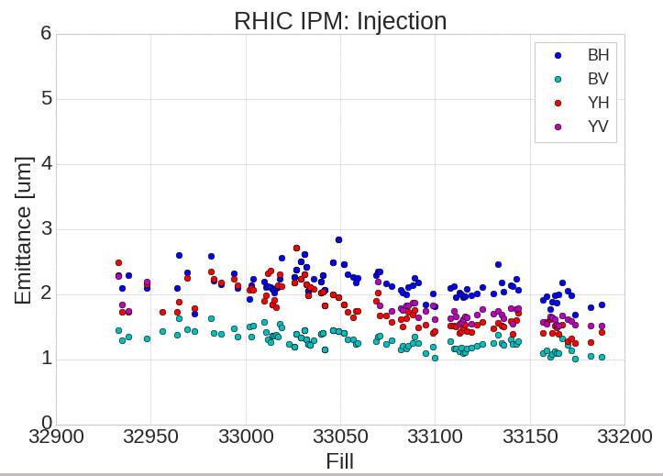
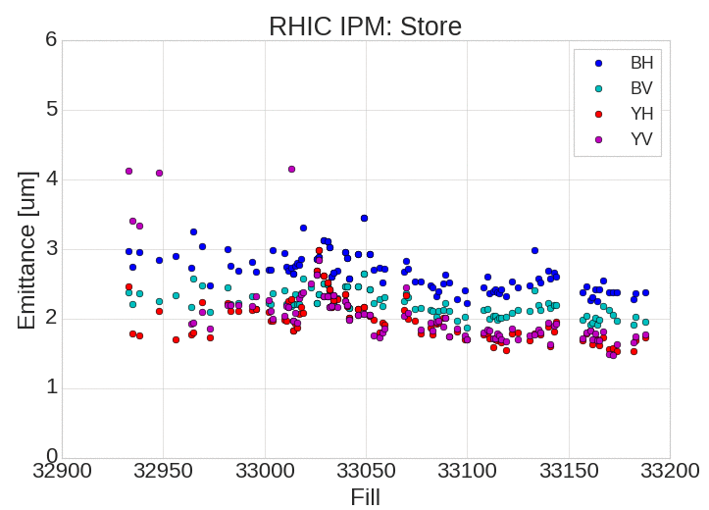
RHIC Emittance
RHIC emittance consistently low for fills in Siemens
More apparent at injection than store

Slide 3
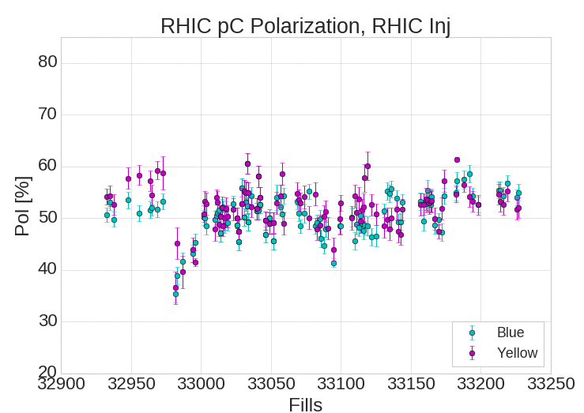
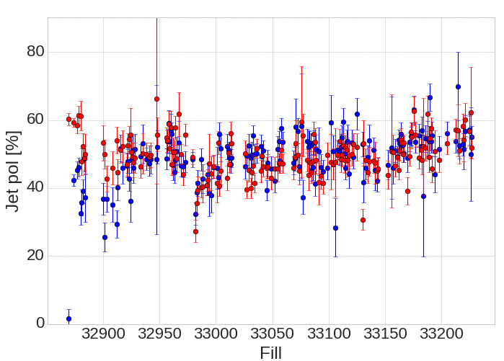
RHIC Polarization
Jet pol

