Slide 1
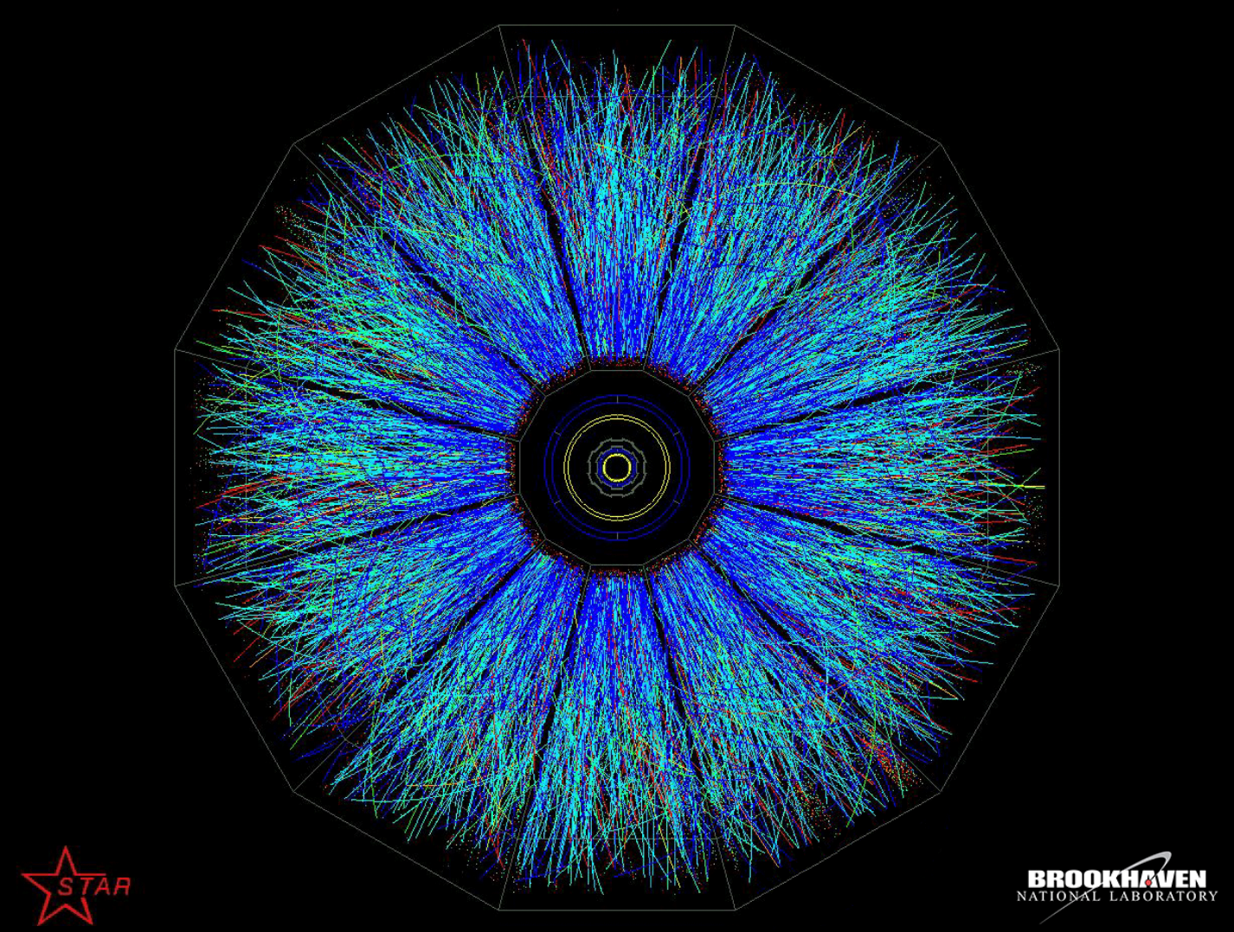
STAR Status Update
Jim Thomas
March 29, 2022

Slide 2
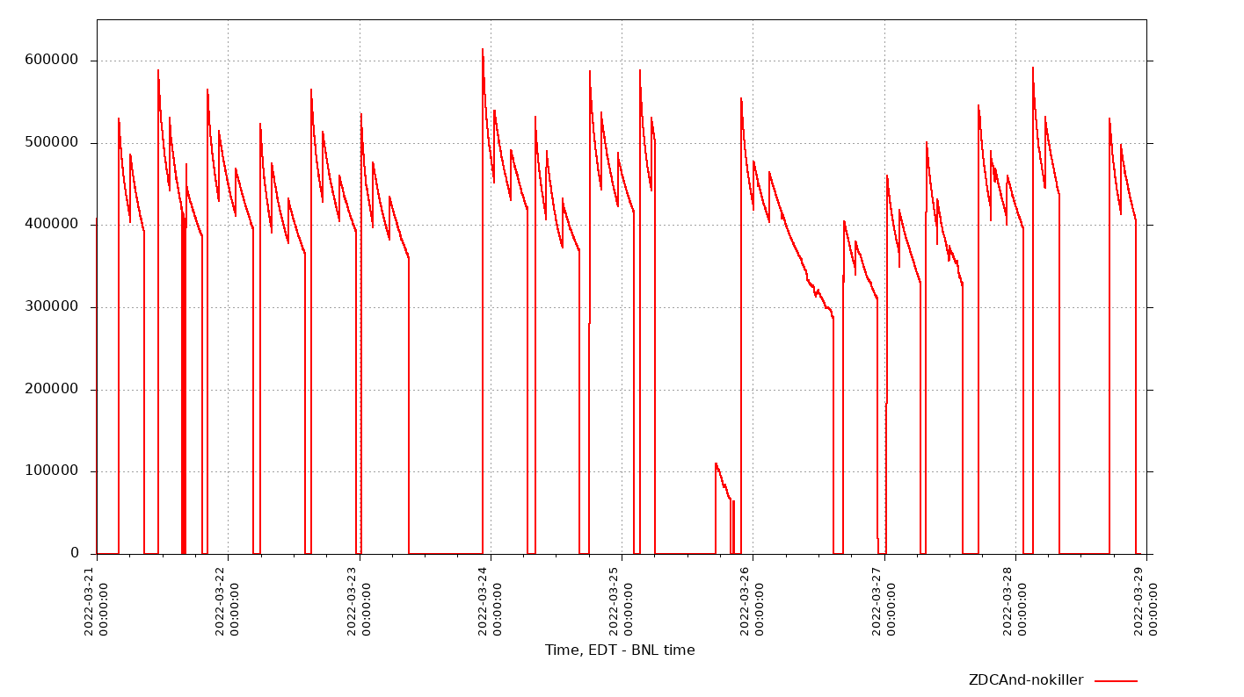
Overview for the week
Vernier scan on Monday 21st, CeC Monday 28th
Polarization slipped a bit in both rings Thursday-Sunday
Dedicated STAR running over the weekend but Booster problems had an impact on performance
Vernier scan
Maintenance
RHIC injector problems IP12 pol angle scan
Booster cavity
Issues; Pol Low
CEC
Tues 00:00 – Mon 23:59
93 hr physics (~1100)
269 runs (~3200)
11 hr cosmics (~575)
Monday
Tuesday
Wednesday
Thursday
Friday
Saturday
Sunday
Monday
Notes:
Plot copied from: STAR ONLINE STATUS viewer => conditions_rich => RICH Scalers_30sec => ZDCandNoKiller
Hours calculated (Tues – Tues) from https://online.star.bnl.gov/RunLog => TRG Setup (your choice) (This is Mon-Mon data so add and subtract Tuesdays)

Slide 3
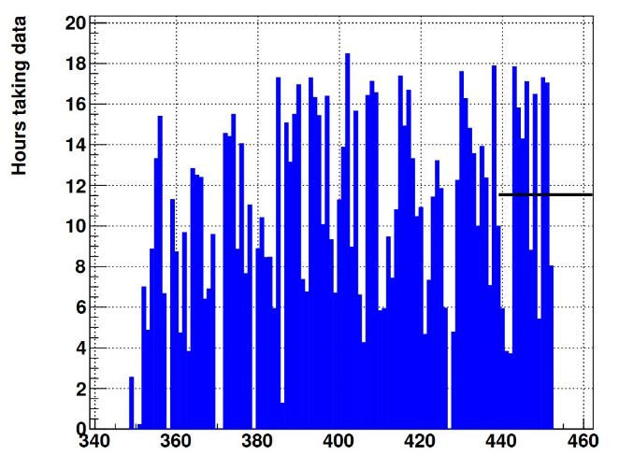
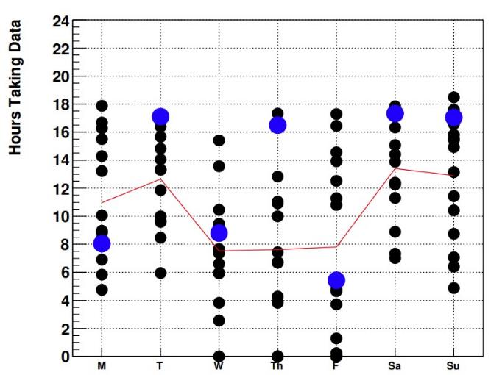
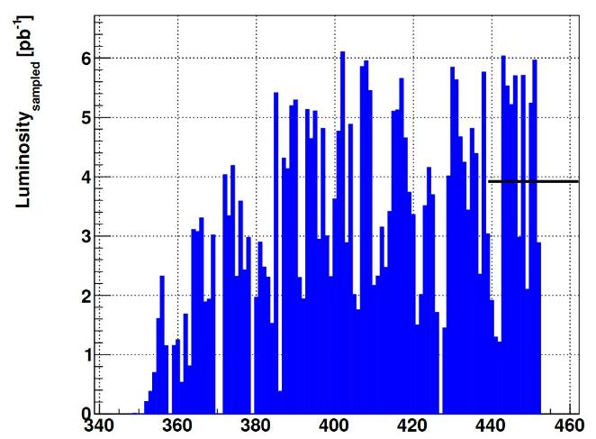
Last Week (Previous Week):
Avg. hrs/day = 11.5 (10.8)
Avg. Samp.Lumi/day = 3.9 pb⁻¹ (3.4 pb⁻¹)
Up from last week but Polarization still low
STAR DAQ hours per day
Hours per day distribution
Blue dots: Last week,
Black dots: Previous weeks Red line: Average
Sampled
Luminosity per day
Notes:
Plots taken from: https://www.star.bnl.gov/cadaccess/common/common2022/trigger2022/runningStatepp500GeV/plots.html

Slide 4
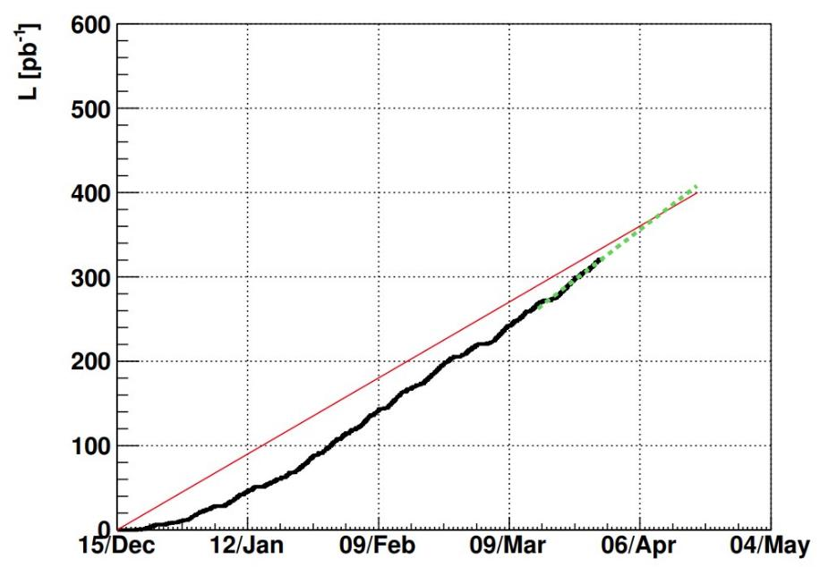
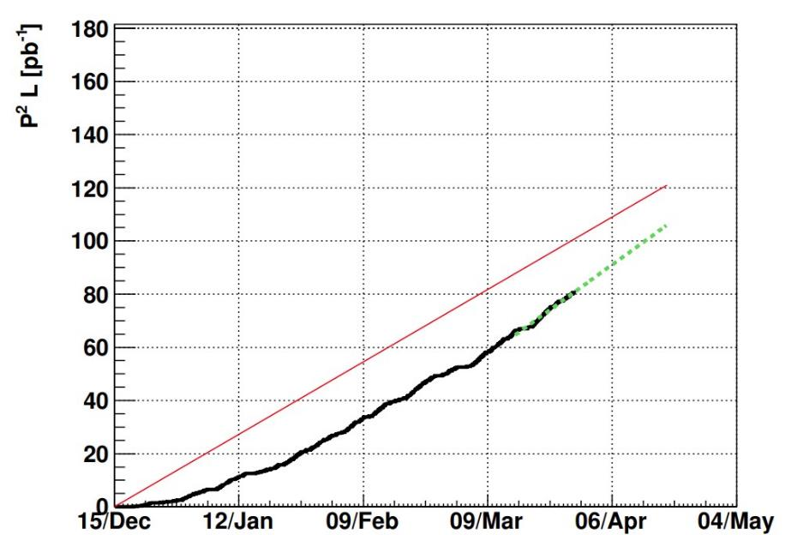
Last Tuesday
Last Tuesday
BUR Request
Linear Projection last 2 week’s rate
BUR request P²L = 120 pb⁻¹ (Statistics, shown below, as of Tuesday 00:00)
Currently at P²L = 80 pb⁻¹, 66% of BUR goal. 7 pb⁻¹ since last week in P²L.
Projection to reach P²L = 105 pb⁻¹ by end of run
Notes:
Plots taken from: https://www.star.bnl.gov/cadaccess/common/common2022/trigger2022/lumipp500GeV/tracker.html

